Slide 1
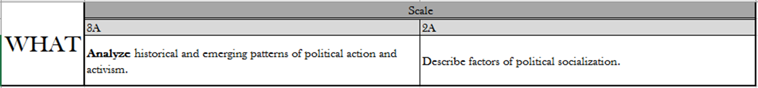
naturalization | undocumented immigrant | citizenship | resident aliens | lawful permanent resident

Slide 6

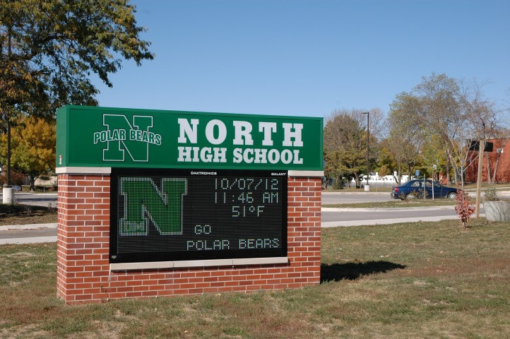

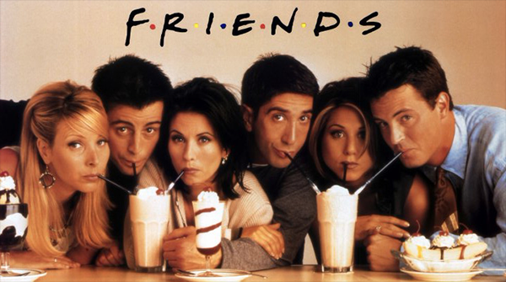



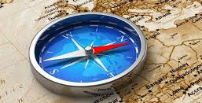
Political Socialization
Directions: Research the agents of political socialization, label and describe its influence on a person’s political ideology.

Slide 7
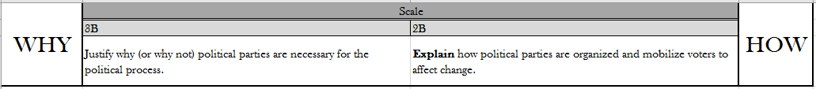
political party | linkage institution | liberalism | conservatism | two-party system

Slide 8
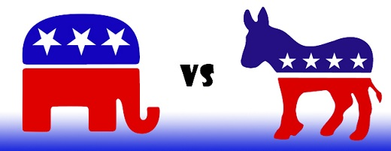
Political Party
Directions: Follow the link to take the survey below to determine which political party matches your political ideology. http://www.people-press.org/quiz/political-party-quiz/
Republicans are described as conservatives and Democrats are described as Liberals. Research their viewpoints on the issues below, then write whether each viewpoint is conservative or liberal.
Republican
Democrat
1 - Government should play a large role in solving society’s problems | 2 - Same-Sex Marriage - Marriage is between a man and a woman. | 3 - Abortion - Women should have the right to choose whether or not to have an abortion | 4 - Welfare - the government should provide food stamps/EBT cards for those who can’t afford food
5 - Energy - Oil is a depleting resource. Other sources of energy must be explored. | 6 - Welfare - the individual citizen and local organizations like churches should provide food to those who can’t afford it. | 7 - Marijuana legalization - People are going to smoke marijuana whether it is legal or not. We should legalize it and tax it, instead of making criminals out of those who use marijuana. | 8 - Energy - Oil, gas and coal are all good sources of energy and are abundant in the U.S. Oil drilling should be increased both on land and at sea.
9 - Birth Control - the cost of birth control should be paid for by the individual | 10 - Abortion - Considered murder, and should be against the law | 11 - Government should play a small role in solving society’s problems | 12 - Immigration - Undocumented immigrants should not receive welfare benefits like food stamps, medicaid, and financial aid
13 - Marijuana legalization - The US has enough problems with drugs and alcohol, we should not legalize another drug. | 14 - Immigration - Undocumented immigrants should receive welfare benefits such as food stamps, medicaid, and financial aid | 15 - Birth Control - the cost of birth control should be covered by insurance | 16 - Same-Sex Marriage - Marriage is between two people who love each other, regardless of sex.

Slide 9
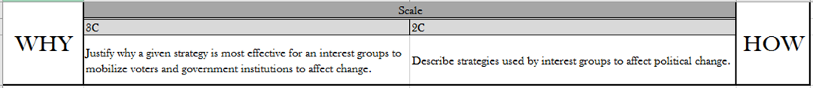
suffrage | interest group | electoral college | platform | lobbying | PAC

Slide 10
Interest Groups
Directions: Place the characteristics of Political Parties and Interest groups in the correct location on the Venn Diagram.
POLITICAL PARTIES
BOTH
INTEREST GROUPS
Members give their support, and pledge their vote to one political party.
Members support any political party that supports their issues.
Narrow down and select candidates to run for office.
Promotes change of a single issue or topic.
Influence public policy (lawmaking).
Raise money to support candidates for office.
Compete for control of Congress.
Promotes beliefs on a wide range of issues.

Slide 11
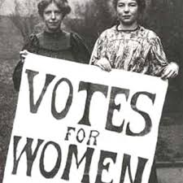
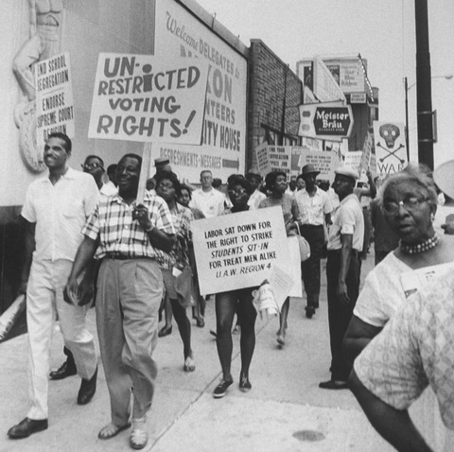
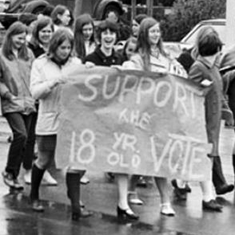
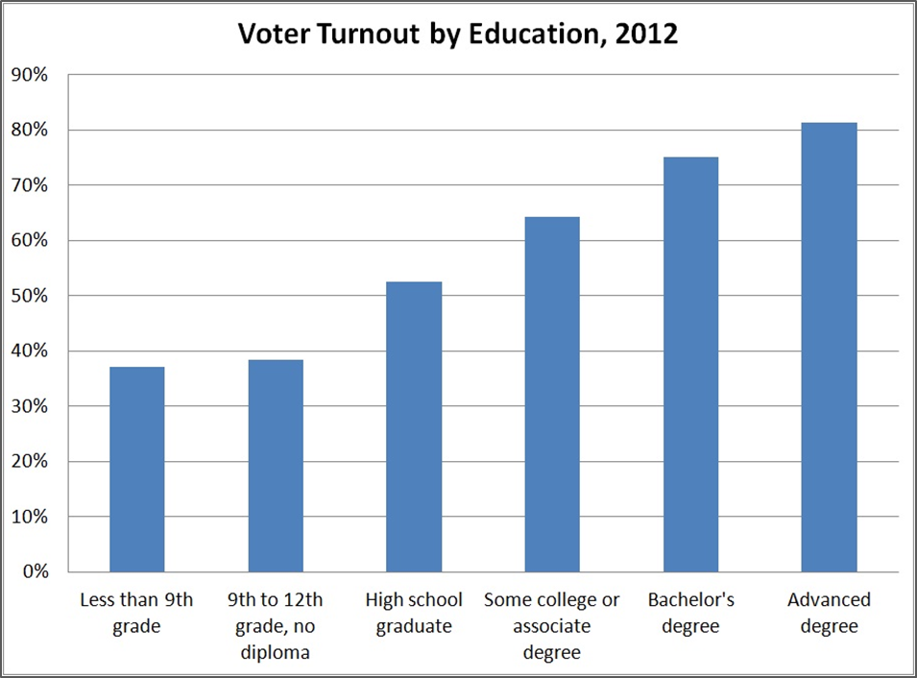
Suffrage
Directions: Various groups of Americans have been fighting for suffrage ever since the US Constitution was created. Follow the link https://tinyurl.com/y8b4crot and describe some of the struggles and victories of each group.
Directions: Analyze the graph below and answer the questions
1. Based on this graph, what connection can you make between education level and voting?
2. Why do you think there is such a strong connection between voting and education level?
3. Americans have fought and died for the right to vote. Why is voting so important in the US?

Slide 12
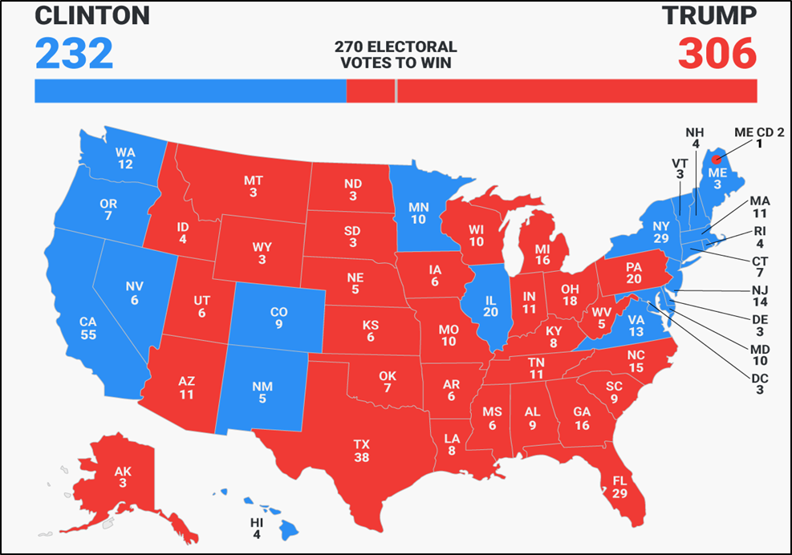
Electoral College
Did you know that the President is actually elected by the Electoral College and not by the popular vote cast by the citizens? The Electoral College process uses an indirect vote where the citizens of each state elect representatives known as electors to choose the President on their behalf. The number of electors granted to each state is determined by the number of Senators from that state (2) and the number of representatives that state has in the House of Representatives (which is determined based on the population of that state.
Directions: Watch the video, and conduct your own research and take notes on how the Electoral College works. Then, analyze the election results from 2016 and answer the question that follows. https://youtu.be/OUS9mM8Xbbw
Candidate | Party | Electoral College Votes | Popular Votes
Donald Trump | Republican | 306 | 62,980,160
Hillary Clinton | Democrat | 232 | 65,845,063
If Hillary Clinton had almost 3 million more votes than Trump, how did Trump win the election?

Slide 13
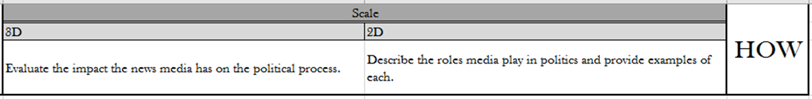
mass media | spin | media bias | negative campaigning

Slide 14
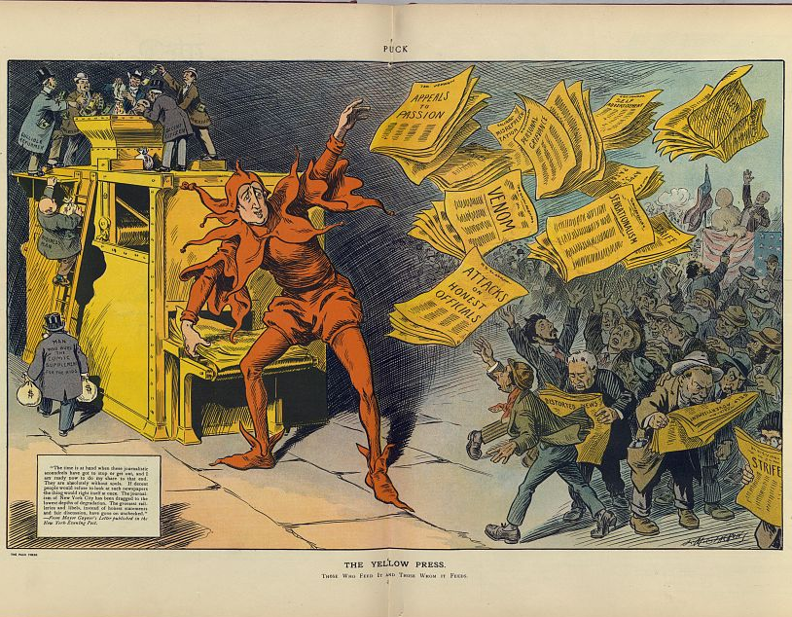
Media
Yellow journalism: a style of newspaper reporting that emphasized sensationalism over facts in order to attract readers and increase circulation. Today it is referred to:
Fake News: false news stories, often of a sensational nature, created to be widely shared online for the purpose of generating ad revenue via web traffic or discrediting a public figure, political movement, company, etc.
Directions: click the links and respond to the prompts given below.
https://tinyurl.com/yay8twof
What issue is being talked about in this article? Do you agree that this is an important issue? Why or Why not?
There are several checklists created to help people decide which news articles are true and which are fake. Use this checklist to help you evaluate the following news stories.
Fake or Real Checklist:
https://tinyurl.com/h8ckwxe
https://tinyurl.com/y7wrjz6a
Should you believe this news story? Why or Why not? Give examples!
https://tinyurl.com/yb94dqny
Should you believe this news story? Why or Why not? Give examples!

