Slide 1
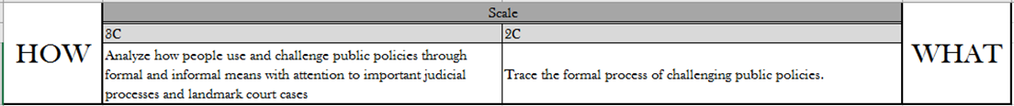
plaintiff | defendant | civil law | criminal law
prosecution | judicial activism | plea bargain | precedent

Slide 2
Civil Law v. Criminal Law
Directions: Explain how civil law is different from criminal law. Provide examples of each type.
Civil Law | Criminal Law
Child Custody
One party suing another party for damages
Assault
An individual being charged with a crime by society
Murder
Divorce
Often represented by a public defender
DUI

Slide 3
Original v. Appellate Jurisdiction
Directions: Describe differences between original and appellate jurisdiction.
Original | Appellate
The authority of the court to hear a case first
The authority to overturn the decision of a lower court
Judge and jury
Panel of judges
Attempts to reach a verdict of guilty or not guilty
Trying to determine if the rights of the individual were violated

Slide 4
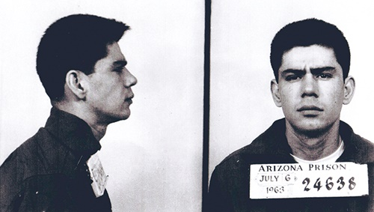
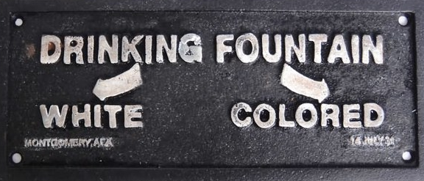
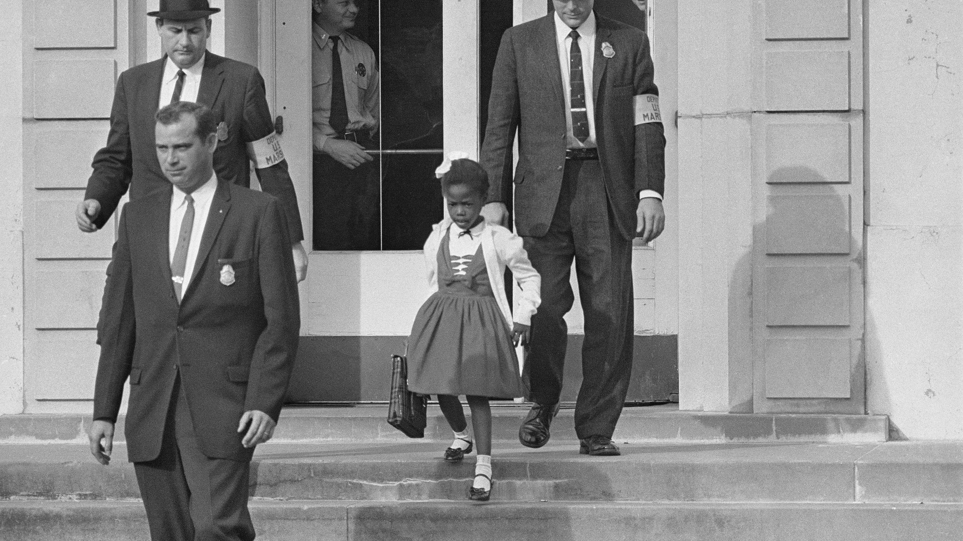
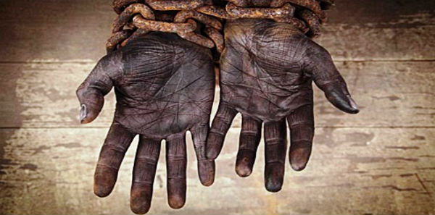
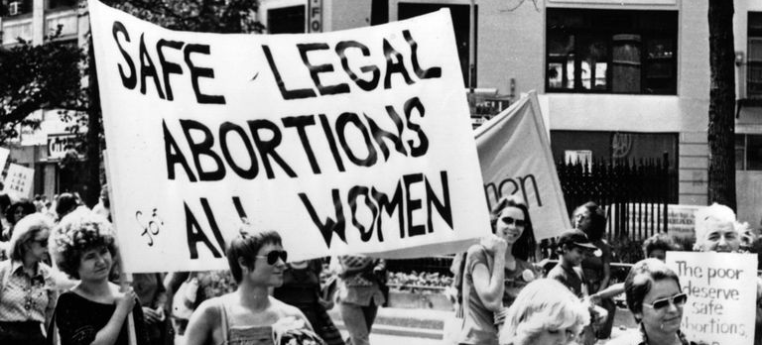
SCOTUS
Directions: The role of the Supreme Court is to interpret the constitutionality of legal actions by Congress, the President, or the states. Describe each landmark court case and define their significance.http://landmarkcases.org/en/Landmark/Cases
Miranda v. Arizona
Plessy v. Ferguson
Brown v. Board of Education
Dred Scott v. Sanford
Roe v. Wade

