Slide 1
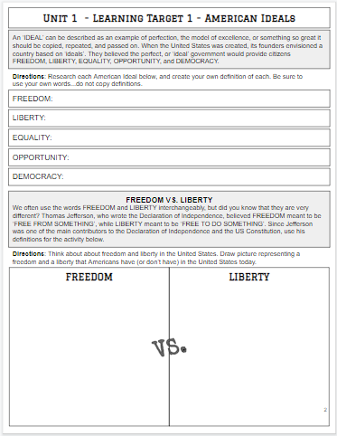

Slide 2
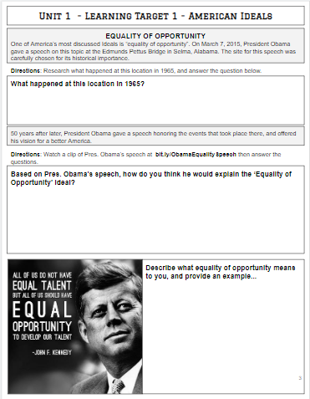

Slide 3
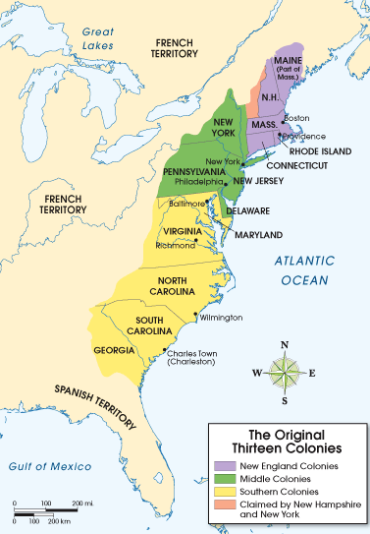
Comparing Colonial Regions
Directions: As the American Colonies grew and more colonists arrived,
each region developed different characteristics. Read the pages included and
use the information you have learned about each region.
based on growing cash crops such as rice, indigo and tobacco.
families settled in small towns centered on strict religious practices
greatest ethnic diversity
based on farming, lumbering, fishing, shipbuilding and trade.
based on livestock and trade in port cities, like Philadelphia
relied heavily on indentured servants, and eventually, on slaves
New England
Middle
Southern

Slide 5
Taxes Lead to Revolution
Directions: The Sugar Act, Stamp Act, Townshend Acts, & Intolerable Acts were all passed by Parliament and met with resistance in the American Colonies.
For the Acts below, give the year they were passed, explain what they did, then why the colonists were opposed to them. History Alive! Ch. 5, p40-42
The Sugar Act
.
The Stamp Act
The Townshend Acts
The Intolerable Acts

Slide 6
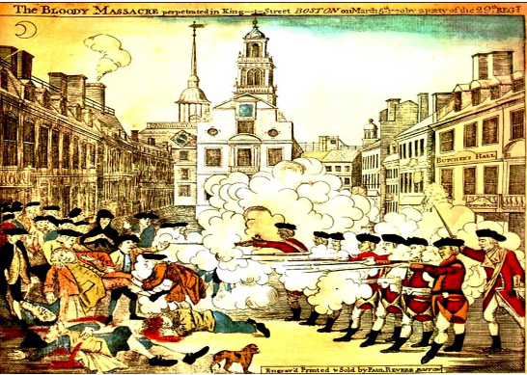
The Boston Massacre
Directions: : On March 5, 1770, British soldiers killed five civilians and injured six others in Boston. The incident became known as the The Boston Massacre. After reading about and analyzing the event, look at the engraving by Paul Revere below. Then, analyze the image by completing the text boxes.
What were the Patriots protesting?
Why?
What were the British soldiers ordered to do?
How did the colonists respond?
What happened?
In the trial…
Who was the defense?
What was the verdict?
What was the sentence?
Who were the Sons of Liberty?
What was their opposition?
What did they do in response to the “massacre”?
Why is the Boston Massacre significant?
Paul Revere was a Patriot. He is responsible for the above artwork.
What else is he known for in regards to the revolution?

Slide 8
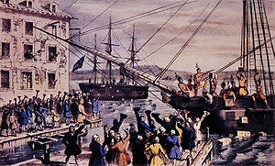

The Boston Tea Party
On December 16th, 1773, just three years after the Boston Massacre, reacted again in protest, this time involving tea. Research this event and answer the questions below.
What happened on the night of
December 16th, 1773?
Who did it?
How did they do it?
What were the Coercive Acts?
What was the Tea Act?
What is Parliament?
Who is the East India Company?
Why do either of those
organizations matter?
Why was the
Boston Tea Party
significant?
Why did it happen?
What was the outcome?

Slide 10
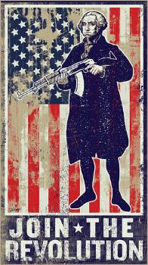
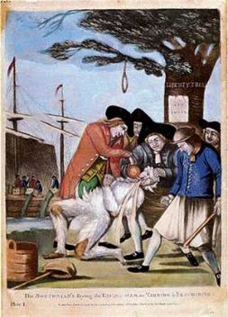
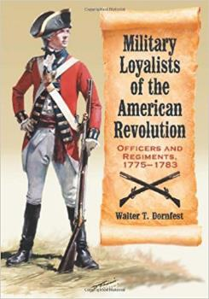
Patriots, Neutrals, and Loyalists
Directions: As calls for independence grew across the 13 Colonies, people began to take sides. After reading about these 3 groups, describe the reasons each group had for their stance, then explain what your stance would be and why if you were alive at the time.
Patriots Neutral Loyalists
Patriots supported Independence. Why?
From whom?
Some were neutral. They were called “fence-sitters”. Why?
Loyalists supported Great Britain. Why?
My stance would be ...

Slide 12
The Declaration of Independence
Directions: The most famous date in American history - July 4, 1776 - marks the date when the Declaration of Independence was formally adopted by the Continental Congress. After analyzing the Declaration, briefly explain each section in your own words.
Preamble
Statement of Beliefs
List of Grievances
Attempts at Negotiation
Declaration

Slide 16
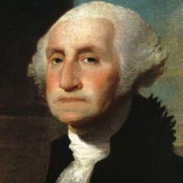
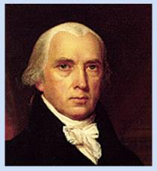
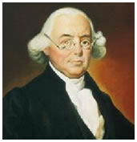
The United States Constitution
Directions: The Constitutional Convention of 1787 took place in Philadelphia and originally was held to revise the Articles of Confederation. It was quickly decided, however, that a totally new government was needed. Despite the fact that most delegates to the Constitutional Convention believed the government designed by the Articles of Confederation had to be replaced, many still feared a strong central government. The Constitution has remained flexible enough to guide the United States through changing times now for several reasons. Most importantly, it describes some very basic principles that constitute the guiding philosophy of the republic. Read about the “Philadelphia Convention”
on the following pages in order to complete the graphic organizer below.
__________?_________
President of the Convention
His contributions included….
__________?_________
Father of the
Constitution
His contributions included….
__________?_________
Three-Fifths
Compromiser
His contributions included….
Virginia Plan
Explain this plan here….
New Jersey Plan
Explain this plan here….
Difficulties
Why did some have trouble getting to the convention?
Frustration
Who did not attend? Why?
Failure
What was the significant failure of the United States Constitution?
What did this failure possibly lead to…?

Slide 20
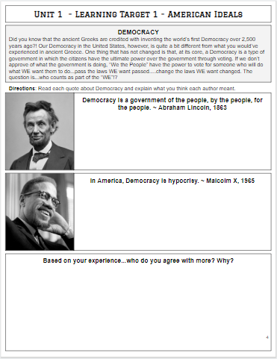

Slide 21
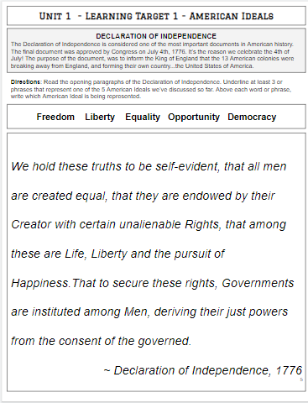

Slide 22
Bill of Rights

Slide 23
Bill of Rights
Directions: Apply the corresponding amendment (numbered and definition) with each appropriate circumstance.
Katie is traveling from Des Moines to Cedar Rapids. She has a permit to carry in the state of Iowa and a licensed and registered 9mm on her person. What amendment is she using?
A policeman finds illegal drugs and weapons in the hallway of an apartment building. To find out who has drugs and weapons in the building, the police chief orders a search of all apartments. Which amendment prevents this type of search?
Suppose the KKK is planning a rally in Des Moines. You, like nearly everyone else, find their message offensive. You ask the mayor to prevent the rally, but he says that the KKK has the right to hold the rally. Which amendment protects this right?
Cody got caught running from the scene of a crime. He may or may not be involved and also may have information on others involved. The arresting officer has placed him under arrest and threatens to tie him to the chair and beat him up under interrogation. Which amendment protects Cody from officer brutality?
Jason is arrested for cheating on his taxes. In court, he refuses to answer questions that make him look guilty. What amendment is he using?
Give an example below of another situation where an amendment has been used (different from the amendments used in the situations above).
EXAMPLE: AMENDMENT:

Slide 24
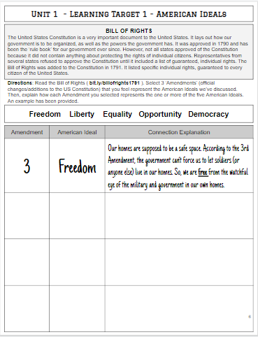

Slide 25
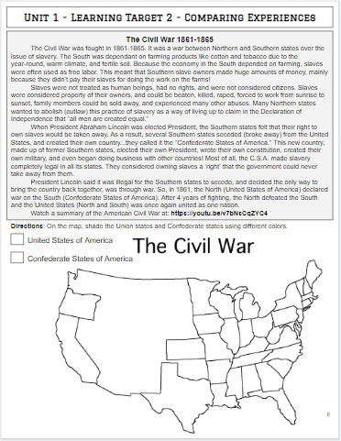

Slide 26
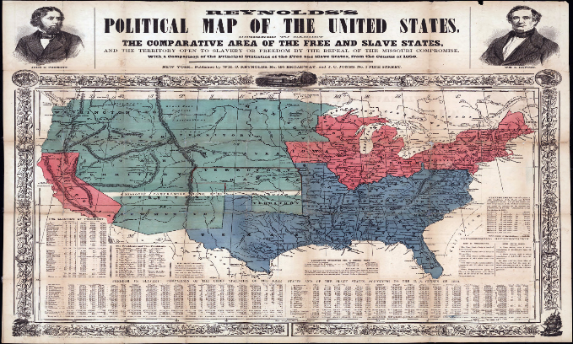
Sectionalism
Directions: The period of time between the War of 1812 and the start of the Civil War in 1861 is known as the “Antebellum” period. During this time the North and South developed very different identities. For example, the use of slaves in the South increased, while the abolitionist movement grew in the North. Research the Antebellum period in the North and South, and explain the factors that caused each to develop different identities.
North
South
Terms to consider:
Industrialization Immigration Factories
Large Population Railroads Abolition
Uncle Tom’s Cabin Large cities Agriculture
Hot summers/Cold Winters Cash crops Slave economy
Short growing season Warm Climate Fertile soil
Long growing season Cotton Planter class
WEST
NORTH
SOUTH

Slide 27
Antebellum America:
North vs. South

Slide 28
Setting the Scene – Unit Preview
Mid-1800’s
  Differences between the North and the South grew so strong that compromise no longer seemed possible
Tragically, Americans turned to civil war to settle their disagreements.
  The long and bloody war resulted in defeat for the South and victory for the Union

Slide 29
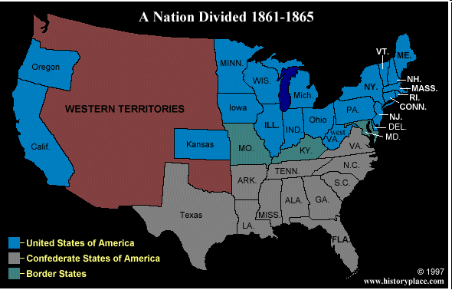
America Divided
Economic changes created divisions in the United States
  Three areas of conflict:
    North – economy based in manufacturing and trade
    South – relied on slaves to raise crops for economy
    West – settlers wanted cheap land and good transportation

Slide 30
ANTEBELLUM NORTH
Rise of Urbanism

Slide 31
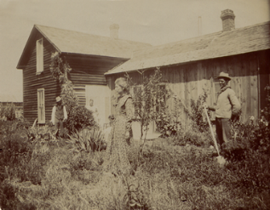
The North: Farming
Mostly small farms
Labor provided by family members
Subsistence agriculture: food crops and livestock
Slavery not profitable in this system

Slide 32
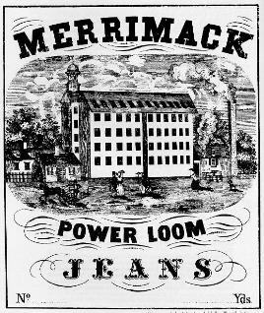
The North: Industry
Factories first began in New England
  92% of the nation’s industries were in the North
Produced fabric and shoes
This is called the Industrial Revolution
Goods made in factories rather than in homes
75% of Nation’s Wealth in North

Slide 33
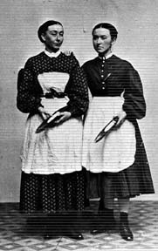
The North: Labor
Factories required workers
First factory workers were young women, called “Mill Girls”
Paid an hourly wage
“Free Labor” – no slaves

Slide 34
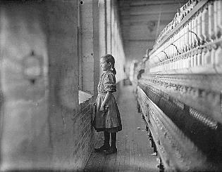
The North: Labor
Wages were low
Working hours long
Working conditions often dangerous
Child labor

Slide 35
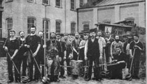
The North: Labor
By 1850, most “Mill Girls” replaced by immigrants in the factories
Immigrants willing to work for lower wages
Created a “working class”

Slide 36
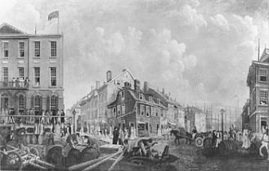
The North: Cities
Factories and workers in cities
Several large cities: Boston, New York, Philadelphia, St. Louis, Chicago
Crowded conditions and urban slums
22 Million Americans

Slide 37
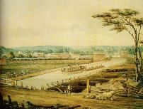
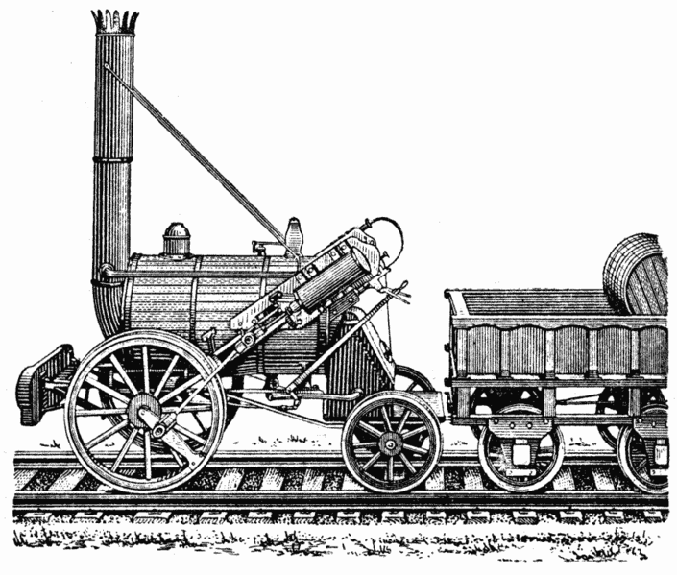
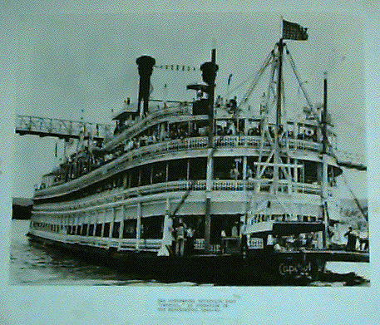
The North: Transportation
Factory goods needed to be moved to market
Canals were built
Erie Canal linked the Hudson River with Lake Erie
Also steamboats and railroads improved transportation
  75% of America’s Railroads were in the North

Slide 38
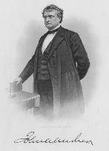
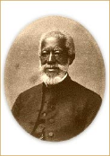
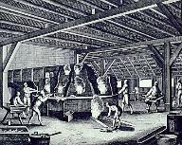
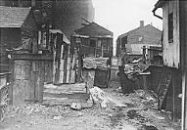
The North: Social Classes
The wealthy: businessmen, factory owners and professionals
Working class
Servants and urban poor
Free blacks

Slide 39
ANTEBELLUM SOUTH
Victorian Era America

Slide 40
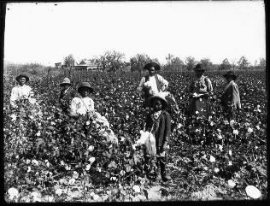
The South: Farming
Plantation economy
  Cash crops like tobacco, sugar, cotton and rice
  Large “farms”
  Purpose was to make a profit
Also small farms on poor land and in the mountains

Slide 41
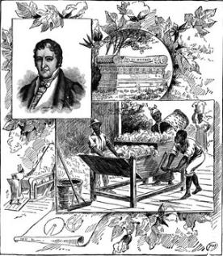
The South: King Cotton
In 1790, Eli Whitney invented the Cotton Gin, which cleaned cotton by machine.
More cotton grown & more slaves needed.
By 1820s, cotton was 1/2 of our total exports – big business!

Slide 42
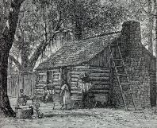
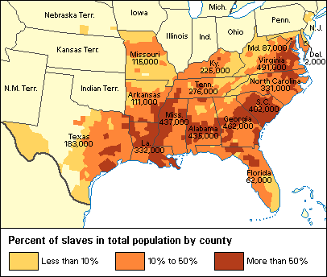
The South: Labor
Source of labor on cotton plantations was slaves
4 million by 1860
Slaves were 1/3 of total population of South
  Slavery was allowed by the 3/5’s Compromise
In some places, slaves outnumbered whites

Slide 43
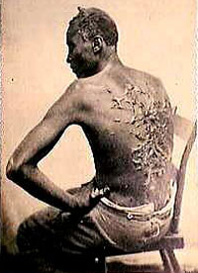
The South: Chattel Slavery
A system of slavery in which one human being owned another as property
Life-long condition
Slavery inherited – children of slaves were also slaves
Often cruel and brutal

Slide 44
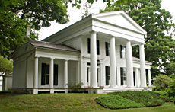
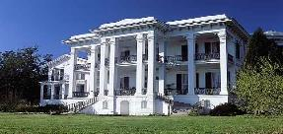
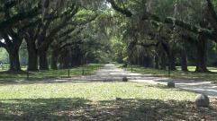
The South: Social Classes
Wealthy white plantation owners
Lived on rich flat land near rivers
10,000 wealthy families in 1860
Owned more than 50 slaves
A minority, but political & economic power

Slide 45
Slave Cost
Slave trade banned in 1808
  Slave demand rises as does the cost of slaves
    1790 - $300
    1860 – 1500
  Slave traders began to smuggle Slaves into the United States
    1790 – 500,000 Slaves
    1850 – 4 Million Slaves

Slide 46
Southern Society in 1850
“Slave-ocracy”
(plantation owners)
6,000,000
The “Plain Folk”
(small slave-owners & yeoman farmers)
250,000
Black Freemen
3,200,000
Black Slaves
U.S. population in 1850 was 23,000,000
9,500,000 lived in the South (40%)

Slide 47
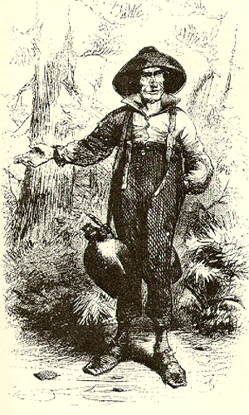
The South: Social Classes
Yeoman farmers
  9 Million Southerners
Some owned a few slaves
2/3 of all whites owned no slaves at all
Subsistence agriculture – lived on poor land

Slide 48
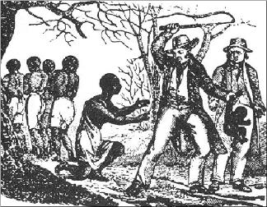
The South: Social Classes
Slaves the lowest social class
No rights, could be sold at any time, families were split up, most did hard labor in the fields.

Slide 49
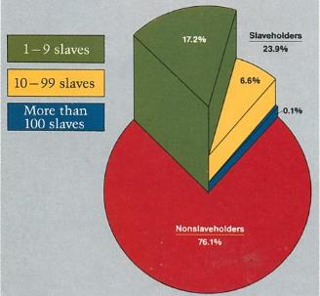
The South: Southern White
Social Class - 1860
Non-Slave holders
  76.1%
1-9 slaves
  17.2%
10-99 slaves
  6.6%
More than 100 slaves
  0.1%

Slide 50
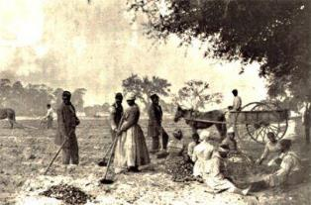
The South: Industry, Cities and Transportation
Economy entirely focused on agriculture
Very little industry
Few cities
Few canals or railroads
Rural society

Slide 51
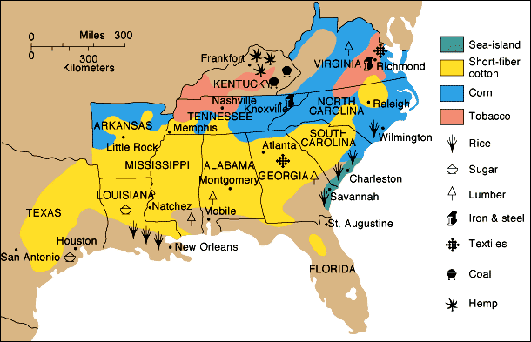
Southern Agriculture
50% of all slaves lived in the Black Belt (“Cotton Belt”)

Slide 52
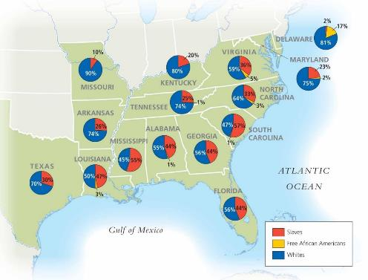
Southern Population

Slide 53
Essential question:
Explain how economic, social, or demographic changes led to the development of regional identities.
Complete the graphic organizer on the following page to help you explain.

Slide 54
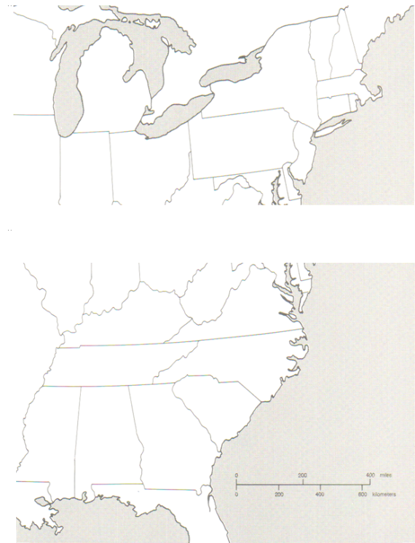
Battles of the Civil War Map
Directions: For each battle listed, draw an arrow to where it occurred on the map. Then in the box, give the (1) date of the battle; (2) winner if the battle; and (3) the battle’s significance in terms of the Civil War.
The Union
Shiloh
Antietam
The Confederacy
Gettysburg
Bull Run
Appomattox
Sherman’s March

Slide 55
Timeline to War
Directions: The decade before the Civil War saw many events that led to tension between North and South. Some were positive for Northern states and some for the South. Ten important events are found below. First, order the events correctly by year. Then decide whether each event was good for the North or the South.
Dred Scott Decision
John Brown’s Raid
Fugitive Slave Act Passed
Lincoln Elected President
Kansas Nebraska Act
Confederacy Formed
South Carolina Secedes
Lincoln-Douglas Debates
Uncle Tom’s Cabin Published
Preston Brooks beats Charles Sumner in the Senate
1850 1851 1852 1853 1854 1855 1856 1857 1858 1859 1860 1861
NORTH
SOUTH

Slide 56
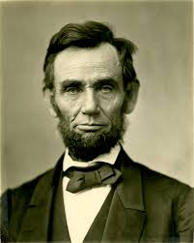
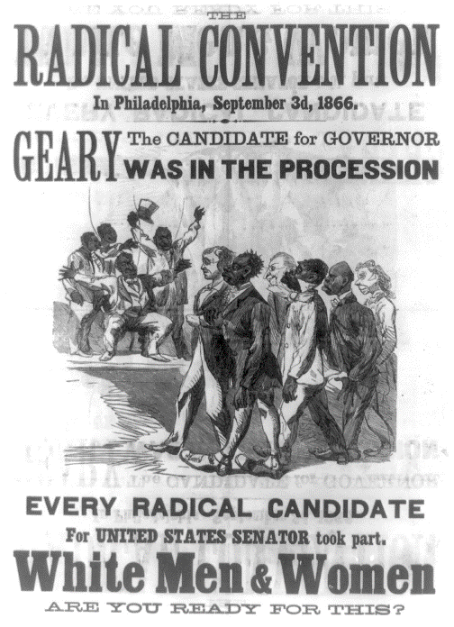
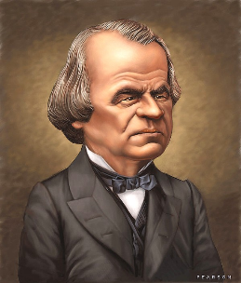
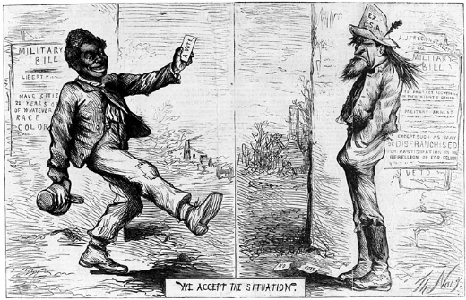
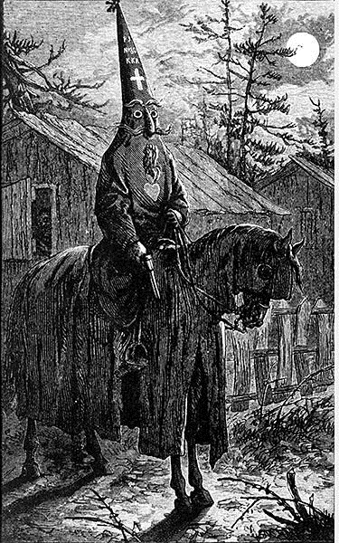

Reconstruction
Directions: As the Civil War was coming to a close, various plans were developed about how the Southern states should be treated and how they should be brought back into the Union. Complete the graphic organizer by describing the specifics of each plan for Reconstruction.
Abraham Lincoln’s Plan
Radical Republican Plan
Andrew Johnson’s Plan
There were some other “laws” and organizations that emerged and resurged as a result of Reconstruction. Describe each, give their purpose/goal, and outcome.
Freedmen’s Bureau
Black Codes
Ku Klux Klan

Slide 57

Reconstruction
Directions: The Reconstruction Amendments are the 13th, 14th, and 15th Amendments to the United States Constitution. They were adopted between 1865 and 1870, the five years immediately following the Civil War. First, match the Amendment to the summary of what it did then, summarize the immediate and long-term effects each had on the nation.
13th Amendment
14th Amendment
15th Amendment
This Amendment guaranteed that no male could be denied the right to vote based on “race, color, or previous condition of servitude.”
This Amendment ended slavery in America forever
This Amendment guaranteed full citizenship & rights to everyone born in the US, including former slaves.
Plessy v. Ferguson
When was it?
What was the argument?
What was the verdict?
Why is it a significant court case?

Slide 58


Slide 59


Slide 60


Slide 61



Impacts of Reconstruction on America
Directions: Explain how the United States changed due to Reconstruction and how these changes impacted daily life on the home front for various groups.
Women
African Americans
Native Americans

Slide 62


