Slide 1
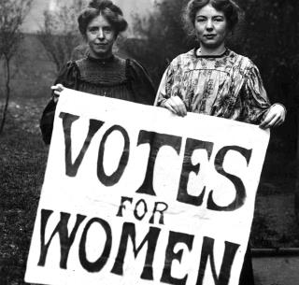
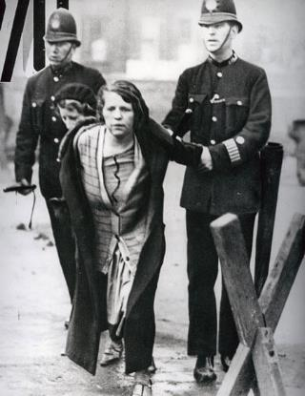
Female Suffrage
Directions: On Election Day in 1920, millions of American women exercised their right to vote for the first time. It took activists and reformers nearly 100 years to win that right, and the campaign was not easy: Disagreements over strategy threatened to cripple the movement more than once. But on August 26, 1920, the 19th Amendment to the Constitution was finally ratified, enfranchising all American women and declaring for the first time that they, like men, deserve all the rights and responsibilities of citizenship. Follow this link http://ow.ly/oLDv30fomwO
in order to complete the organizer. Remember there is additional information on the previous slide.
Who supported suffrage for women?
What was the first convention called to discuss women’s rights?
How did these groups campaign for women’s suffrage and equal rights?
What obstacles were faced in the fight for their rights?
Did women gain suffrage?
If so, when?
What annual event regarding women began in the year 1921?

Slide 2
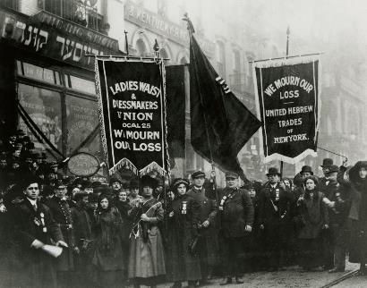
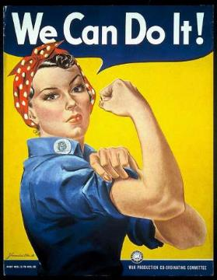
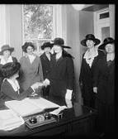
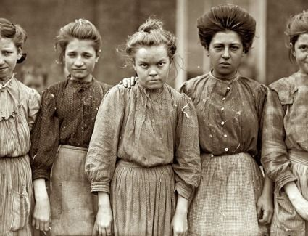
Labor Movement for Women
Directions: Research and describe each group as it has impacted the lives of women in the labor force.
Rosie the Riveter
International Ladies’ Garment Workers’ Union
U.S. Department of Labor Women’s Bureau
Lowell Mill Girls

Slide 3
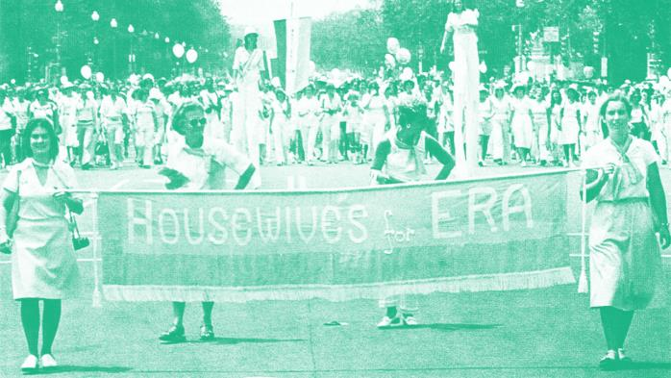
Equal Rights for Women
Directions: Women haven’t always had the same rights as men. Follow this website https://www.equalrightsamendment.org/the-equal-rights-amendment
To complete the organizer.
.
What was the equal rights amendment?
What year was it passed?
What rights did it offer women?
What did it change for women?
Is it a federal or state amendment?
What states are affected?
What’s next?
Things have significantly changed over time. Read this article from the 1950’s
https://www.littlethings.com/1950s-good-housewife-guide/5
Describe 3 things that you read about and what are your thoughts.

Slide 5
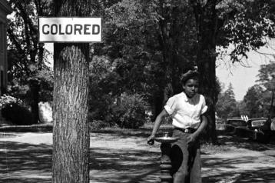
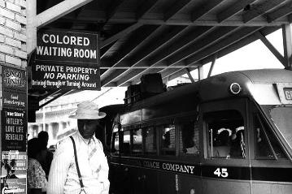
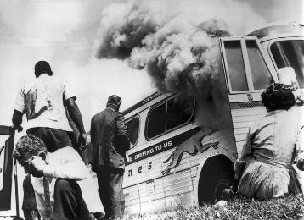
Jim Crow Laws
Directions: In the 35 years since the end of the Civil War and abolition of slavery, African Americans had made few gains in the struggle for equality. Many southern states had passed Jim Crow laws that segregated blacks from whites in trains, schools, hospitals, and other public places.. Follow these links https://www.history.com/topics/jim-crow-laws and http://www.pbs.org/wgbh/americanexperience/features/freedom-riders-jim-crow-laws/ and http://www.pbs.org/wgbh/americanexperience/films/freedomriders/ in order to complete the graphic organizer below. Give details. Also History Alive: Chapter 16
What were Jim Crow laws?
What were the Black Codes?
Who was Ida B. Wells?
What were obstacles to the 15th Amendment?
What is NAACP?
Who were the Freedom Riders?

Slide 6
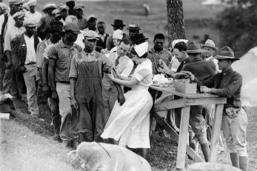
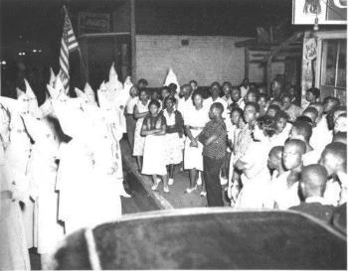
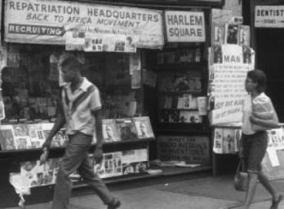
President Wilson asked Americans to help make the world “safe for democracy,” but many African Americans wondered more about democracy at home. With lynchings, Jim Crow laws, and segregated army units, some were not sure what they should be fighting for.
Research more in, History Alive: Chapter 24 and follow these links http://www.ushistory.org/us/47c.asp and http://www.history.com/topics/ku-klux-klan and https://www.history.com/topics/black-history/great-migration in order to complete the organizer below.
The Great Migration
What was the Great Migration?
What is Americanization?
What is meant by intolerance?
What was the Chicago Race Riot of 1919?
What was the “Back to Africa” movement?
Why did the 1920’s see a resurgence in the KKK?

Slide 7
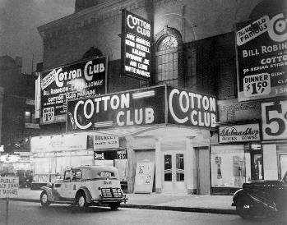
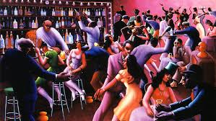
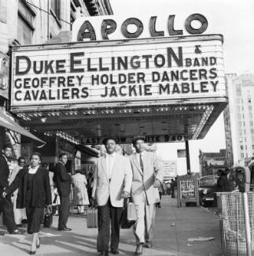
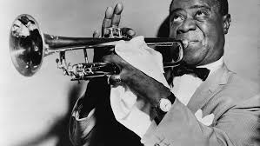
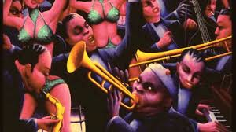
Harlem Renaissance
Directions: The Harlem Renaissance was a movement of African-American culture that was an outpouring of creativity among poets, artists, writers, musicians, actors, and performers some of who became famous that began in the New York City neighborhood of Harlem in the 1920's. Follow these links http://www.loc.gov/rr/program/bib/harlem/harlem.html and http://ow.ly/YkK630fjtW0 in order to interpret the images below as to how they pertain to the Harlem Renaissance..

Slide 8
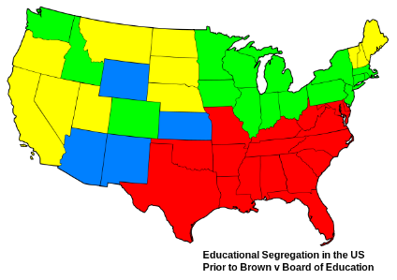
Brown vs. the Board of Education
Directions: This landmark Supreme Court case would forever change American schools. You can learn more about the Supreme Court ruling here and also from the National Historic site here. https://www.nps.gov/brvb/index.htm First, complete the key to the map. Then, complete the graphic organizers at the bottom with (1) what the ruling was, (2) what was the Justification/ under what grounds it was found, and (3) what was the reaction and resistance it was met with.
Segregated school forbidden.
Segregated school required.
Segregated school optional.
No legislation on schools.
US Prior to Brown Map Key
Ruling
Grounds & Justification
Reaction & Resistance

Slide 10
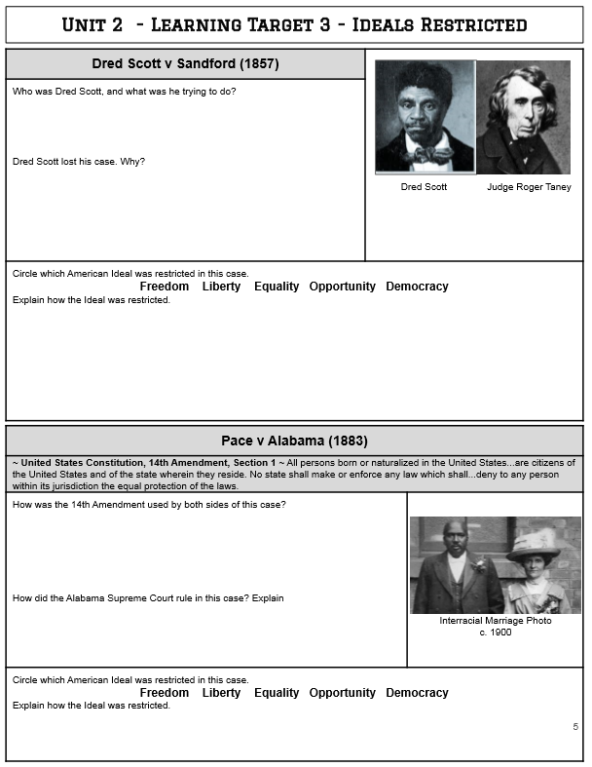

Slide 11
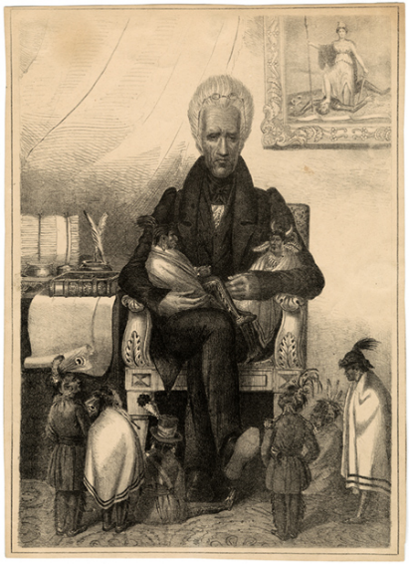
The Indian Removal Act
Directions: Analyze how the Indian Removal Act was introduced and debated
as well as President Jackson’s message to Congress on Indian Removal.
Chapter 8 in History Alive! Then complete the graphic organizers below.
Why was there a need
for Indian removal?
The 1835 lithograph below is titled
“Andrew Jackson as the Great Father”.
What do you feel is the message of the cartoon?
Who passed the
Indian Removal Act?
What was Jackson’s message to Congress on Indian Removal?
Although most tribes
went along,
some
Which tribes resisted?
How?
What happened?
Which was the most famous forced migration?

Slide 12
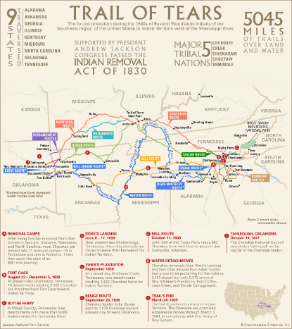
The Trail of Tears
Directions: After the passage of the Indian Removal Act, about 20,000 Cherokee were marched westward at gunpoint on what became known as the Trail of Tears. After learning here http://ow.ly/KMIz30fo5tf explain the significance of the Supreme Court case and Treaty, then watch the videos and give response. Use map as a reference.
Cherokee Nation v. Georgia
What was the basis for this court case?
What was the ruling?
Look in History Alive!
Chapter 8 – did the ruling stand?
Why or why not?
The Trail of Tears
http://ow.ly/Xaeq30fo8Qb
http://ow.ly/xsyw30fo8SI
http://ow.ly/S1fq30fo8Yr
http://ow.ly/vhqs30fo8RD
Treaty of New Echota
What were the provisions of the treaty?
Who signed it?
How many signed?
How many were opposed?
Was it ratified?
Why or why not?

Slide 13
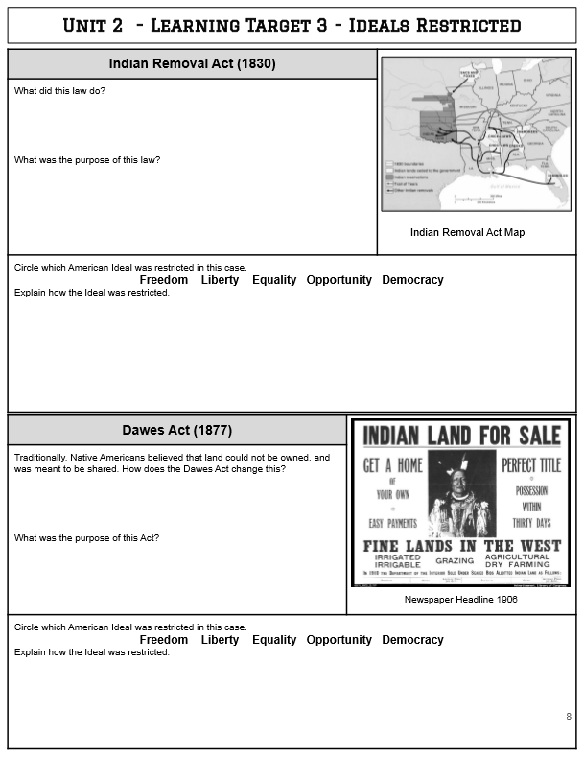

Slide 15
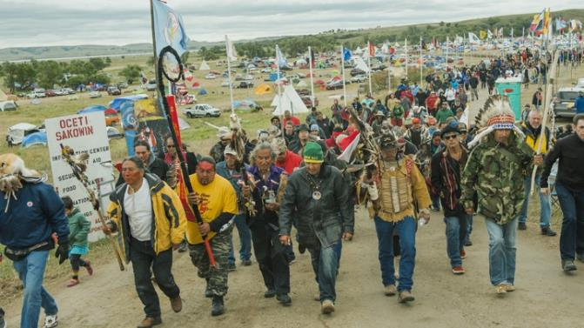
Current Native Issues
Directions: Research online in order to complete the graphic organizer.
Be sure to include where you found your information.
Find a current (no more than 10 years old) land dispute
What are the living conditions like in today's reservations?
What is the Indian Child Welfare Act and why is it controversial?
Common stereotypes of Native Americans?
How were these formed?

Slide 16
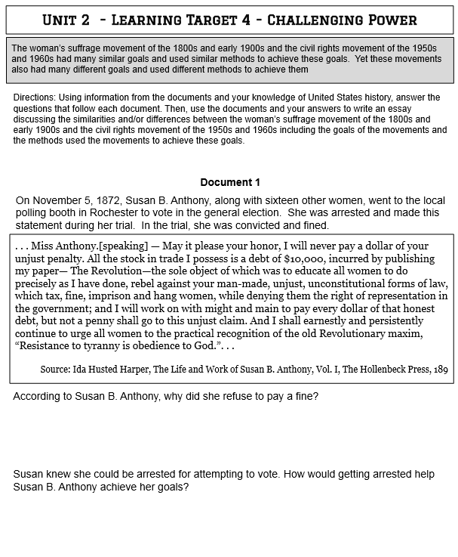

Slide 17
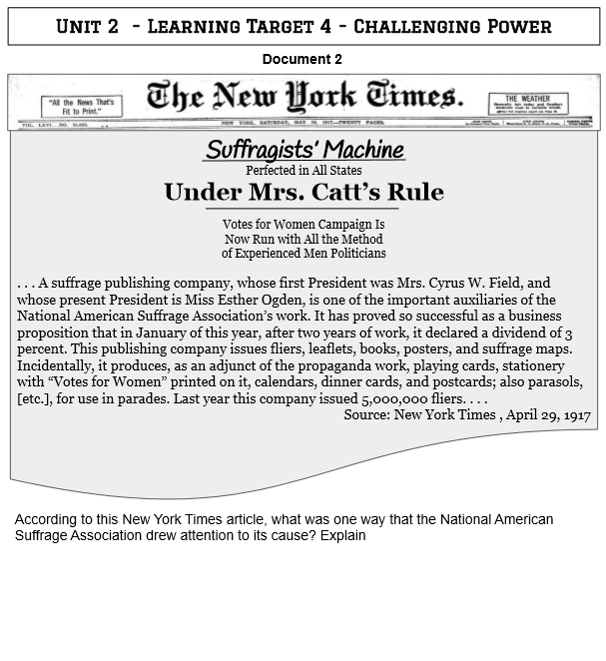

Slide 18
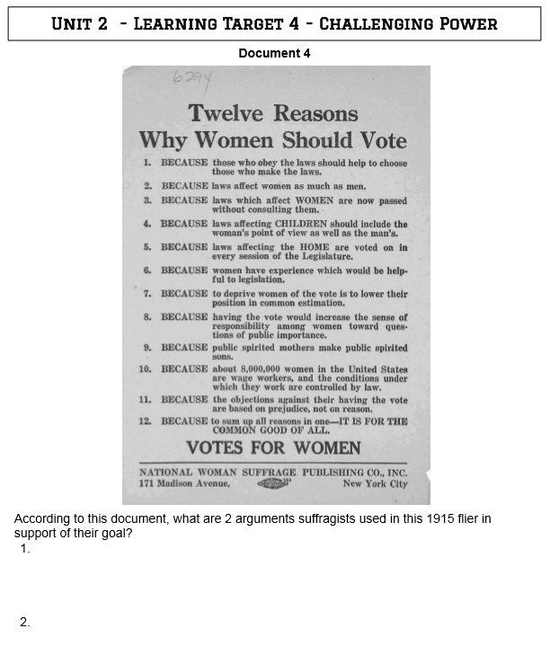

Slide 19
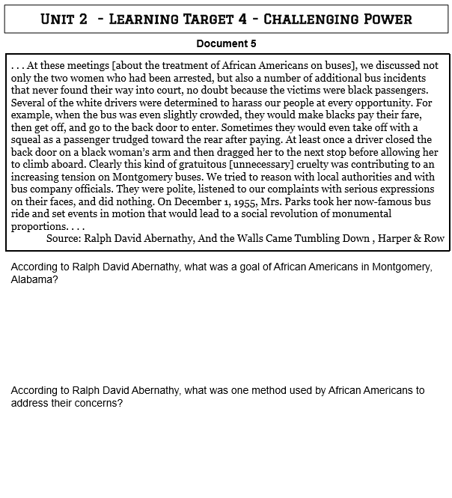

Slide 20
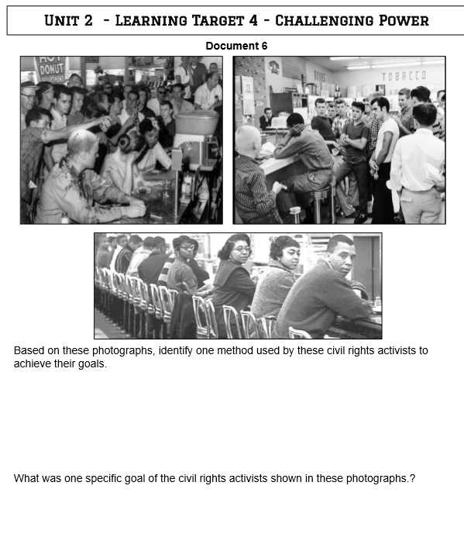

Slide 22
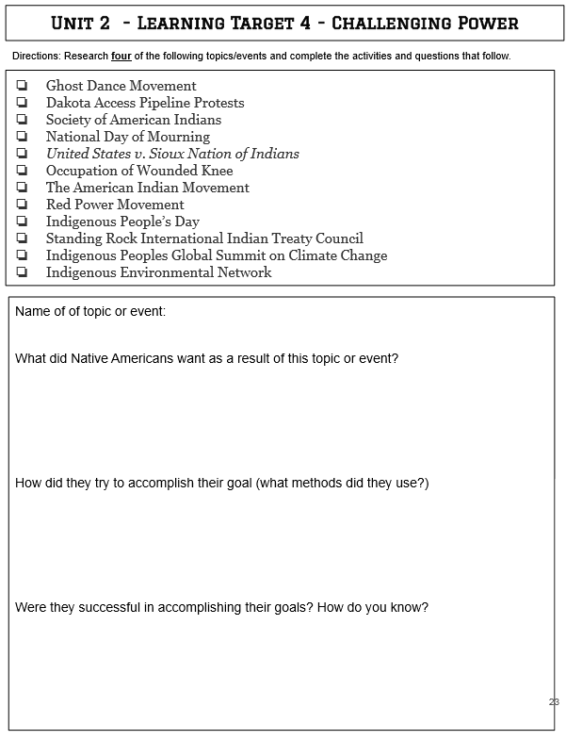

Slide 23
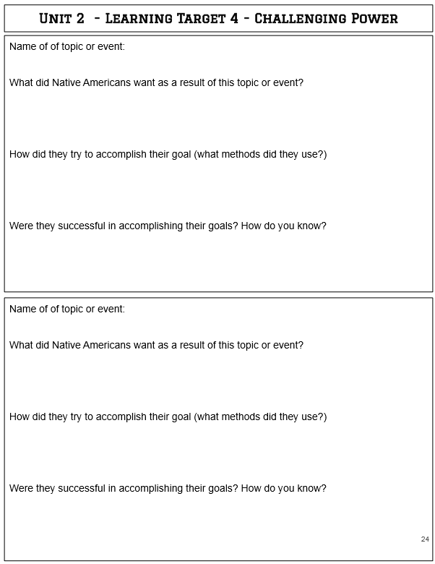

Slide 24
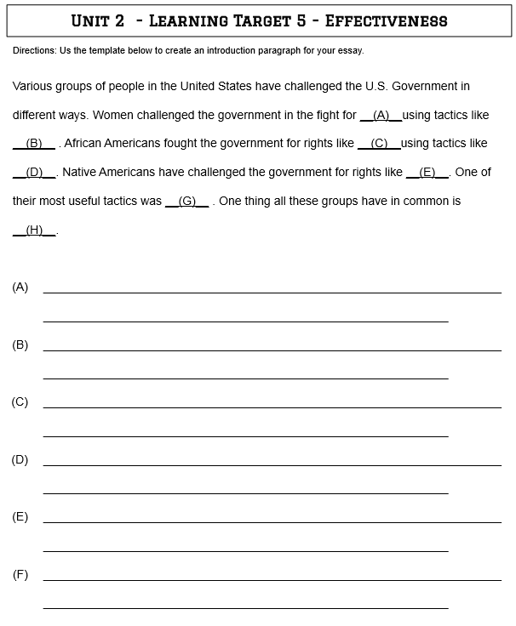

Slide 25
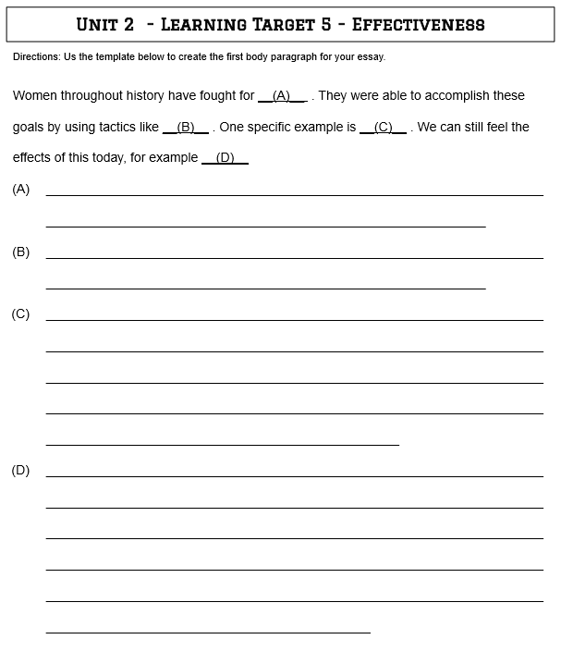

Slide 26
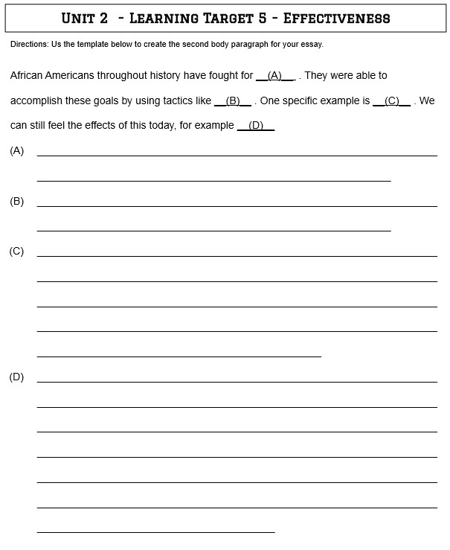

Slide 27
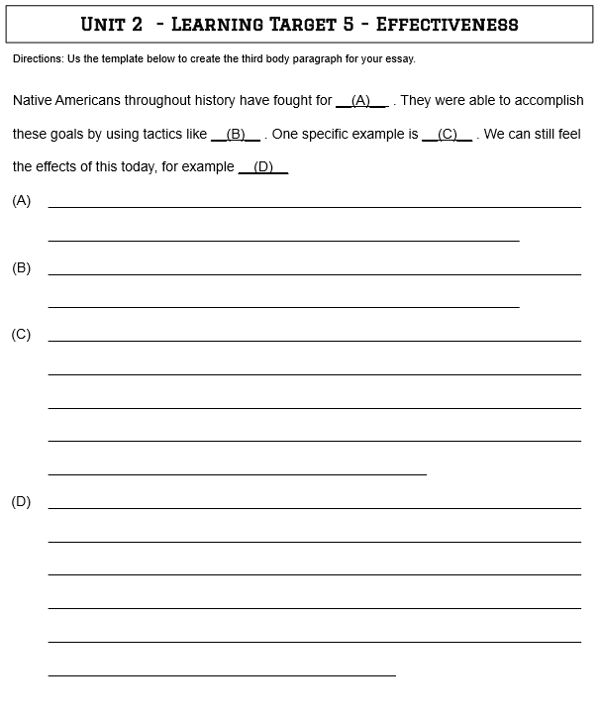

Slide 28
