Slide 2
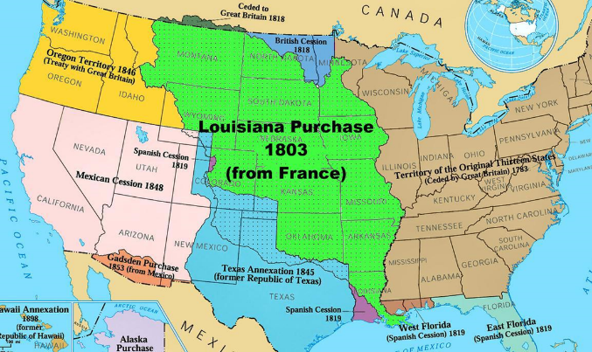

Slide 4
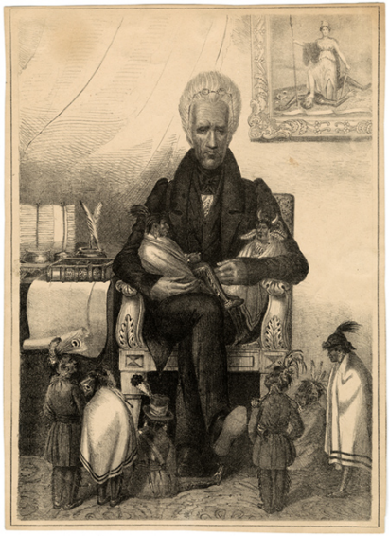
The Indian Removal Act
Directions: Analyze how the Indian Removal Act was introduced and debated
as well as President Jackson’s message to Congress on Indian Removal.
Chapter 8 in History Alive! Then complete the graphic organizers below.
Why was there a need
for Indian removal?
The 1835 lithograph below is titled
“Andrew Jackson as the Great Father”.
What do you feel is the message of the cartoon?
Who passed the
Indian Removal Act?
What was Jackson’s message to Congress on Indian Removal?
Although most tribes
went along,
some
Which tribes resisted?
How?
What happened?
Which was the most famous forced migration?

Slide 5
amendments | segregation | popular sovereignty | sectionalism | abolition
Dred Scott | Kansas Nebraska Act | Compromise of 1850 | Missouri Compromise

Slide 6
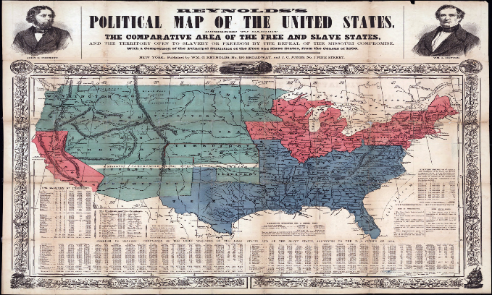
Sectionalism
Directions: The period of time between the War of 1812 and the start of the Civil War in 1861 is known as the “Antebellum” period. During this time the North and South developed very different identities. For example, the use of slaves in the South increased, while the abolitionist movement grew in the North. Research the Antebellum period in the North and South, and explain the factors that caused each to develop different identities.
North
South
Terms to consider:
Industrialization Immigration Factories
Large Population Railroads Abolition
Uncle Tom’s Cabin Large cities Agriculture
Hot summers/Cold Winters Cash crops Slave economy
Short growing season Warm Climate Fertile soil
Long growing season Cotton Planter class
WEST
NORTH
SOUTH

Slide 7
Antebellum America:
North vs. South

Slide 8
Setting the Scene – Unit Preview
Mid-1800’s
  Differences between the North and the South grew so strong that compromise no longer seemed possible
Tragically, Americans turned to civil war to settle their disagreements.
  The long and bloody war resulted in defeat for the South and victory for the Union

Slide 9
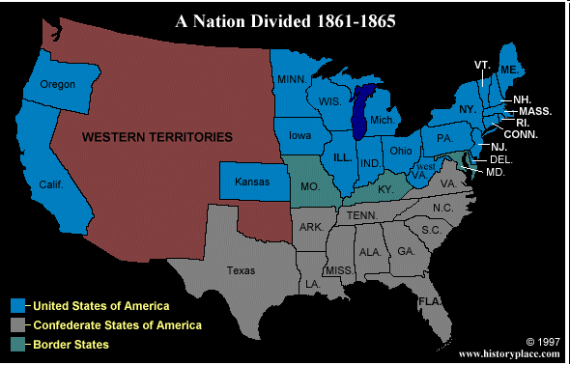
America Divided
Economic changes created divisions in the United States
  Three areas of conflict:
    North – economy based in manufacturing and trade
    South – relied on slaves to raise crops for economy
    West – settlers wanted cheap land and good transportation

Slide 10
ANTEBELLUM NORTH
Rise of Urbanism

Slide 11
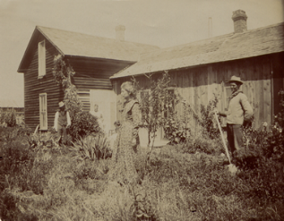
The North: Farming
Mostly small farms
Labor provided by family members
Subsistence agriculture: food crops and livestock
Slavery not profitable in this system

Slide 12
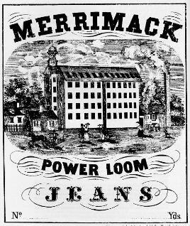
The North: Industry
Factories first began in New England
  92% of the nation’s industries were in the North
Produced fabric and shoes
This is called the Industrial Revolution
Goods made in factories rather than in homes
75% of Nation’s Wealth in North

Slide 13
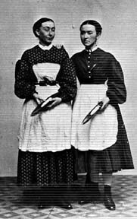
The North: Labor
Factories required workers
First factory workers were young women, called “Mill Girls”
Paid an hourly wage
“Free Labor” – no slaves

Slide 14
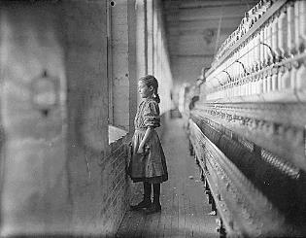
The North: Labor
Wages were low
Working hours long
Working conditions often dangerous
Child labor

Slide 15
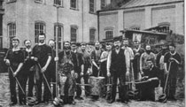
The North: Labor
By 1850, most “Mill Girls” replaced by immigrants in the factories
Immigrants willing to work for lower wages
Created a “working class”

Slide 16
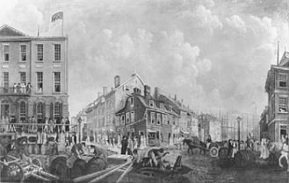
The North: Cities
Factories and workers in cities
Several large cities: Boston, New York, Philadelphia, St. Louis, Chicago
Crowded conditions and urban slums
22 Million Americans

Slide 17
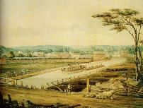
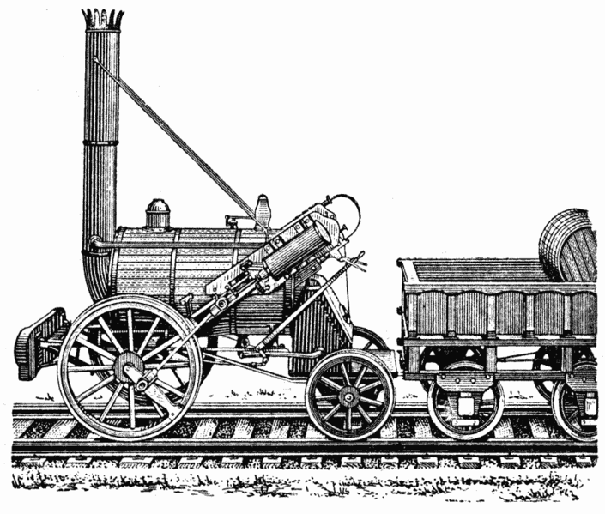
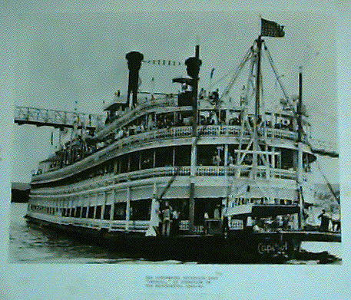
The North: Transportation
Factory goods needed to be moved to market
Canals were built
Erie Canal linked the Hudson River with Lake Erie
Also steamboats and railroads improved transportation
  75% of America’s Railroads were in the North

Slide 18
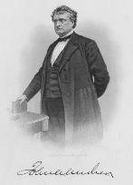
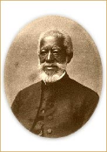
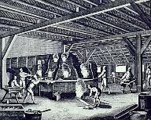
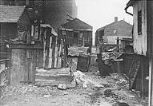
The North: Social Classes
The wealthy: businessmen, factory owners and professionals
Working class
Servants and urban poor
Free blacks

Slide 19
ANTEBELLUM SOUTH
Victorian Era America

Slide 20
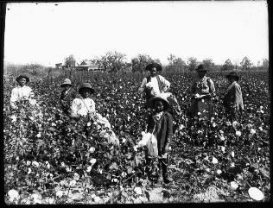
The South: Farming
Plantation economy
  Cash crops like tobacco, sugar, cotton and rice
  Large “farms”
  Purpose was to make a profit
Also small farms on poor land and in the mountains

Slide 21
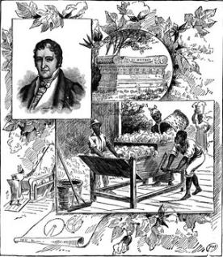
The South: King Cotton
In 1790, Eli Whitney invented the Cotton Gin, which cleaned cotton by machine.
More cotton grown & more slaves needed.
By 1820s, cotton was 1/2 of our total exports – big business!

Slide 22
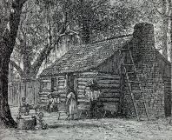
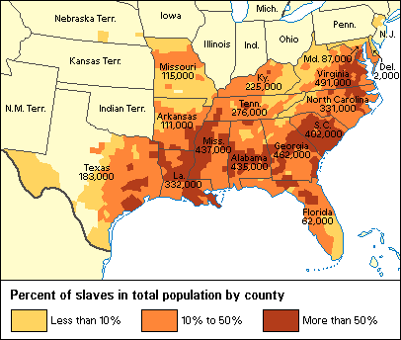
The South: Labor
Source of labor on cotton plantations was slaves
4 million by 1860
Slaves were 1/3 of total population of South
  Slavery was allowed by the 3/5’s Compromise
In some places, slaves outnumbered whites

Slide 23
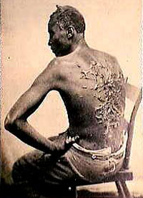
The South: Chattel Slavery
A system of slavery in which one human being owned another as property
Life-long condition
Slavery inherited – children of slaves were also slaves
Often cruel and brutal

Slide 24
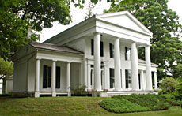
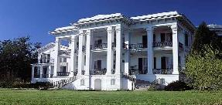

The South: Social Classes
Wealthy white plantation owners
Lived on rich flat land near rivers
10,000 wealthy families in 1860
Owned more than 50 slaves
A minority, but political & economic power

Slide 25
Slave Cost
Slave trade banned in 1808
  Slave demand rises as does the cost of slaves
    1790 - $300
    1860 – 1500
  Slave traders began to smuggle Slaves into the United States
    1790 – 500,000 Slaves
    1850 – 4 Million Slaves

Slide 26
Southern Society in 1850
“Slave-ocracy”
(plantation owners)
6,000,000
The “Plain Folk”
(small slave-owners & yeoman farmers)
250,000
Black Freemen
3,200,000
Black Slaves
U.S. population in 1850 was 23,000,000
9,500,000 lived in the South (40%)

Slide 27
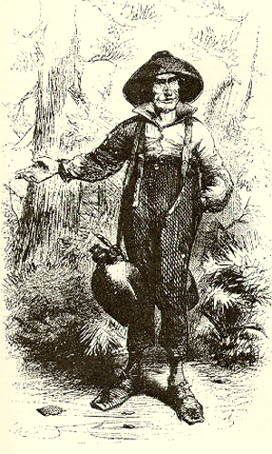
The South: Social Classes
Yeoman farmers
  9 Million Southerners
Some owned a few slaves
2/3 of all whites owned no slaves at all
Subsistence agriculture – lived on poor land

Slide 28
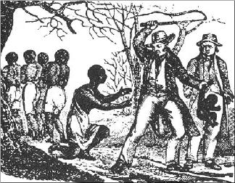
The South: Social Classes
Slaves the lowest social class
No rights, could be sold at any time, families were split up, most did hard labor in the fields.

Slide 29
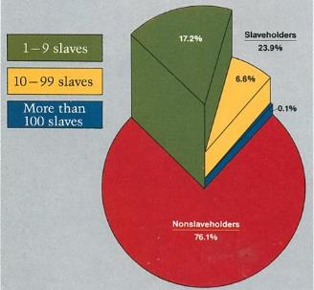
The South: Southern White
Social Class - 1860
Non-Slave holders
  76.1%
1-9 slaves
  17.2%
10-99 slaves
  6.6%
More than 100 slaves
  0.1%

Slide 30
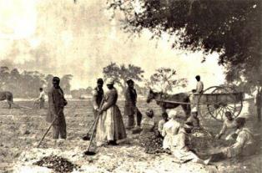
The South: Industry, Cities and Transportation
Economy entirely focused on agriculture
Very little industry
Few cities
Few canals or railroads
Rural society

Slide 31
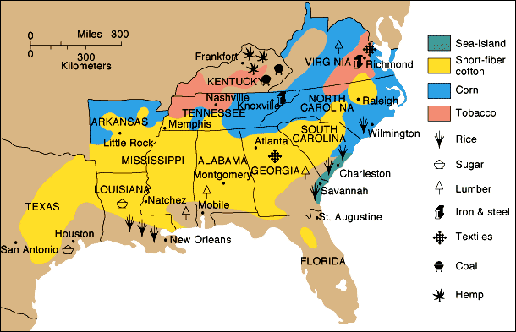
Southern Agriculture
50% of all slaves lived in the Black Belt (“Cotton Belt”)

Slide 32
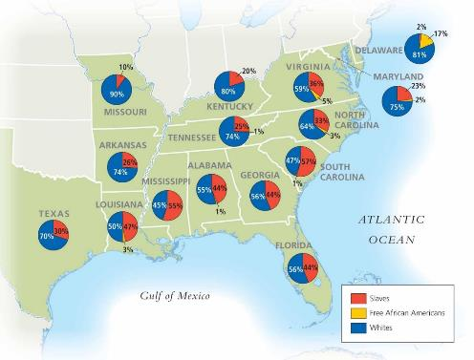
Southern Population

Slide 33
Essential question:
Explain how economic, social, or demographic changes led to the development of regional identities.
Complete the graphic organizer on the following page to help you explain.

Slide 34
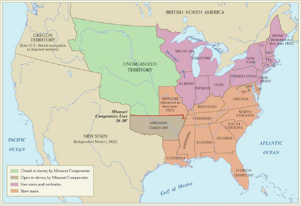
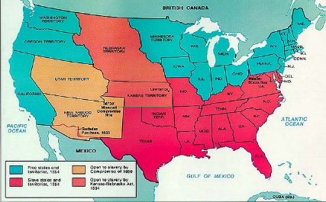
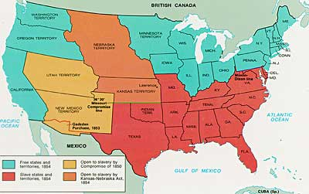
Compromises Over Slavery & Statehood
Directions: The years before the Civil War saw several compromises and acts each time new states would join the union. Congress sought to always keep a balance of Free and Slave states. Analyze the 3 maps then, describe why the compromise was reached and what it did.
Missouri Compromise
Compromise of 1850
Kansas
Nebraska
Act

Slide 35
Timeline to War
Directions: The decade before the Civil War saw many events that led to tension between North and South. Some were positive for Northern states and some for the South. Ten important events are found below. First, order the events correctly by year. Then decide whether each event was good for the North or the South.
Dred Scott Decision
John Brown’s Raid
Fugitive Slave Act Passed
Lincoln Elected President
Kansas Nebraska Act
Confederacy Formed
South Carolina Secedes
Lincoln-Douglas Debates
Uncle Tom’s Cabin Published
Preston Brooks beats Charles Sumner in the Senate
1850 1851 1852 1853 1854 1855 1856 1857 1858 1859 1860 1861
NORTH
SOUTH

Slide 36
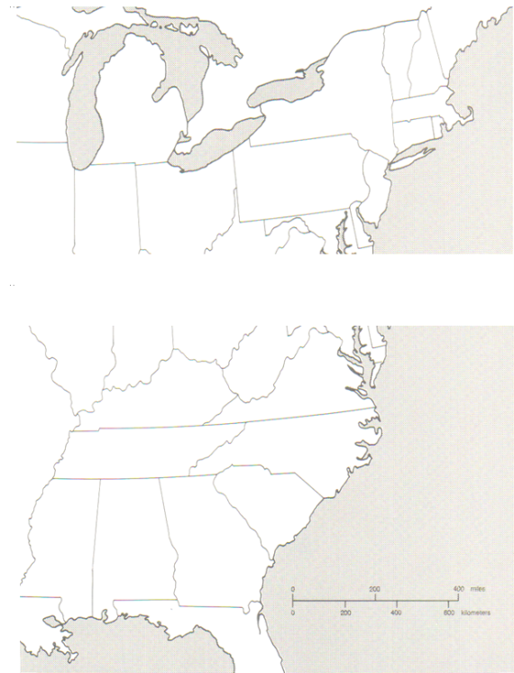
Battles of the Civil War Map
Directions: For each battle listed, draw an arrow to where it occurred on the map. Then in the box, give the (1) date of the battle; (2) winner if the battle; and (3) the battle’s significance in terms of the Civil War.
The Union
Shiloh
Antietam
The Confederacy
Gettysburg
Bull Run
Appomattox
Sherman’s March

Slide 37
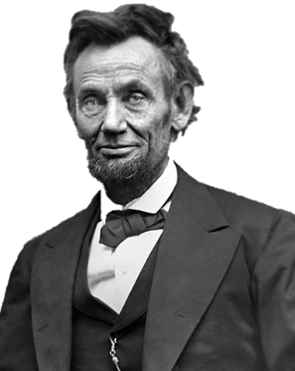
Lincoln’s Great Speeches
Directions: Abraham Lincoln was an incredible writer and gave some of the most famous speeches in American history. He also issued historic proclamations that changed America. Research these works below, give the date it was issued and briefly describe its message.
The Gettysburg Address
2nd
Inaugural Address
Emancipation Proclamation

Slide 39
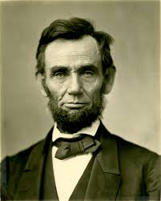
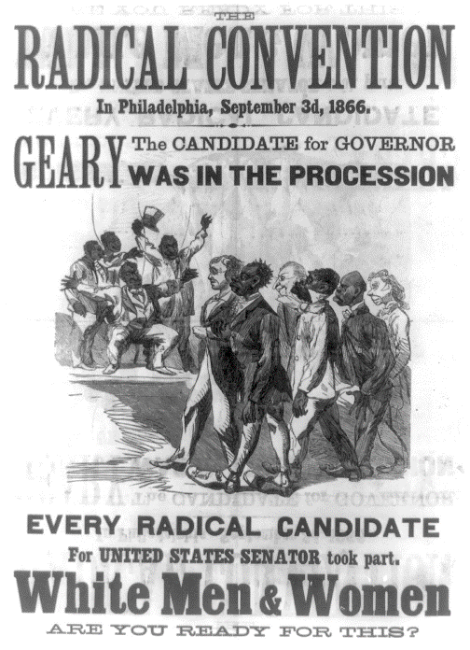
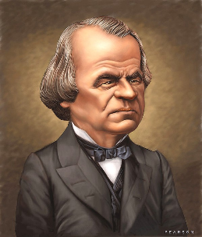
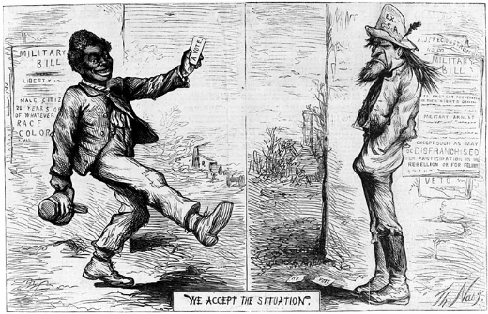
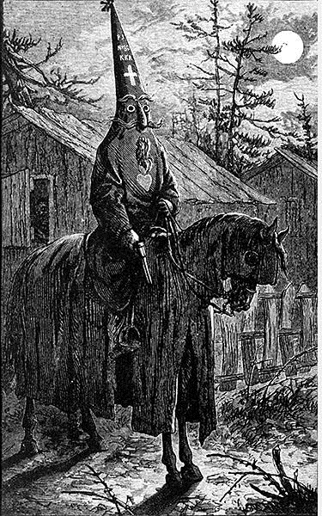
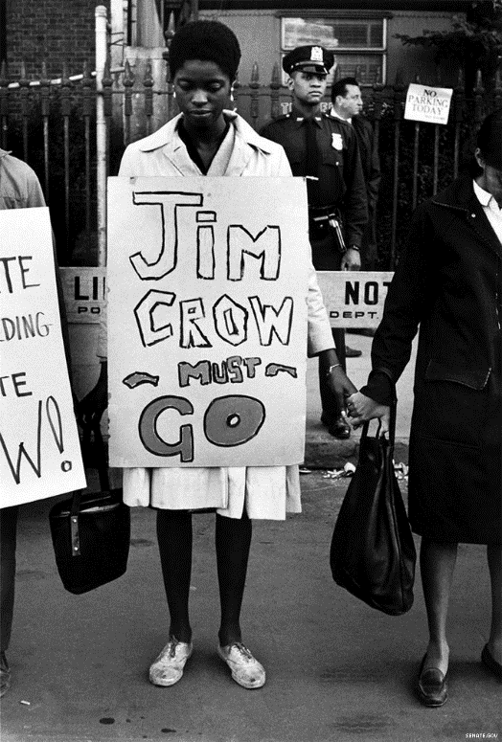
Reconstruction
Directions: As the Civil War was coming to a close, various plans were developed about how the Southern states should be treated and how they should be brought back into the Union. Complete the graphic organizer by describing the specifics of each plan for Reconstruction.
Abraham Lincoln’s Plan
Radical Republican Plan
Andrew Johnson’s Plan
There were some other “laws” and organizations that emerged and resurged as a result of Reconstruction. Describe each, give their purpose/goal, and outcome.
Freedmen’s Bureau
Black Codes
Ku Klux Klan

Slide 40
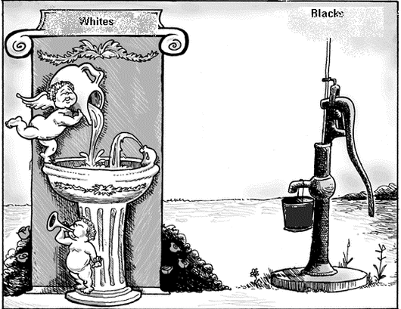
Reconstruction
Directions: The Reconstruction Amendments are the 13th, 14th, and 15th Amendments to the United States Constitution. They were adopted between 1865 and 1870, the five years immediately following the Civil War. First, match the Amendment to the summary of what it did then, summarize the immediate and long-term effects each had on the nation.
13th Amendment
14th Amendment
15th Amendment
This Amendment guaranteed that no male could be denied the right to vote based on “race, color, or previous condition of servitude.”
This Amendment ended slavery in America forever
This Amendment guaranteed full citizenship & rights to everyone born in the US, including former slaves.
Plessy v. Ferguson
When was it?
What was the argument?
What was the verdict?
Why is it a significant court case?

