Slide 1
migration | immigration | populism | nativism

Slide 2
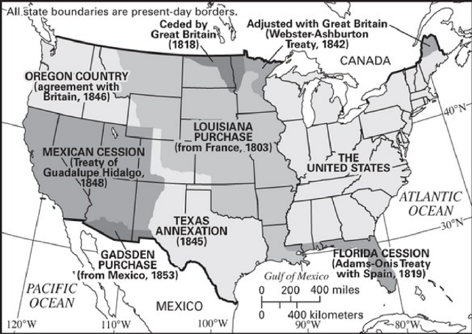

Slide 3
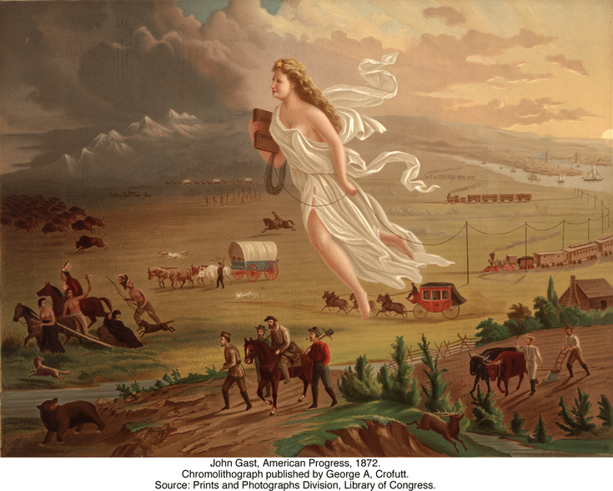
Manifest Destiny
Directions: Artist John Gast’s 1872 painting “American Progress” has come to symbolize Manifest Destiny and the groups affected most by it. Research more about the painting, then complete the graphic organizers by explaining more about the American Frontier, who is pictured and how Manifest Destiny impacted them.
Her
Buffalo
Railroads
Cowboys
Native Americans
49ers
Farmers
.

Slide 5
urbanization | agrarian | labor union | tenement

Slide 6
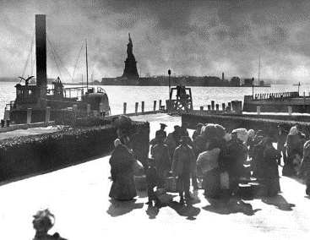
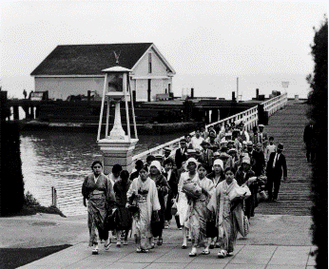
Immigration Islands
Ellis Island Angel Island
Directions: Millions of immigrants came to the United States at the turn of the century.
Many arrived with few possessions and little money. They faced many challenges
adapting to life in their new home. History Alive! Chapter 15
Continue reading in the chapter and follow these links
https://www.youtube.com/watch?v=ubT-Bm36L2U
https://www.history.com/topics/ellis-island
https://www.britannica.com/topic/Angel-Island-Immigration-Station
in order to respond to the prompts below.
What were some of the reasons (pull factors) for Europeans immigrating to the United States?
What were some of the difficulties (push factors) for Europeans immigrating to the U.S.?
What were some of the examinations and inspections immigrants endured?
What happened if an immigrant failed these examinations/inspections?
Compare and contrast Angel and Ellis Island.
What was Angel Island called in respect to Ellis Island?
What is the famous statue located at Ellis Island?
What are the famous landmarks in regards to Angel Island?
What was the Chinese Exclusion Act? Why is it significant in respect to this topic?

Slide 7

Indian Wars Timeline
Directions: As American settlers moved West, they frequently came into
conflict with American Indians. Research about battles, events, and treaties
here http://ow.ly/KEaQ30fo9JT of the American Indian Wars here http://ow.ly/R4Hv30fo9W7 Place each on the timeline then summarize each.
1830
1840
1850
1860
1870
1880
1890
Sand Creek Massacre
Sioux Wars
Indian Removal Act
Wounded Knee Massacre
Dawes Act (Allotment Act)
Treaty of Fort Laramie
Battle of Little Bighorn
Also, see here http://ow.ly/fnrC30fIitU as to how the
Native American lands disappeared over time.

Slide 8
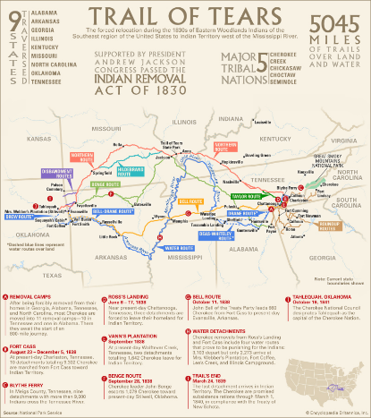
The Trail of Tears
Directions: After the passage of the Indian Removal Act, about 20,000 Cherokee were marched westward at gunpoint on what became known as the Trail of Tears. After learning here http://ow.ly/KMIz30fo5tf explain the significance of the Supreme Court case and Treaty, then watch the videos and give response. Use map as a reference.
Cherokee Nation v. Georgia
What was the basis for this court case?
What was the ruling?
Look in History Alive!
Chapter 8 – did the ruling stand?
Why or why not?
The Trail of Tears
http://ow.ly/Xaeq30fo8Qb
http://ow.ly/xsyw30fo8SI
http://ow.ly/S1fq30fo8Yr
http://ow.ly/vhqs30fo8RD
Treaty of New Echota
What were the provisions of the treaty?
Who signed it?
How many signed?
How many were opposed?
Was it ratified?
Why or why not?

Slide 9
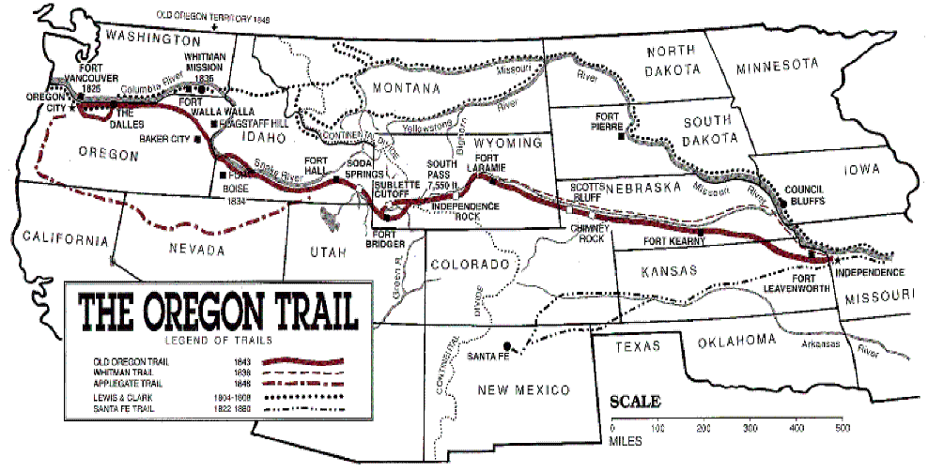
The Oregon Trail
Directions: One of the most popular routes to the west in the mid-1800’s was the 2,000 mile Oregon Trail. Research about the trail here http://ow.ly/DhIG30fG8J8 here http://ow.ly/tPxV30fG8LW and here http://ow.ly/zrJx30fG95Y to complete the prompts below..
When did the travel on the Oregon Trail begin?
Where did the trail begin and end?
How long was the journey from the Missouri "jumping off" place to California or Oregon?
What is meant by the “jumping off” place?
How long did the trip take on the average?
What if they ran out of food or other materials along the way?
Why did people go west?
How many travelers followed the trails to California and Utah?
How many people died on the Oregon Trail?
What kinds of illnesses did people get while traveling?
What were some other causes of death on the trail?
How many travelers were killed by Indians and vice versa?

Slide 10
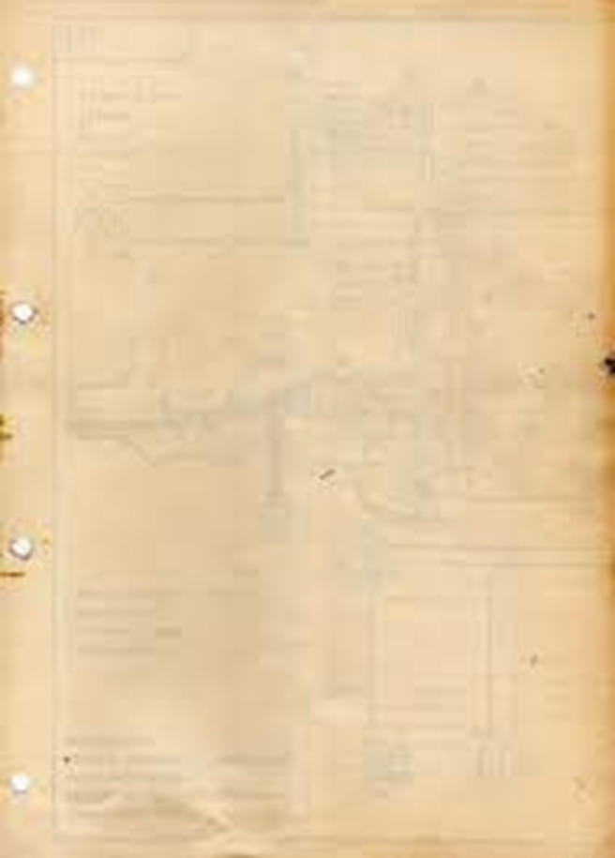
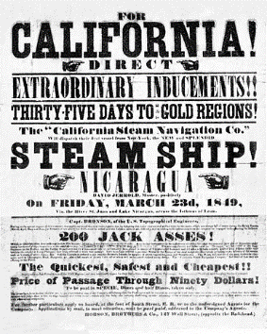
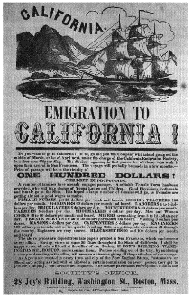
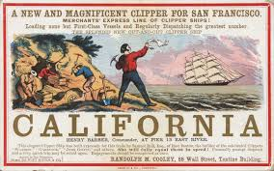
The California Gold Rush
Directions: The discovery of gold in Northern California in 1848 radically changed America as the subsequent Gold Rush brought thousands to the West Coast. Read here http://ow.ly/U5Fr30fG7Z7 here http://ow.ly/tz8530fG82O to answer the prompts below.
Who were the 49rs?
Why were they going to California?
What were some of the troubles they faced heading West?
How did this change
the nation?
What did this mean for
Native Americans?

Slide 11
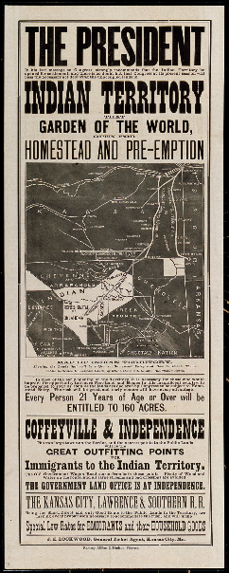
The Homestead Act
Directions: In 1862, President Lincoln officially signed the Homestead Act into law. After researching more about the Act, here http://ow.ly/7luD30fGbf8 explain the reasons for its passage, what the Act did, what the opposition to it was, and the effect that it had on the U.S.
Signed into law in May 1862, the Homestead Act opened up settlement in the western United States, allowing any American, including freed slaves, to put in a claim for up to 160 free acres of federal land. By the end of the Civil War, 15,000 homestead claims had been established, and more followed in the postwar years. Eventually, 1.6 million individual claims would be approved; nearly ten percent of all government held property for a total of 420,000 square miles of territory.
The Homestead Act (May 20, 1862) set in motion a program of public land grants to small farmers. Before the Civil War, the southern states had regularly voted against homestead legislation
because they correctly foresaw that the law would hasten the settlement of western territory, ultimately adding to the number and political influence of the free states. This opposition to the homestead bill, as well as to other internal improvements that could hasten western settlement, exacerbated sectional conflicts. Indeed, the vision of independent yeomen establishing homesteads on the prairies was offered in the political rhetoric of the 1850s as a vivid contrast to the degradation of slave labor on southern plantations.
A homestead bill passed the House in 1858 but was defeated by one vote in the Senate; the next year, a similar bill passed both houses but was vetoed by President James Buchanan. In 1860, the Republican platform included a plank advocating homestead legislation.
The Homestead Act remained in effect for more than 100 years. The final claim, for 80 acres in southeastern Alaska, was approved in 1988.
After the southern states had seceded, homestead legislation was high on the Republican agenda. The Homestead Act of 1862 provided that any adult citizen (or person intending to become a citizen) who headed a family could qualify for a grant of 160 acres of public land by paying a small registration fee and living on the land continuously for five years. If the settler was willing to pay $1.25 an acre, he could obtain the land after only six months’ residence.
But the law did not provide the new beginning for urban slum dwellers that some had hoped; few such families had the resources to start farming, even on free land. The grants did give new opportunities to many impoverished farmers from the East and Midwest, but much of the land granted under the Homestead Act fell quickly into the hands of speculators. Also, over time, the growing mechanization of American agriculture led to the replacement of individual homesteads with a smaller number of much larger farms.
Reasons for the Act
What the Act did
Opposition to the Act
Effect of the Act on the US

Slide 12
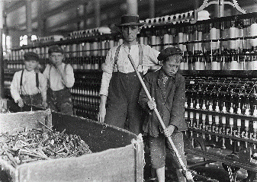
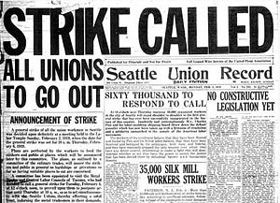
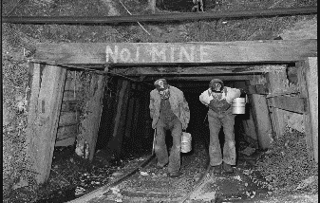
Labor Unions
American have long cherished the ideal of equality. Unlike European countries, the United States has never had monarchs or noble families who held economic and political power just because they were part of an upper class. In the Gilded Age, however, a class system started to emerge in the United States. That is, society began to divide into unequal groups based on wealth and power. In 1879, an economist Henry George described this change as an “immense wedge” being forced through society. “Those who are above the point of separation are elevated, but those who are below are crushed down.” These people being crushed belonged to the working class. History Alive Ch 14
Directions: Continue researching in History Alive: Chapters 14 & 17 as well as
the Breaker Boys, The Jungle, and Killing for Coal books in order to respond to the prompts below.
What were working conditions like? (Sweatshops)
What were living conditions like?
(Tenement housing)
What was child labor?
National Child Labor Committee?
Who were the Knights of Labor?
The American Federation of Labor?
Define:
Haymarket Affair
Homestead Strike
Pullman Strike
Who was Jane Adams?
What was the Hull House?
What are worker’s
compensation laws?

