Slide 1
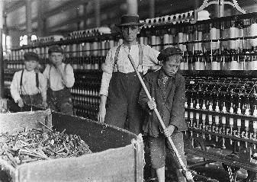
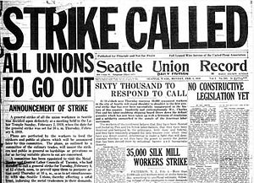
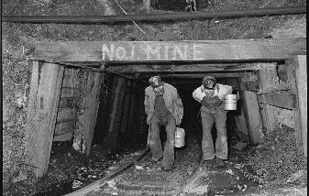
Labor Unions
American have long cherished the ideal of equality. Unlike European countries, the United States has never had monarchs or noble families who held economic and political power just because they were part of an upper class. In the Gilded Age, however, a class system started to emerge in the United States. That is, society began to divide into unequal groups based on wealth and power. In 1879, an economist Henry George described this change as an “immense wedge” being forced through society. “Those who are above the point of separation are elevated, but those who are below are crushed down.” These people being crushed belonged to the working class. History Alive Ch 14
Directions: Continue researching in History Alive: Chapters 14 & 17 as well as the Breaker Boys, The Jungle, and Killing for Coal books in order to respond to the prompts below.
What were working conditions like? (Sweatshops) What were living conditions like? (Tenement housing)
What was child labor?
National Child Labor Committee?
Who were the Knights of Labor?
The American Federation of Labor?
Define: Haymarket Affair Homestead Strike Pullman Strike
Who was Jane Adams?
What was the Hull House?
What are worker’s compensation laws?

Slide 2
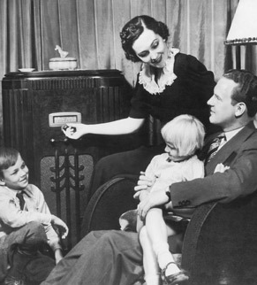
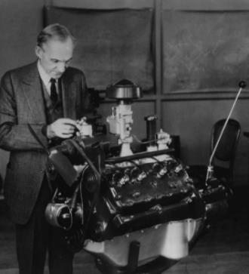
Innovations
Directions: Art, literature, music, dance, and movies all helped shape the culture of the nation, mass media and mass production emerged to tell the world. Research the radio http://ow.ly/zxah30fvyq5 and the automobile http://ow.ly/1wvv30fvyuN
In order to complete the graphic organizer below. Also History Alive! Chapter 28
Mass media
Mass production
The radio was the innovation that contributed most to the development of a national popular culture in the 1920’s. Why?
Henry Ford was responsible for the assembly line. Summarize the impact that had on society and also include how the radio fit into mass production.
What is another significant invention from the 1920’s? How did it help shape society?
Thinking ahead (World War II): How do you think these innovations impacted society during times of war?

Slide 3
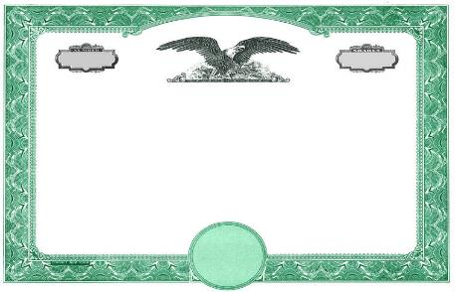
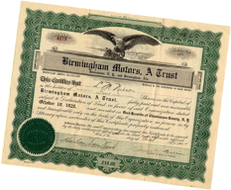
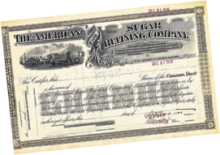
Depressing 30’s
Directions: The rise in modernity, roar of the 20’s, new innovations, and the continued post-war sentiment changed society, industry, and the way that supply and demand worked within each.
Industry had thrived in the 1920’s because manufacturers were able to make a lot of merchandise very quickly. The ability to mass-produce a wide range of consumer goods started the stock boom. However , for mass production to succeed, people had to buy the goods being churned out of factories. By the late 1920s, demand for consumer goods could not keep up with production. People simply could not afford to buy all that was being produced. The resulting glut of goods in the market, combined with the stock market crash and the bank crisis, caused the economy to collapse.
The Wall Street Crash of 1929, also known as Black Tuesday, was the most devastating stock market crash in America’s history and marked the beginning of the Great Depression.
Research the following page, as well as continuing reading in Chapter 30 of History Alive! To explain how each of the causes listed on the stock certificate below led to the crash.
Buying on Margin
Overproduction
Underconsumption
Hawley-Smoot Tariff Act

Slide 4
Great Depression Timeline Sort
Directions: The Great Depression began suddenly, but dragged on for a decade. Rearrange the boxes below by dragging and dropping them so that they are in the correct order and match the correct year.
WWI veterans march on Washington DC demanding the bonuses they were promised for their service.
1929
1931
FDR announces a 4-day “bank holiday” while working on a plan to prevent bank failures.
1932
FDR is elected to an unprecedented 3rd term as president as threat of a world war looms.
1933
The stock market crashes and over $30 billion in stock value eventually disappears.
1933
FDR takes office after winning a landslide election in November and replaced Hoover as president.
1934
FDR is elected to his 2nd term, winning every state except Maine & Vermont.
1935
Banks failures become frequent and many Americans lose all they had deposited.
1936
Dust storms blanket the midwest and send deposits as far east and NY and Boston.
1940
The Social Security Act is signed into law to provide benefits for retirees and the unemployed.

Slide 5
FDR’s New Deal
Directions: President Roosevelt’s New Deal created dozens of federal agencies designed to help ease the Depression. Since most had abbreviated nicknames, it became known as an “Alphabet Soup”. Match the definition of each agency to its abbreviation arrow also giving the full name of the agency and if each reform was able to help Americans’ living conditions.
Provided deposit insurance to depositors in US banks in order to restore trust in the American banking system.
Used bonds to issue new mortgages to families currently in default and to prevent foreclosure.
Gave jobs to millions of unemployed people to carry out public works projects, including the construction of public buildings and roads.
Provided flood control, electricity generation, and economic development in the Tennessee Valley.
Provided unskilled manual labor jobs related to the conservation and development of natural resources in rural lands.
Paid farmers subsidies not to plant on part of their land and to kill off excess livestock in order to raise the value of crops.

Slide 6
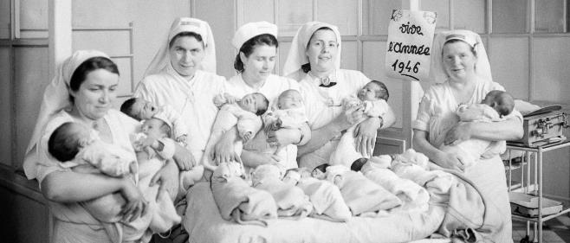
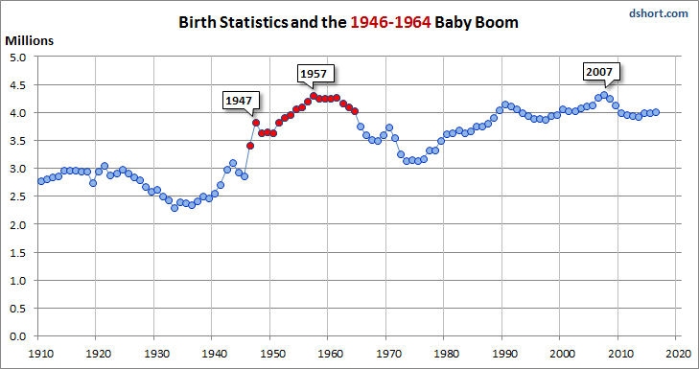
Baby Boom
Directions: Follow the link in order to answer the questions in the organizer.
https://www.khanacademy.org/humanities/us-history/postwarera/postwar-era/a/the-baby-boom
What was the Baby Boom and when did it happen?
How did this help the US economy?
What historical events led to the Baby Boom?
How did the Baby Boom relate to the Great Depression and World War II

Slide 7
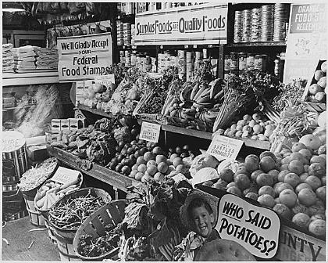
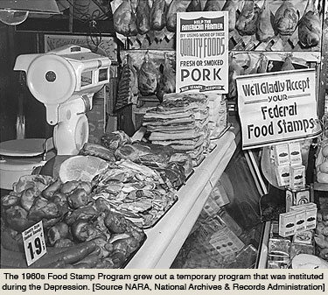
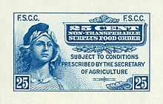
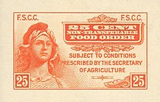
Food Stamps
Directions: Follow the link in order to answer the questions in the organizer.
https://time.com/4711668/history-food-stamp-fraud/
What year were food stamps implemented?
By 1943 how many people were on food stamps?
What event caused the food stamp era to die out?
Why did president Kennedy reintroduce foodstamps in the 1960s?

Slide 8
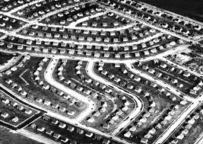
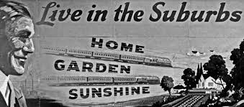
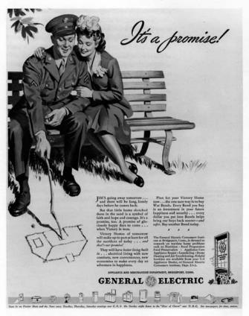
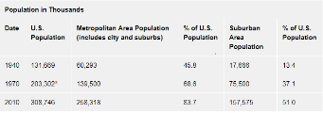
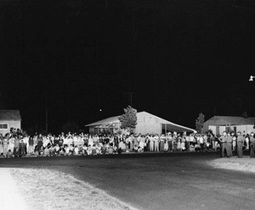
Suburbanization
Directions: Follow the link in order to answer the questions in the organizer.
https://oxfordre.com/americanhistory/view/10.1093/acrefore/9780199329175.001.0001/acrefore-9780199329175-e-64
After WWII, Americans left the city and migration to where?
What percentage of Americans lived in the suburbs before WWII?
What habits were formed by Americans as a result of suburbanization?
What consequences did suburbanization have on racial issues in post WWII America?

Slide 9
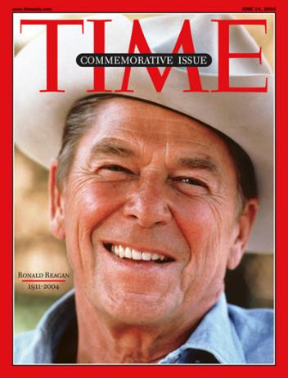
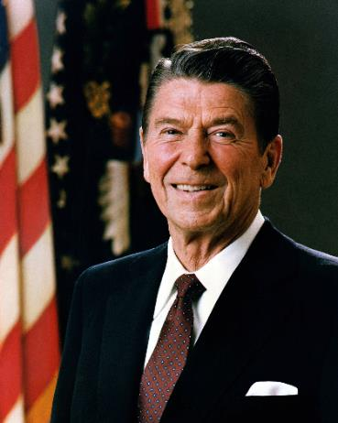
The Reagan Years
Ronald Reagan, a former movie actor and Republican governor of California, made an appealing presidential candidate. His friendly manner and positive, “can-do” attitude won the support of voters across the country.
Directions: Continue reading in History Alive! Chapter 55 as well as following these links
https://www.reaganlibrary.gov/sreference/the-reagan-presidency
https://tinyurl.com/yahpua5z
https://www.history.com/topics/us-presidents/ronald-reagan
In order to respond to the prompts below.
What was the Tax Reform Law of 1986?
What was the Intermediate Nuclear Force Treaty at the Washington Summit in December, 1987?
Who was Sandra Day O’Connor? Why is she significant?
What was President Reagan’s quote in regards to the Berlin Wall? What happened?
What was the Iran-Contra Affair? What did it mean for the Reagan Legacy?

Slide 10
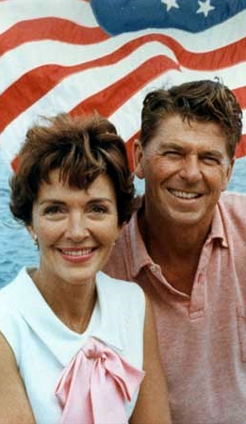
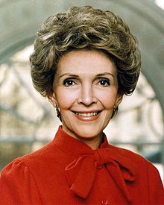
First Lady
Nancy Reagan was an American film actress and the wife of Ronald Reagan, the 40th President of the United States. She was the First Lady of the United States from 1981 to 1989. Her husband’s decision to appoint the first woman justice to the Supreme Court as well as her own contributions as First Lady played a significant part involving the impact of gender roles on social, political, and economic life in the U.S.
Directions:Continue reading in History Alive! Chapter 55 as well as following these links
https://tinyurl.com/26dwrwt and https://tinyurl.com/ybaxecsw
https://www.britannica.com/biography/Nancy-Reagan
in order to respond to the prompts below.
Nancy replaced the White House China. Why was this an issue?
What was Nancy’s response to the assassination attempt on her husband?
What was the Foster Grandparents Program?
Nancy was the first first lady to address the United Nations General Assembly in 1988. What was her agenda?
What was the 1986 "National Crusade for a Drug Free America" bill?

Slide 11
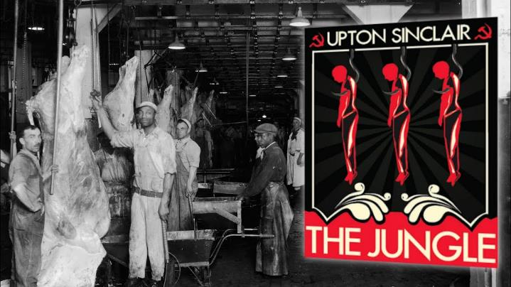
The Jungle - Upton Sinclair
Directions: Read the introduction to the novel “The Jungle” for the DBQ on the following pages.
Sinclair began writing dime store novels at age 15. Born in Baltimore, Maryland in 1878. By his death in 1968 he had written more than 80 books. He said in 1962”You don’t have to be satisfied with America as you find it. You can change it.” Change it he did! Upton Sinclair is best remembered for his novel The Jungle published in 1906. He wrote it to expose his research of the Chicago meatpacking industry. His novel directly led to the passage of the Pure Food and Drug Act of 1906.

Slide 12
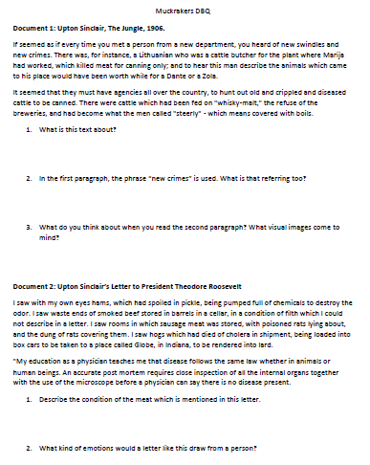

Slide 13
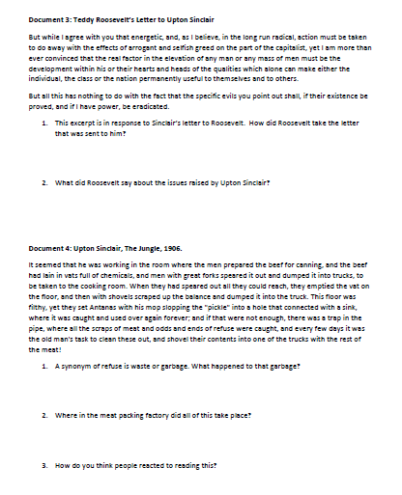

Slide 14
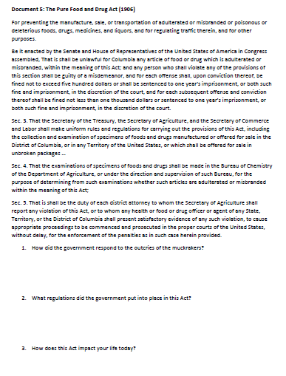

Slide 15
