Slide 2
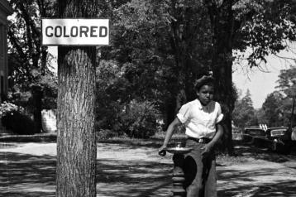
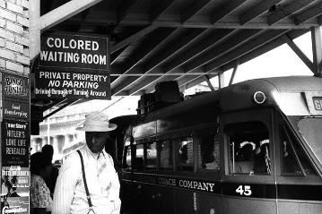
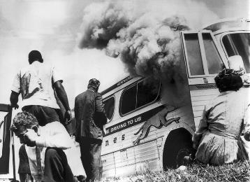
Jim Crow Laws
Directions: In the 35 years since the end of the Civil War and abolition of slavery, African Americans had made few gains in the struggle for equality. Many southern states had passed Jim Crow laws that segregated blacks from whites in trains, schools, hospitals, and other public places.. Follow these links https://www.history.com/topics/jim-crow-laws and http://www.pbs.org/wgbh/americanexperience/features/freedom-riders-jim-crow-laws/ and http://www.pbs.org/wgbh/americanexperience/films/freedomriders/ in order to complete the graphic organizer below. Give details. Also History Alive: Chapter 16
What were Jim Crow laws?
What were the Black Codes?
Who was Ida B. Wells?
What were obstacles to the 15th Amendment?
What is NAACP?
Who were the
Freedom Riders?

Slide 3
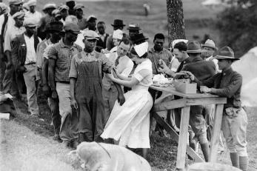
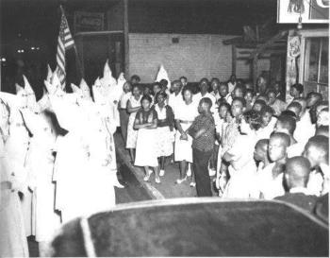
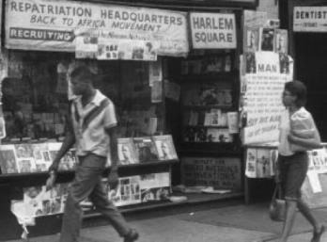
President Wilson asked Americans to help make the world “safe for democracy,” but many African Americans wondered more about democracy at home. With lynchings, Jim Crow laws, and segregated army units, some were not sure what they should be fighting for.
Research more in, History Alive: Chapter 24 and follow these links http://www.ushistory.org/us/47c.asp and http://www.history.com/topics/ku-klux-klan and https://www.history.com/topics/black-history/great-migration
in order to complete the organizer below.
The Great Migration
What was the Great Migration?
What is Americanization?
What is meant by intolerance?
What was the Chicago Race Riot of 1919?
What was the “Back to Africa” movement?
Why did the 1920’s see a resurgence in the KKK?

Slide 4
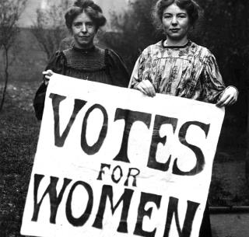
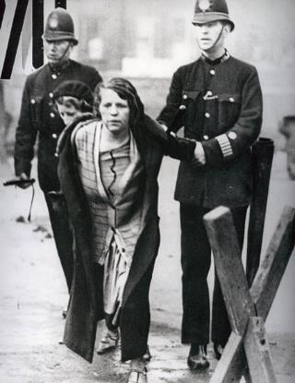
Female Suffrage
Directions: On Election Day in 1920, millions of American women exercised their right to vote for the
first time. It took activists and reformers nearly 100 years to win that right, and the campaign was not easy: Disagreements over strategy threatened to cripple the movement more than once. But on August 26, 1920,
the 19th Amendment to the Constitution was finally ratified, enfranchising all American women
and declaring for the first time that they, like men, deserve all the rights and responsibilities of citizenship.
Follow these links http://ow.ly/oLDv30fomwO and http://ow.ly/f1Pw30foj6v in order to complete the organizer
Who supported suffrage for women?
What was the first convention called to discuss women’s rights?
How did these groups campaign for women’s suffrage and equal rights?
What obstacles were faced in the fight for their rights?
Did women gain suffrage?
If so, when?
What annual event regarding women began in the year 1921?

Slide 5
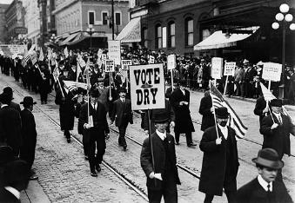
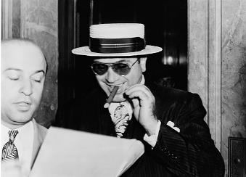
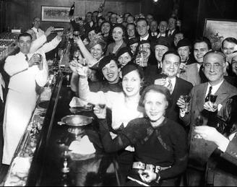
Prohibition in America
Directions: Prohibition was the nationwide ban on the sale, production, importation, and transportation of alcoholic beverages in the US from 1920 to 1933. Follow these links https://prohibition.osu.edu/ and http://www.pbs.org/kenburns/prohibition/about/ and http://ow.ly/vk7030foiTl in order to complete the graphic organizer below.
Who supported prohibition?
What Amendment
created Prohibition?
Why was the
Amendment passed?
What were the unintended effects of Prohibition?
What Amendment eventually repealed Prohibition?
Why was Prohibition repealed?

Slide 6
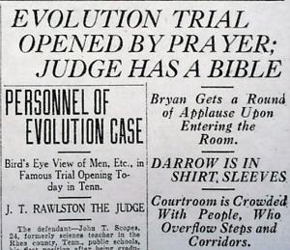
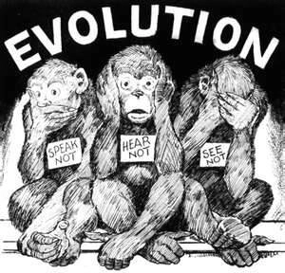
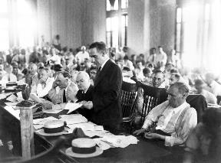
The Scopes Monkey Trial
Directions: In 1925, a Biology teacher in Tennessee was taken to court and fined for teaching Darwin’s theory of evolution. This case reflected the clash between values in the 1920s. Follow these links http://www.ushistory.org/us/47b.asp and http://ow.ly/rEpr30fon7P to complete the graphic organizer.
What is the basis of the trial?
Why is it referred to the “monkey trial”?
What was the outcome?
Why is this trial so significant?

Slide 7
stock market crash | credit | innovation | buying on margin | speculation

Slide 8
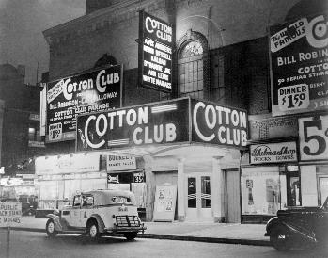
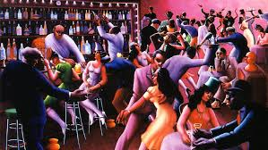
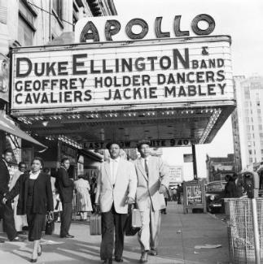

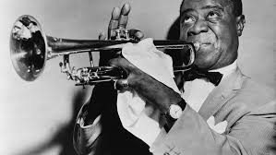
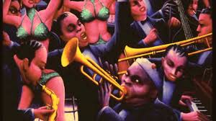
Roaring 20’s
Directions: The Harlem Renaissance was a movement of African-American culture that was an outpouring of creativity among poets, artists, writers, musicians, actors, and performers some of who became famous that began in the New York City neighborhood of Harlem in the 1920's. Follow these links http://www.loc.gov/rr/program/bib/harlem/harlem.html and http://ow.ly/YkK630fjtW0
in order to interpret the images below as to how they pertain to the Harlem Renaissance..

Slide 9
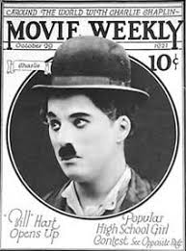
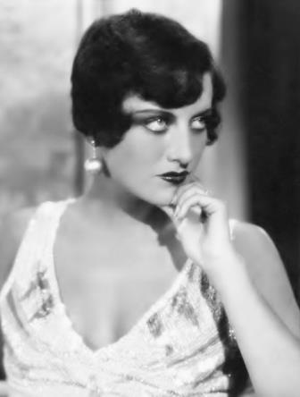
Roaring 20’s
Directions: The 1920s' were a period of economic prosperity, changing social roles,
advances in technology, and a new and vibrant culture. Research the film industry here
http://www.1920-30.com/movies/ watch flappers here http://ow.ly/RBsp30fjrAI , read about
them here http://ow.ly/NnjA30fjshi also in the primary source letter on the following pages
in order to discuss their significance in shaping 1920’s culture using the prompts below.
Charlie Chaplain
Joan Crawford
The first movies were silent films but by the late 1920’s, the first movies with sound were available to audiences.
Describe how the film industry shaped society.
What did conservatives think?
The Famous Flappers of the Roaring Twenties era were constantly in the newspapers. Why?
Why did young American women admire them?
What did the older generation think of them?

Slide 12
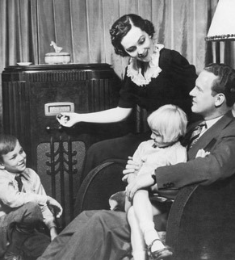
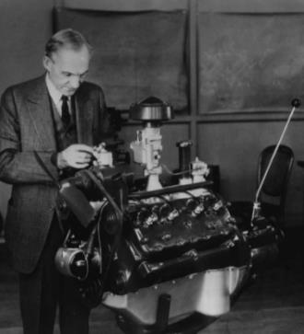
Innovations
Directions: Art, literature, music, dance, and movies all helped shape the culture of the nation, mass media and mass production emerged to tell the world. Research the radio http://ow.ly/zxah30fvyq5 and the automobile http://ow.ly/1wvv30fvyuN
In order to complete the graphic organizer below. Also History Alive! Chapter 28
Mass media
Mass production
The radio was the innovation that contributed most to the development of a national popular culture in the 1920’s. Why?
Henry Ford was responsible for the assembly line. Summarize the impact that had on society and also include how the radio fit into mass production.
What is another significant invention from the 1920’s? How did it help shape society?
Thinking ahead (World War II):
How do you think these innovations impacted society during times of war?

Slide 13
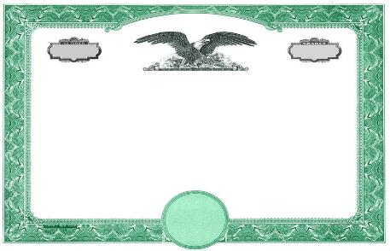
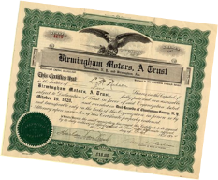
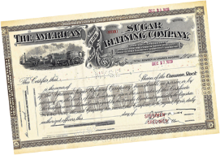
Depressing 30’s
Directions: The rise in modernity, roar of the 20’s, new innovations, and the continued post-war sentiment changed society, industry, and the way that supply and demand worked within each.
Industry had thrived in the 1920’s because manufacturers were able to make a lot of merchandise very quickly. The ability to mass-produce a wide range of consumer goods started the stock boom. However , for mass production to succeed, people had to buy the goods being churned out of factories. By the late 1920s, demand for consumer goods could not keep up with production. People simply could not afford to buy all that was being produced. The resulting glut of goods in the market, combined with the stock market crash and the bank crisis, caused the economy to collapse.
The Wall Street Crash of 1929, also known as Black Tuesday, was the most devastating stock market crash in America’s history and marked the beginning of the Great Depression.
Research the following page, as well as continuing reading in Chapter 30 of History Alive! To explain how each of the causes listed on the stock certificate below led to the crash.
Buying on Margin
Overproduction
Underconsumption
Hawley-Smoot Tariff Act

Slide 14






FDR’s New Deal
Directions: President Roosevelt’s New Deal created dozens of federal agencies designed to help ease the Depression. Since most had abbreviated nicknames, it became known as an “Alphabet Soup”. Match the definition of each agency to its abbreviation arrow also giving the full name of the agency and if each reform was able to help Americans’ living conditions.
Provided deposit insurance to depositors in US banks in order to restore trust in the American banking system.
Used bonds to issue new mortgages to families currently in default and to prevent foreclosure.
Gave jobs to millions of unemployed people to carry out public works projects, including the construction of public buildings and roads.
Provided flood control, electricity generation, and economic development in the Tennessee Valley.
Provided unskilled manual labor jobs related to the conservation and development of natural resources in rural lands.
Paid farmers subsidies not to plant on part of their land and to kill off excess livestock in order to raise the value of crops.

Slide 15
Great Depression Timeline Sort
Directions: The Great Depression began suddenly, but dragged on for a decade. Rearrange the boxes below by dragging and dropping them so that they are in the correct order and match the correct year.
WWI veterans march on Washington DC demanding the bonuses they were promised for their service.
1929
1931
FDR announces a 4-day “bank holiday” while working on a plan to prevent bank failures.
1932
FDR is elected to an unprecedented 3rd term as president as threat of a world war looms.
1933
The stock market crashes and over $30 billion in stock value eventually disappears.
1933
FDR takes office after winning a landslide election in November and replaced Hoover as president.
1934
FDR is elected to his 2nd term, winning every state except Maine & Vermont.
1935
Banks failures become frequent and many Americans lose all they had deposited.
1936
Dust storms blanket the midwest and send deposits as far east and NY and Boston.
1940
The Social Security Act is signed into law to provide benefits for retirees and the unemployed.

