Slide 1
Japan | Germany | USA | Great Britain | France | Soviet Union | Italy
Axis Powers | Allied Powers
rationing | leapfrogging | propaganda | kamikaze
Truman Doctrine | Marshall Plan | Berlin Airlift | NATO

Slide 2
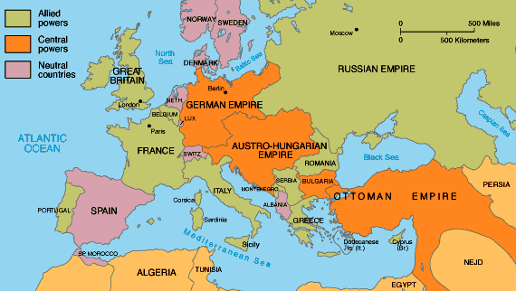
Neutrality Acts
For most Americans, the war was a distant conflict that did not concern them. Few felt alarmed by its outbreak. In September 1914, Theodore Roosevelt smugly observed that the US was lucky to be almost “alone among the great civilized powers being unshaken by the present worldwide war.” Research more in Chapter 34 of History Alive! in order too respond to the prompts below.
1) The Neutrality Acts (1935 to 1937) were intended to keep the United States from
  being drawn into a European war
  provoking a war with Japan
  a war to protect the Panama Canal
  aiding the Axis Powers
2) Define each
Isolationism | Fascism | Totalitarianism
Nazism | Nationalism | Militarism
3) According to the map, which European countries were neutral?

Slide 3
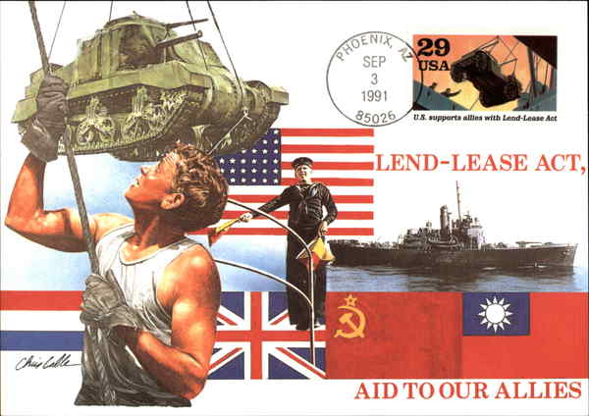
Lend Lease Act
After war broke out in Europe, isolationism lost some of its appeal for Americans. Most now openly supported the Allies. Hoping to keep the United States out of the war, Hitler sought to expand his alliance. In September 1940, Germany, Italy, and Japan signed the Tripartite Pact, making Japan a member of the Axis powers. The three nations agreed to provide mutual support in the event of an attack by a country not yet in the war. The attacker they had in mind was the United States. Continue reading History Alive! Chapter 34 in order to respond to the prompts below.
If the United States
entered the war, who would they have to fight?
What did the
Neutrality Acts ban?
Define the
Lend Lease Act.
What is meant by
“fight on two fronts”?
What was
“cash and carry”?
What was the outcome
of the Lend Lease Act?

Slide 4
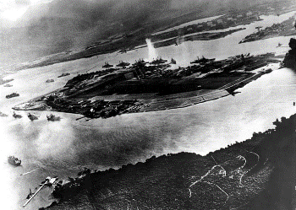
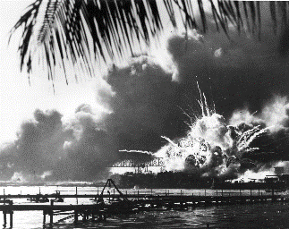
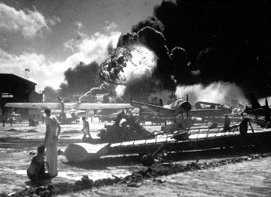
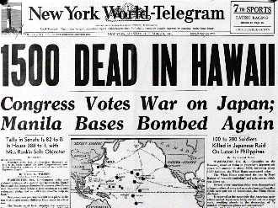
Pearl Harbor
From 1940 to 1941, Japan continued seeking raw materials through conquest. It occupied French Indochina, in Southeast Asia, and set its sights on the Dutch East Indies. Its goal was to push Western powers out and establish a “new order in East Asia,” with Japan at the center. The United States tried to undercut Japan’s aggression in several ways. It sent loans and other aid to Japan’s enemy, China, and froze Japanese assets in American banks. It also blocked the export of vital resources, including oil, to Japan. Relations between the two nations steadily worsened.
By 1941, American intelligence officers had managed to intercept and decode secret messages from Japan to its foreign offices. Late in the year, officers learned of a coming attack on American territory in the Pacific Ocean. They thought the attack might target an American base in the Philippines. Instead it was aimed at Pearl Harbor, Hawaii – the home of the U.S. Pacific Fleet.
When was Pearl Harbor attacked? How long did the attack last?
How many Japanese bombers and fighter planes attacked Pearl Harbor?
How many U.S. ships were damaged or sunk? How many U.S.military aircraft were damaged or destroyed?
How many Americans were killed and how many were wounded? How many Japanese planes were lost?
What did U.S. President Roosevelt do in response? What did Germany and Italy do in response?

Slide 5
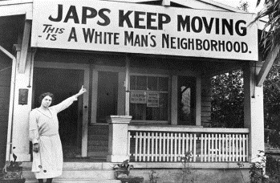
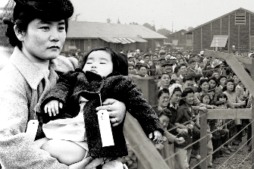
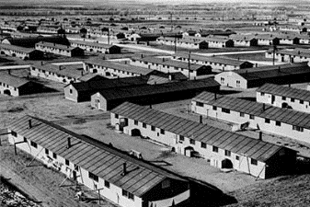
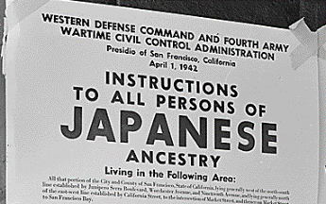
Japanese-American Internment
Directions: Starting in 1942, the US government forced about 110,000 Japanese-Americans who lived along the west coast into camps called “War Relocation Camps”. Most of the people held were there until the war ended in 1945. Follow this link https://www.archives.gov/research/alic/reference/military/japanese-internment.html
then answer the questions and provide pictures for the spaces below.
What was Executive Order 9066?
Why was it enacted?
How do you think it felt to grow up in the conditions you see below?
How do you think Japanese-Americans reacted to attitudes like the one above?
Do you feel the US was justified in “relocating” Japanese-Americans? Explain.
Japanese Americans were placed in internment camps during World War II
        due to numerous acts of espionage and sabotage
        in retaliation for the placement of Americans in concentration camps by the Japanese
        because they were seen as a threat to national security
        because many were loyal to Japan

Slide 6
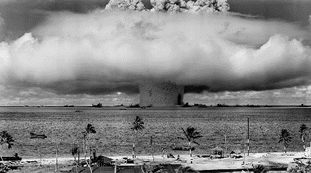
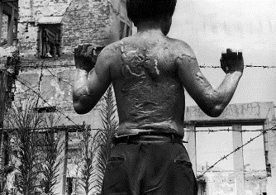
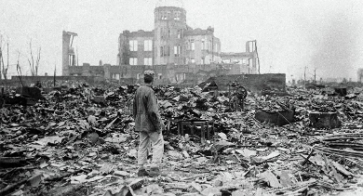
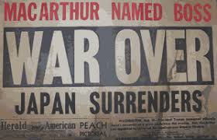
Hiroshima & Nagasaki
Directions:.The atomic bombs dropped on Japan had a devastating effect. The searing
heat from the blasts turned thousands of people into ash. Birds caught fire in midflight.
Clothing, trees, and wooden building exploded into flames. Survivors suffered from
sever burns, radiation sickness, and later, cancer. History Alive Chapter 36
The atomic bomb attacks on Hiroshima and Nagasaki prompted Japan to surrender
to the Allies on August 14, 1945. Continue reading in the textbook and follow these links
https://tinyurl.com/ya5bd6uw and https://tinyurl.com/ybs7qtx6
https://www.youtube.com/watch?v=b293Ok7FLV4
In order to respond to the prompts below.
What was the Manhattan Project?
What was “Fat Man” and “Little Boy”?
What effects (immediate and lasting) did the bombs have on the people in its path?
Was the United States justified in dropping the atomic bombs? Why or why not?

Slide 8
An end to neutrality
Pearl Harbor brought an abrupt end to American isolationism in December 1941
FDR had already been readying the nation for war
Many US industries already producing war goods
FDR encouraged an “arsenal for democracy”
1940 FDR had increased size of the navy
Congress passes War Powers Act
Gave FDR unprecedented control over the nation
FDR creates:
War production Board (WPB)
National War Labor Board (NWLB)
Office of Price Administration (OPA)
Office of War Mobilization (OWM)
Late 1942 1/3 economy committed to war production

Slide 9
Economic recovery
US becomes the world’s largest manufacture of armaments
300,000 planes
2.6 million machine guns
6 million tons of bombs
91,000 cargo/war ships
WWII will lead the US out of the Great Depression
US government spends 250 million a day (320 billion)
Keynesian economics
17 million jobs created
Corporate profits up 70%
Real industrial wages up 50%
Closing gap between rich and poor
Unprecedented prosperity for most Americans

Slide 10
Public sacrifice
Shortages of goods created inflation
Rationing of goods common
Voluntary & Gov. supervised
Increased wages lead to a high percentage of savings
FDR’s Revenue Act raised taxes for most Americans
Propaganda tied sacrifice directly to the war effort
Pushed voluntary conservation measures
Encouraged enlistment
Promoted bond sales
To manage propaganda, FDR creates Office of War Information (OWI)
Emphasized a good vs evil struggle
Promoted total destruction of the enemy
Villainized the enemy (particularly the Japanese)

Slide 11
Changing roles of women
Working women were a social stigma during the Great Depression (took jobs from men)
Federal government urged women into war production
Allowed men to serve in the military
More than 1/3 of labor force
Many women held nontraditional jobs breaking gender stereotypes
Gov. allowed gender discrimination in many industries
Women made 65% of man’s salary
Mothers were derided for taking jobs
Blamed for abandoning children
Women filled a number of non-combat roles (over 300k enlist)
War had a lasting impact on impression of women in society

Slide 12
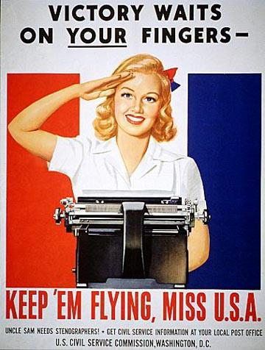

Slide 13
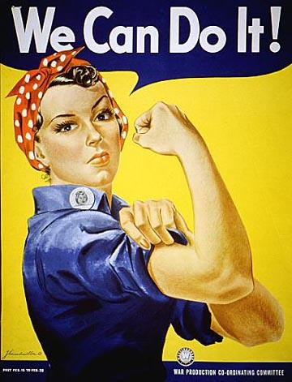

Slide 14
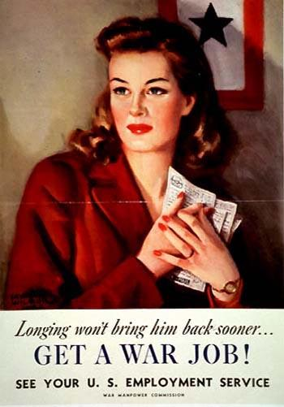

Slide 15
Minority groups during the war
African Americans
Major push to fight discrimination
NAACP membership grew
Campaigned for anti-lynching laws and against poll taxes
Congress of Racial Equality (CORE) founded in 1942
Were discriminated against in war industries
A. Philiip Randolph threatened a march on Washington
Led FDR to issue Executive Order 8802
Creates the Fair Employment Practices Commission
Protests led to minimal gains
Served in segregated military units
Many units served with distinction
Violent race riots occurred across the country

Slide 16
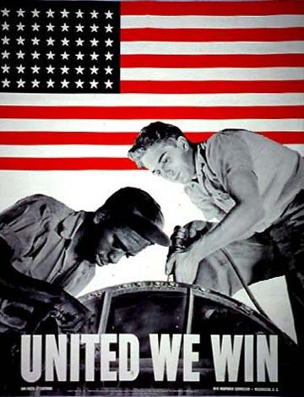

Slide 17
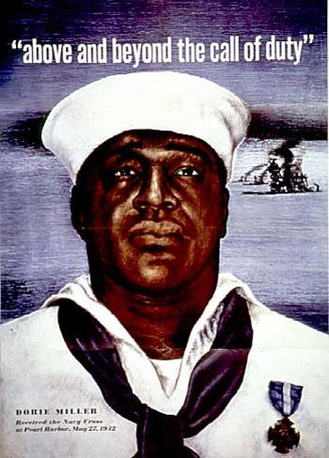

Slide 18
Minority groups during the war
Native Americans
Many Native Americans attempt to leave reservations
Find discrimination
Led to formation of National Congress of American Indians
A few joined the military, (Navajo Code Talkers)
Latinos
Bracero program
Initially imported “foreign laborers” into the US
Many stayed behind rather than return
Encouraged future illegal immigration
Zoot suit riots (Summer 1943)
All minority groups volunteered/commended for military service in numbers disproportionate to pop

Slide 19
Minority groups during the war
Japanese Americans
100k First and Second generation Japanese Americans were placed in concentration camps
Rooted in anti Japanese propaganda
Japanese were labeled a security risk on the West Coast (Not in Hawaii)
FDR issued Executive Order 9066
Forced to sell property
Held for duration of war
Freed after pledging loyalty to the US
Supreme Court validated FDR’s authority
Korematsu v. US
Limited number served in military (442nd)

Slide 20
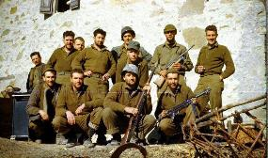
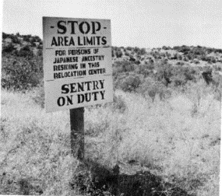
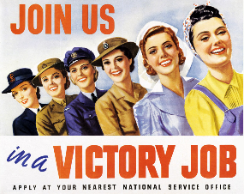
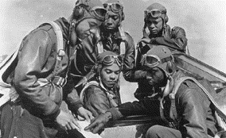
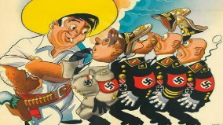
Impacts of WWII on America
With the United States fully, and officially, engaged in World War II, the nation went on a total war effort. To orchestrate the conversion of industry to supply the United States’ war effort, the Roosevelt administration created the War Production Board. The War Production Board’s responsibility was to regulate the production and allocation of materials and fuel. The board began by ending the production of non-essential goods and imposing a rationing system for various items. Continue research in Chapter 35 of History Alive! In order to respond.
Directions: Explain how the US economy changed due to World War II and how these changes impacted daily life on the home front for various groups.
American Gis
Opportunities:
Hardships:
Japanese Americans
Opportunities:
Hardships:
Women
Opportunities:
Hardships:
African Americans
Opportunities:
Hardships:
Mexican Americans
Opportunities:
Hardships:

Slide 21
containment | iron curtain | Cold War | détente

Slide 22
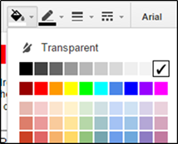
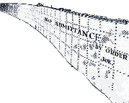
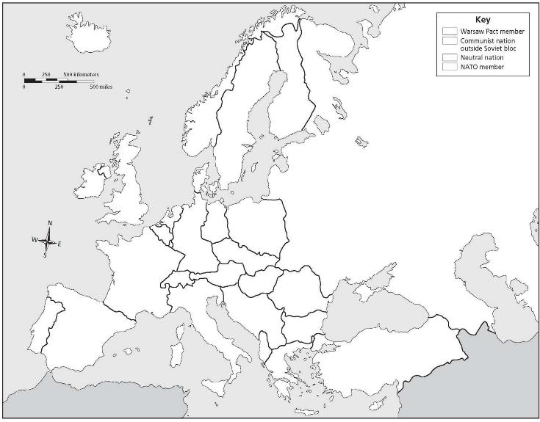
Cold War Alliances of Europe
Directions: The Iron Curtain was the symbolic division of Europe between communist countries under the Soviet Union’s influence in the east and more open countries in the west. Label each country by dragging and dropping, then use the paint bucket tool fill the text boxes to identify which alliance they belonged to. Then drag & drop the “iron curtain” to divide them.
Poland
E. Germany
Spain
Great Britain
USSR
Norway
France
Finland
Hungary
Ireland
Greece
Turkey
Bulgaria
Romania
Sweden
W. Germany
Italy
The paint bucket tool selector can be seen above - be sure you have selected a box before choosing the color. Students can also choose different colors for the alliances if they choose.
Key
Warsaw Pact
NATO
Neutral

Slide 24




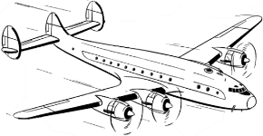
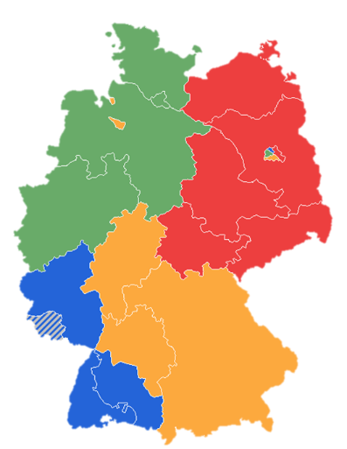


German Occupation & the Berlin Airlift
Directions: After Germany’s surrender in World War II, the country, and its capital Berlin, were divided into 4 occupation zones by the Allied countries. While France, England, and the US desired to rebuild their territories to be strong democratic allies, the Soviet Union wished to keep its former enemy weak and divided. As a result, they cut off the east and trapped those in West Berlin. Drag & drop the flags below to match the occupation zones, then read about the Berlin Airlift here and complete the boxes on the Berlin Airlift.
What was it?
Why was it necessary?
What was the result?

Slide 26
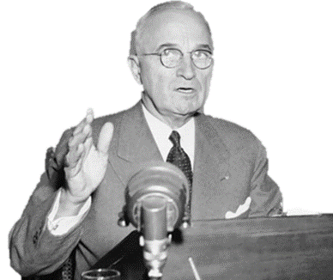

Containment & the Truman Policy
Directions: President Harry Truman began a new policy toward communism known as Containment. Learn about this policy and how it involved various strategies to prevent the spread of communism around the world. Then, for each document, describe how the US tried to contain communism in that region.
Stopping Communism in Western Europe
Stopping Communism in Asia
Stopping Communism in Latin America

Slide 29
The Marshall Plan
Directions: The Marshall Plan was America’s initiative to help Europe rebuild after World War II. The US gave $17 billion in economic support to the democratic countries of Western Europe. A popular poster supporting it used a windmill to demonstrate how all democracies should work together. You can learn more about the plan here, then describe each aspect of the Marshall Plan on the graphic organizer.
Type your response here
Type your response here
What did it do?
Who did it help?
The Marshall Plan
The Marshall Plan
Type your response here
Type your response here
Why did the US
do this?
How did it work?
c
What impact did the Marshall Plan have on Europe and the world?

Slide 31

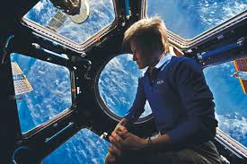

Iowan Influence
Directions: Evaluate Iowans or groups of Iowans who have influenced United States history. Follow the links in order to respond to the prompts in the box below.
https://www.jsc.nasa.gov/Bios/htmlbios/whitson.pdf
https://www.glamour.com/story/women-of-the-year-2017-peggy-whitson
https://www.nasa.gov/astronauts/biographies/peggy-a-whitson
https://tinyurl.com/y8czc9ow
Who is Peggy Whitson? Why is she significant?
What other Iowan or Iowans have influenced U.S. history?
There is a common misconception that one person cannot make a change. Much of history argues that many times significant change began with just one person.
Can you think of such a person in history?
What was the change?
Did they make the world better? Or worse?
Butterfly Effect – the scientific theory
that a single occurrence, no matter
how small, can change the course
of the universe forever.
How do you want to affect change?

Slide 32


Proxy Wars
Directions: America fought 2 wars (or Proxy Wars to be specific) during the Cold War. One in Korea and one in Vietnam. Both were intended to stop the spread of communism but had different results. Complete the Venn diagram with characteristics that apply and then some that apply to both. Think about reasons for the war, when it was fought, how, people involved, effects, perspectives on them, and their results.
Both
Korean War
Vietnam War
Explain the effects of the Vietnam conflict at home and abroad.
Define and describe each:
Hawks & Doves My Lai Massacre
Viet Cong Kent State Shootings
Vietnamization Veterans: POW/MIA

Slide 40
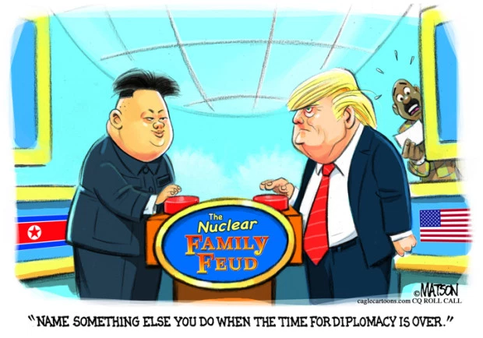
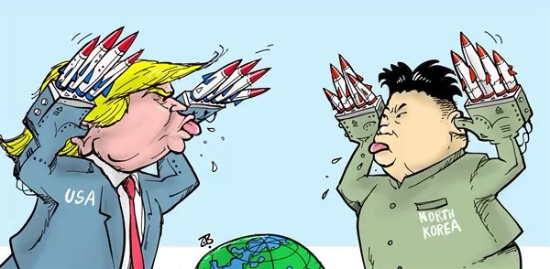
History Repeats Itself
Directions: Look at the cartoons below. Who is in them? What is happening? Why do you think that? How do you think this relates to this unit of study involving the Cold War?

