Slide 1
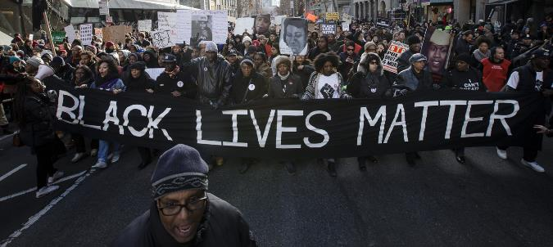
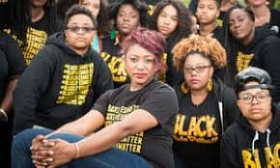
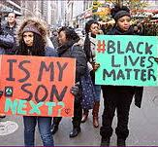
#blacklivesmatter
Directions: Follow the links in order to answer the questions in the organizer.
https://blacklivesmatter.com/ and https://blacklivesmatter.com/about/herstory/
What is the #blacklivesmatter movement?
When was it started?
By who? Why?
Find 3 news articles that discuss the movement and describe.

Slide 2

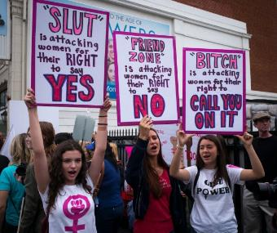
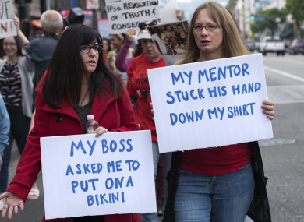
#metoo
Directions: Follow the links in order to answer the questions in the organizer.
https://metoomvmt.org/about/ and https://metoomvmt.org/
What is the #metoo movement?
When was it started?
By who? Why?
Find 3 news articles that discuss the movement and describe.

Slide 3
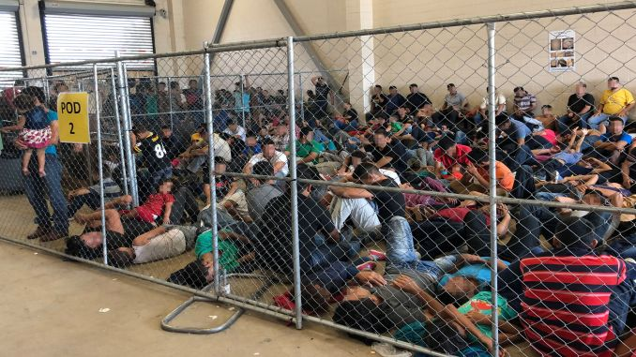
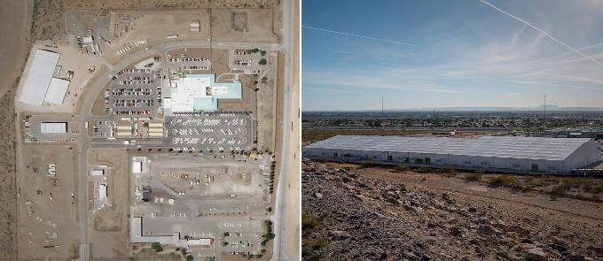
Immigration
Directions: Research online in order to answer the questions below.
How many immigrants does American see each year?
What are the top 5 ethnicities that are immigrating to the US?
What are some reasons they are moving here?
Compare and contrast: how are these reasons similar or different from the 1800s?
Describe the current confilct with immigration today.
Describe what is happening at the US/Mexico boarder
You are now running for president: Create your own immigration policy for the United States

Slide 4
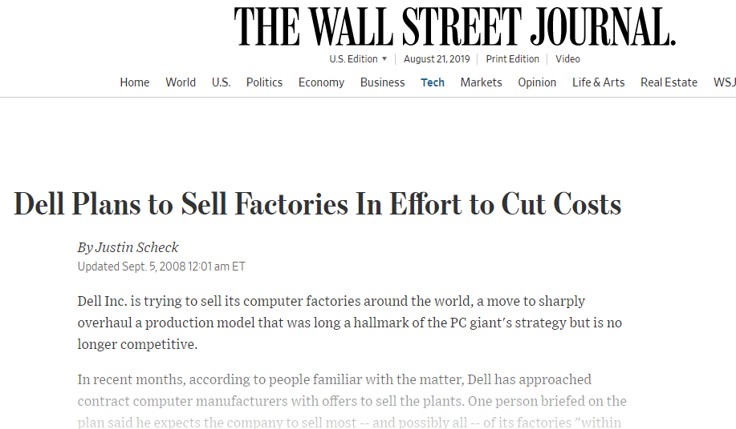
Deindustrialization
Directions: Find ads that say : Dell to close largest US manufacturing plant.. US trade deficit growing...
900 jobs lost of overseas manufacturing.. etc. in order to answer the questions below.
Explain the US used to lead the way in industrialization (recall industrial revolution worksheet?)
Possible causes of deindustrialization: have students think of reasons why we are losing factories and not leading the world in industrialization anymore.
3 reasons: https://www.thoughtco.com/reasons-for-deindustrialization-3026240
No longer have access to natural resources and raw materials. The US put a cap on what we are allowed to take. China, which does not have any laws on this, is leading the world in water pollution.
Globalization: Companies moving businesses overseas to make products cheaper. Pros: we get clothes cheaper and that countries employement raises. Cons: we lose jobs.. but cheaper items means more people spend money.
Trade Deficit: We buy more goods than we sell, causing an imbalance. Because we don't have money it makes the cost of producing goods go up so we move companies overseas.

Slide 5
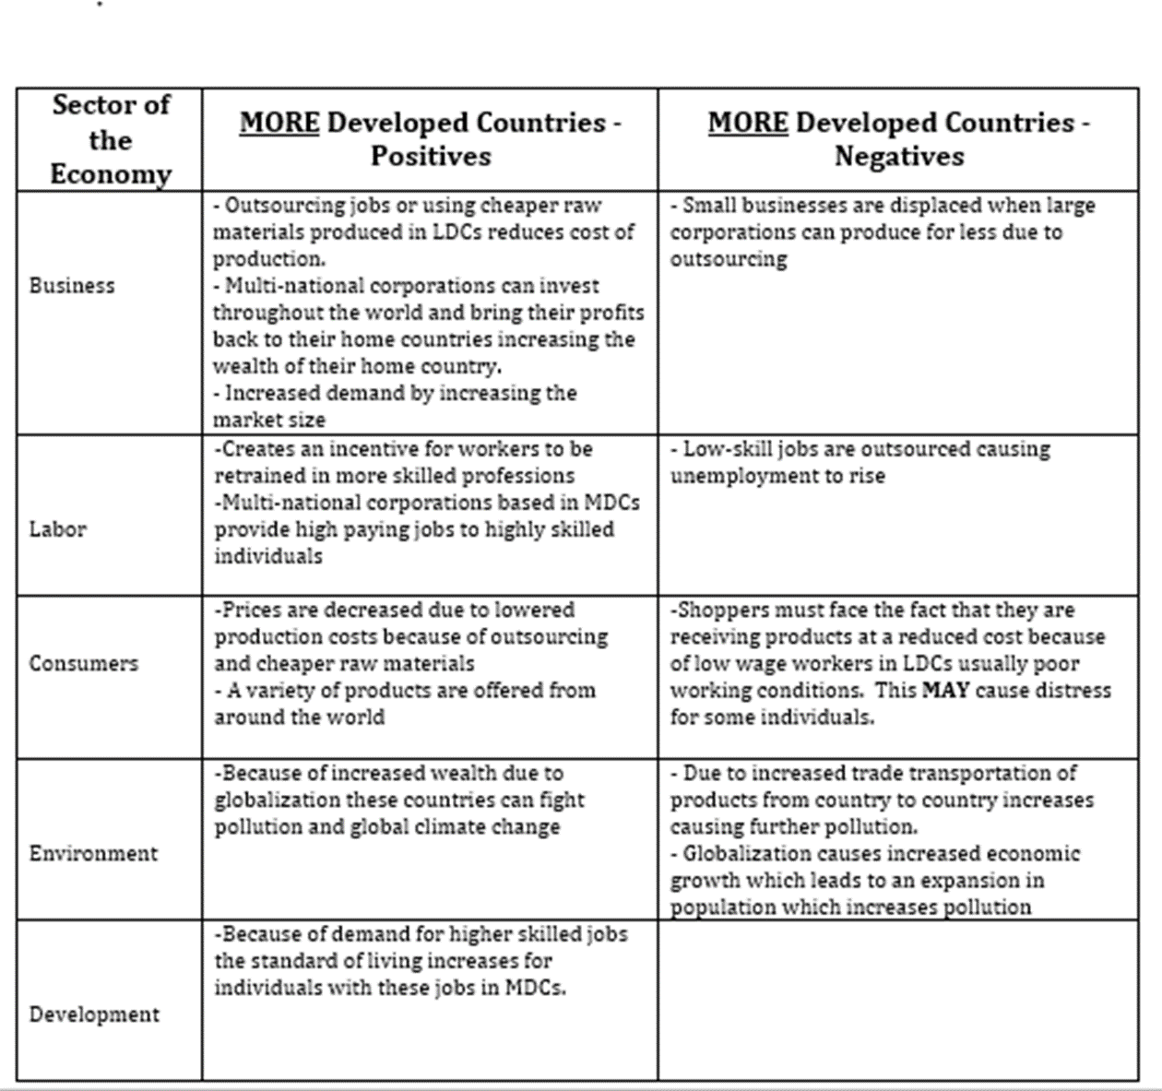
globalization

Slide 6
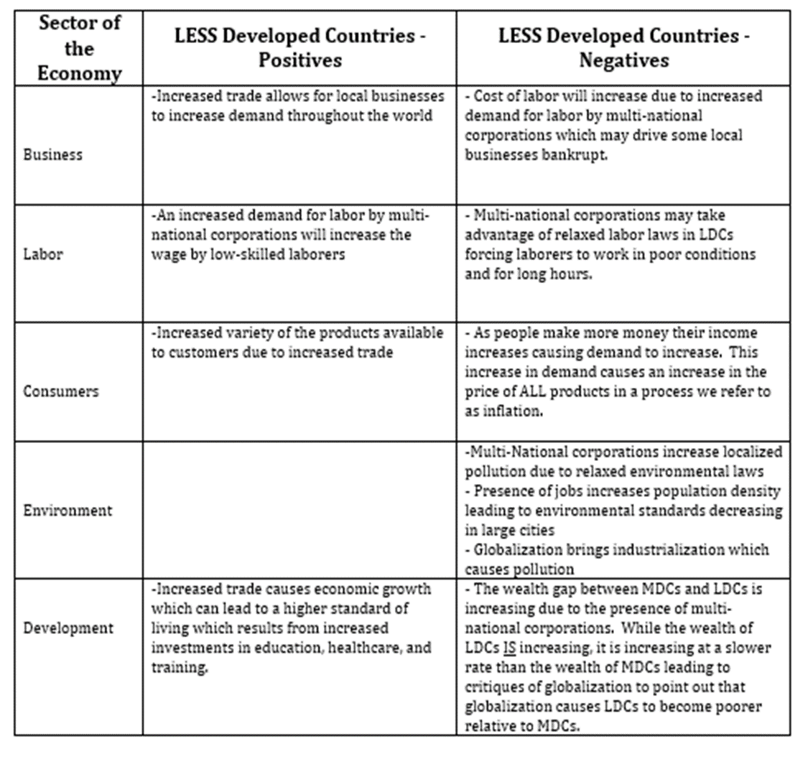

Slide 7
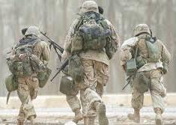
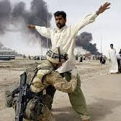
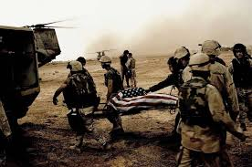
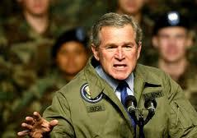
War in Iraq
Research online in order to answer the questions below.
What dangers did President Bush say Iraq posed to the region and the world? Name two.
What were the U.S. government’s declared goals in sending troops to Iraq?
Why did many Iraqis distrust the Iraq Interim Governing Council?
What was the effect of U.S. involvement in Fallujah?
What percentage of Iraqis participated in the elections in December 2005?
Who is the president of Iraq? Who is the Prime Minister?
What events contributed to the U.S. led invasion of Iraq in March 2003?
Describe the different groups involved in the ongoing conflict in Iraq. What are their goals?

