Slide 1
gerrymandering | NAACP | civil disobedience | Black Power

Slide 2
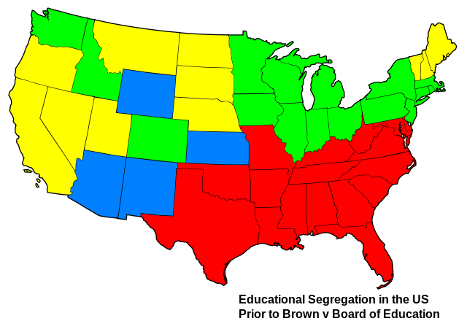

Brown vs. the Board of Education
Directions: This landmark Supreme Court case would forever change American schools. You can learn more about the Supreme Court ruling here and also from the National Historic site here. https://www.nps.gov/brvb/index.htm First, complete the key to the map. Then, complete the graphic organizers at the bottom with (1) what the ruling was, (2) what was the Justification/ under what grounds it was found, and (3) what was the reaction and resistance it was met with.
Segregated school forbidden.
Segregated school required.
Segregated school optional.
No legislation on schools.
US Prior to Brown Map Key
Ruling
Grounds & Justification
Reaction & Resistance

Slide 4

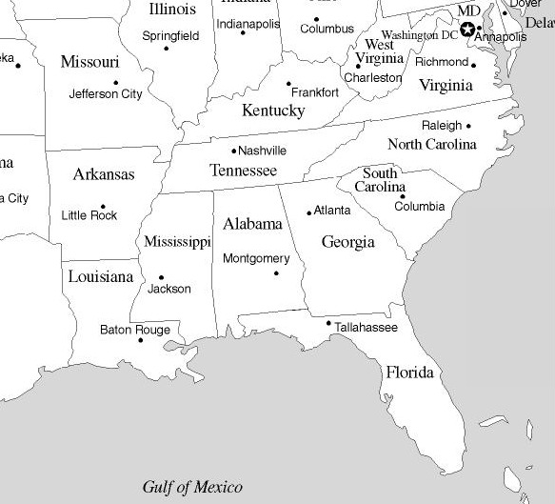
The Freedom Riders
Directions: The Freedom Riders were civil rights activists who rode interstate buses
into the South 1961 to protest segregation. Use these online resources, https://www.gilderlehrman.org/sites/default/files/swf/freedomRiders/index.html
on the Freedom Riders, this collection of documents and resources, http://www.pbs.org/wgbh/americanexperience/films/freedomriders/ Then, drag and drop the descriptions of what happened to each correct location.
At the bottom, explain the impact the Freedom Riders had.
May 17 - Riders are arrested by Bull Connor, who then brings them to Tennessee and dumps them on the side of the road.
May 24 - Riders are arrested for using a “white only” restroom and jailed for over a month.
May 14 - A mob of more than 100 KKK members of attacked the freedom riders on Mother's Day.
May 8 - 1st confrontation when Joseph Perkins is arrested for trespassing as he attempts to have his shoes shined at a whites-only shoeshine chair and spends two nights in jail.
May 1-5 - Gather on buses and depart for the South.
Impact
May 17 - Riders are arrested by Bull Connor, w
May 17 - Riders are arrested by Bull Connor, who then brings them to Tennessee and dumps them on the side of the road.

Slide 5
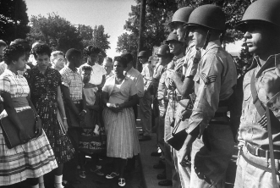
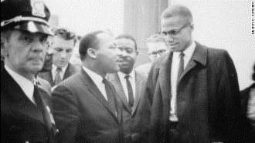
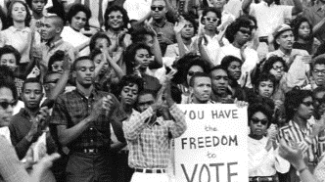
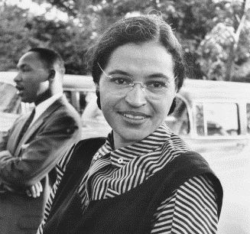
Goals of the Civil Rights Movement
Directions: Evaluate to what extent key individuals and groups of the Civil Rights Movement achieved their goals. Define and describe each.
Montgomery Bus Boycott
Integration of Central High School
Sit-Ins
Freedom Rides
Birmingham Campaign
March on Washington
Civil Rights Act of 1964
Voting Rights Act of 1965
Malcolm X
Stokely Charmichael

Slide 6
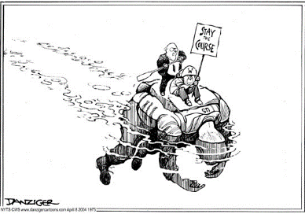
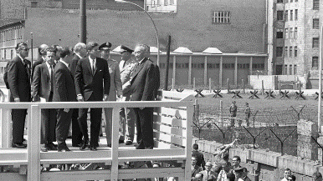
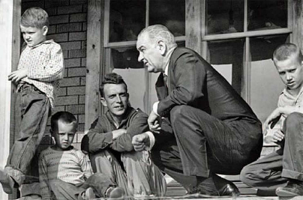
Social/Political/Economic Changes
Directions: Identify and describe the social, political, and economic changes to American life during the 50’s, 60’s, and 70’s by responding to the prompts below. History Alive Chapters 44-55
What is meant by “stay the course” in Vietnam?
President Kennedy and the Berlin Wall
President Johnson and the War on Poverty
What was the Republican Party’s disgrace by the
mainstream presidencies of Nixon and Ford
What is meant by President Carter being
“soft on communism”?
By the late 1970’s, did Americans trust their government?
Why or why not?

Slide 7
Reagan Revolution | Reagan Doctrine | New Right | New Left | Moral Majority

Slide 8
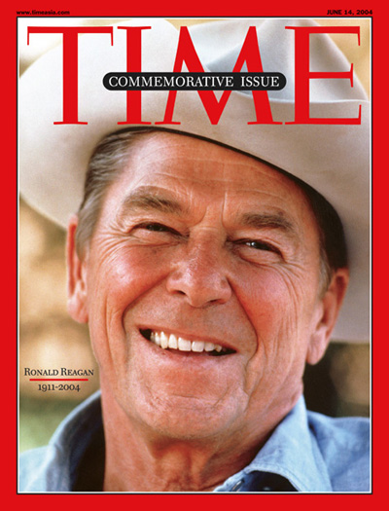
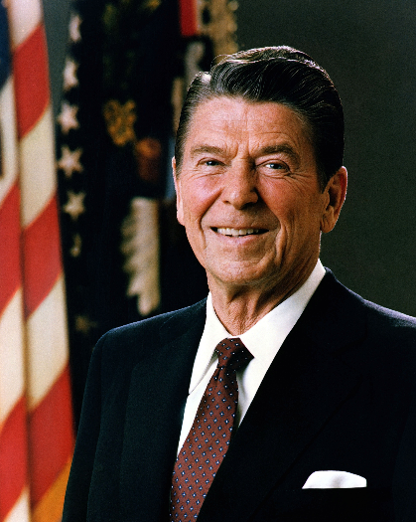
The Reagan Years
Ronald Reagan, a former movie actor and Republican governor of California, made an appealing presidential candidate. His friendly manner and positive, “can-do” attitude won the support of voters across the country.
Directions: Continue reading in History Alive! Chapter 55 as well as following these links
https://www.reaganlibrary.gov/sreference/the-reagan-presidency
https://tinyurl.com/yahpua5z
https://www.history.com/topics/us-presidents/ronald-reagan
In order to respond to the prompts below.
What was the Tax Reform Law of 1986?
What was the Intermediate Nuclear Force Treaty at the Washington Summit in December, 1987?
Who was Sandra Day O’Connor? Why is she significant?
What was President Reagan’s quote in regards to the Berlin Wall? What happened?
What was the Iran-Contra Affair? What did it mean for the Reagan Legacy?

Slide 9
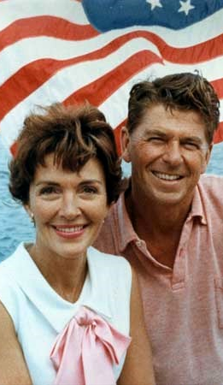
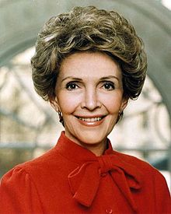
First Lady
Nancy Reagan was an American film actress and the wife of Ronald Reagan, the 40th President of the United States. She was the First Lady of the United States from 1981 to 1989. Her husband’s decision to appoint the first woman justice to the Supreme Court as well as her own contributions as First Lady played a significant part involving the impact of gender roles on social, political, and economic life in the U.S.
Directions:Continue reading in History Alive! Chapter 55 as well as following these links
https://tinyurl.com/26dwrwt and https://tinyurl.com/ybaxecsw
https://www.britannica.com/biography/Nancy-Reagan
in order to respond to the prompts below.
Nancy replaced the White House China. Why was this an issue?
What was Nancy’s response to the assassination attempt on her husband?
What was the Foster Grandparents Program?
Nancy was the first first lady to address the United Nations General Assembly in 1988.
What was her agenda?
What was the 1986 "National Crusade for a Drug Free America" bill?

Slide 10
Events in American History
Directions: Match each of the events below to the corresponding year on the timeline. Be sure to use both sides as some will happen in the same year.
1980 1982 1984 1986 1988 1990 1992 1994 1996 1998 2000 2002
Operation Desert Storm begins in the Persian Gulf after Iraq invades Kuwait.
The Patriot Act is passed giving the government greater surveillance powers.
Wars in Iraq & Afghanistan begin to combat terrorism.
Bill Clinton elected president.
NAFTA creates a free trade agreement between the USA, Canada, and Mexico.
Sandra Day-O’Connor becomes the first woman appointed to the Supreme Court.
Iran-Contra Affair uncovers Reagan administration trading “arms for hostages” and funneling money to Nicaraguan Contras.
Republicans sweep midterm elections after Clinton scandal.
Ronald Reagan is elected president and begins the ‘Reagan Revolution”.
George W. Bush elected president.
52 Americans are taken hostage at the US embassy in Iran and held for 444 days
George H. W. Bush elected president.
9/11 terrorist attacks on the World Trade Center and Pentagon.

