Slide 1
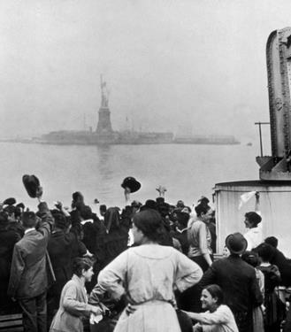
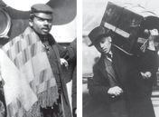
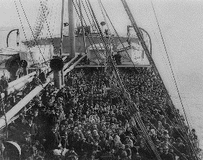
UNIT 3: Immigration
Introduction
In 1886, the Statue of Liberty, a gift from France, was unveiled on an island in New York Harbor. The colossal statue, with its torch of freedom held high, made a strong impression on the hundreds of thousands of immigrants who passed by it each year. One of those newcomers, Edward Corsi, recalled what it was like seeing Lady Liberty for the first time:
I looked at that statue with a sense of bewilderment, half doubting its reality. Looming shadowy through the mist, it brought silence to the decks of the Florida. This symbol of America—this enormous expression of what we had all been taught was the inner meaning of this new country we were coming to—inspired awe in the hopeful immigrants. Many older persons among us, burdened with a thousand memories of what they were leaving behind, had been openly weeping ever since we entered the narrower waters on our final approach toward the unknown. Now somehow steadied, I suppose, by the concreteness of the symbol of America's freedom, they dried their tears.
—Edward Corsi, In the Shadow of Liberty, 1935
Corsi understood the symbolism of the Statue of Liberty for freedom-seeking immigrants. So did poet Emma Lazarus, who grew up in an immigrant family. These words she wrote about the statue are inscribed on its base:
"Give me your tired, your poor,
Your huddled masses yearning to breathe free,
The wretched refuse of your teeming shore.
Send these, the homeless, tempest-tost to me,
I lift my lamp beside the golden door!"
—Emma Lazarus, "The New Colossus," 1883

Slide 2
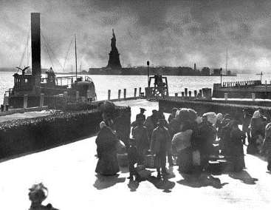
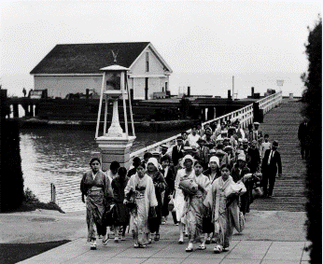
Immigration Islands
Ellis Island Angel Island
Directions: Millions of immigrants came to the United States at the turn of the century.
Many arrived with few possessions and little money. They faced many challenges
adapting to life in their new home. History Alive! Chapter 15
Continue reading in the chapter and follow these links
https://www.youtube.com/watch?v=ubT-Bm36L2U
https://www.history.com/topics/ellis-island
https://www.britannica.com/topic/Angel-Island-Immigration-Station
in order to respond to the prompts below.
What were some of the reasons (pull factors) for Europeans immigrating to the United States?
What were some of the difficulties (push factors) for Europeans immigrating to the U.S.?
What were some of the examinations and inspections immigrants endured?
What happened if an immigrant failed these examinations/inspections?
Compare and contrast Angel and Ellis Island.
What was Angel Island called in respect to Ellis Island?
What is the famous statue located at Ellis Island?
What are the famous landmarks in regards to Angel Island?
What was the Chinese Exclusion Act? Why is it significant in respect to this topic?

Slide 3
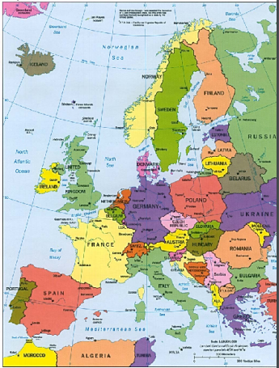
Push/Pull Factors
Migration: Occurs when people move WITHIN a nation
Immigration: Occurs when people move from one nation to another nation
“2nd Wave of Immigration”
a) Most from Southern & Eastern Europe
b) The highest number came from ITALY
c) Other nations included Russia, Poland, Hungary
Directions: Match the characteristics from the word bank to the corresponding factor in order to answer the question why might someone want to move to another country?
..
PUSH | PULL
Jobs
Corrupt governments
Lack of opportunity
Poor education
Safety/protection
Fair/just government
Lack of religious freedom
Civil strife
Lower cost of living
Medical care
Lack of medical care
Natural disasters
Higher standard of living
Lack of religious freedom
Opportunity
Religious freedom
Poverty

Slide 4
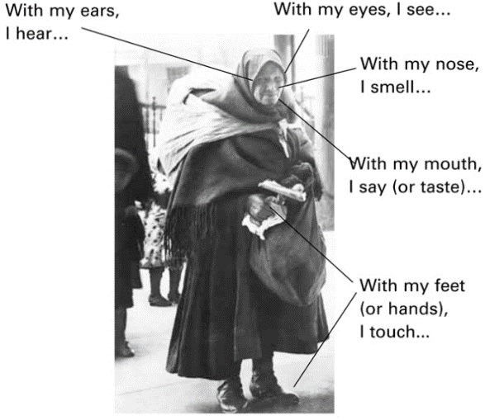
UNIT 3: Immigration
DIRECTIONS: After reading this section in the Student Text, create a sensory figure by completing at least four sensory statements around the photograph below. Sensory statements describe what immigrants might have experienced or felt through any of their senses. Base your statements on information from the reading.
EXAMPLE
Reading on next page

Slide 5
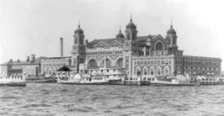
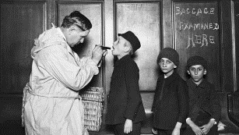
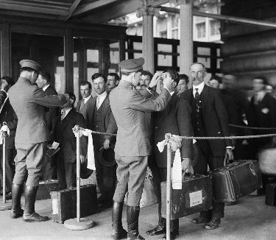
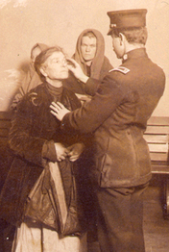
UNIT 3: Immigration
To Ellis Island and Beyond
At the turn of the century, European immigrants arrived in New York Harbor by the thousands every day. After all they had been through, they looked forward to stepping onto dry land. First-class and second-class passengers—those on the upper decks—did just that. After a brief onboard examination, they disembarked at the Hudson River piers. Steerage passengers, however, had to face one last hurdle: Ellis Island.
The Ellis Island Immigration Station, built in 1892 on a small piece of land in the harbor, was the port of entry for most European immigrants arriving in New York. Steerage passengers passed through a set of buildings staffed by officers of the Bureau of Immigration. This was a time of high anxiety for the immigrants. An array of officials would examine them closely to make sure they were fit to enter the country. Some of them would not pass inspection.
Medical Inspections at Ellis Island Outside the main building at Ellis Island, officials attached an identification tag to each immigrant. The medical inspection began after the immigrants entered the building. Public Health Service doctors watched as people crossed through the baggage room and climbed the steep stairs to the enormous Registry Room, or Great Hall. This brief observation period became known as the "six-second exam." People who limped, wheezed, or otherwise showed signs of disease or disability would be pulled aside for closer inspection.
In the Great Hall, the immigrants underwent a physical examination and an eye test. During the brief physical, the doctor checked for a variety of health problems, using chalk to mark the immigrant's clothing with a symbol for the suspected disease or other problem. For example, an L stood for lameness, an H meant a possible heart condition, and an X indicated a mental problem. Disabled individuals or those found to have incurable illnesses would face deportation, a forced return to their home country.
The most dreaded mark was an E for eye condition. The doctor would check for trachoma, a contagious infection that could lead to blindness. Anyone with trachoma would certainly be rejected. In fact, this disease accounted for the most deportations by far.

Slide 6
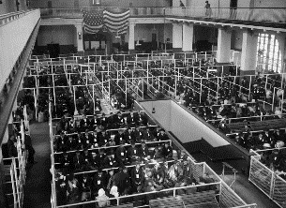
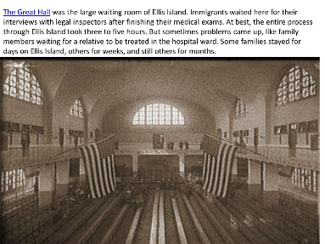
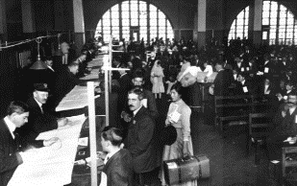
UNIT 3: Immigration
Legal Interviews in the Great Hall Immigrants with medical problems would be sent to a detention area. The rest got in line and slowly worked their way to the back of the Great Hall for the legal interview. One by one, they stood before the primary inspector, who usually worked with an interpreter. The inspector asked a list of 29 questions, starting with "What is your name?"
It was once thought that many names were shortened or respelled at Ellis Island, but actually such changes were rare. Passenger lists, including the 29 questions and answers, were created at the port of departure in Europe. Immigrants provided their name, age, sex, race, marital status, occupation, destination, and other information. Steamship officials wrote the answers on the passenger list. In most cases, Ellis Island inspectors merely asked the questions again to verify that the answers matched those on the passenger list.
The trickiest question was, "Do you have work waiting for you in the United States?" Those immigrants who wanted to show they were able to succeed in their new country sometimes answered yes. However, the Foran Act, a law passed by Congress in 1885, made it illegal for U.S. employers to import foreigners as contract laborers. The law's main purpose was to prevent the hiring of new immigrants to replace striking workers. Any immigrant who admitted to signing a contract to work for an employer in the United States could be detained.
About 20 percent of immigrants failed either the medical examination or the legal interview. This does not mean they were denied entry. Those with treatable illnesses were sent to a hospital on Ellis Island for therapy. There they might stay for days or weeks until a doctor pronounced them fit. Other detained immigrants had to await a hearing in front of a Board of Special Inquiry. These immigrants stayed in dormitories on the second and third floors of the main building, sleeping in iron bunks that resembled those in steerage.
The board members reviewed the details of each immigrant's case and listened to testimony from the detainee's friends and relatives, if any lived nearby. The board voted to accept almost all of the immigrants who came before it. In the end, about 2 percent of all immigrants were deported.
Most of the immigrants who passed through Ellis Island spent a very short time undergoing medical and legal examination. Yet the whole process, including the waiting time, lasted for several agonizing hours. It ended with the legal interview. Immigrants who passed that final test were free to go. Relieved that the long ordeal was over, they boarded a ferry bound for New York City and a new life.

Slide 7
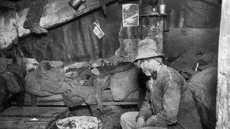
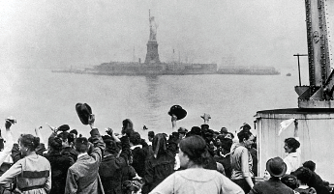
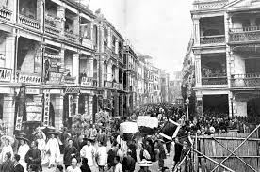
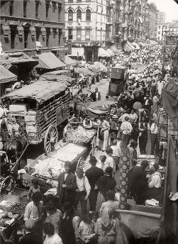
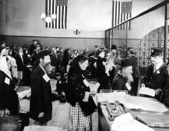
UNIT 3: Immigration
Beyond Ellis Island: Life in the Cities Some new European immigrants quickly found their way to the farm country of the Midwest. However, the majority of the jobs were in the cities, so most immigrants stayed in New York or boarded trains bound for Boston, Cleveland, Chicago, or other industrial centers. As a result, urban populations exploded. From 1870 to 1920, the proportion of Americans who lived in cities jumped from about 25 percent to 50 percent.
Newly arrived urban immigrants tended to live in the least desirable districts, where housing was cheapest. Such areas often contained the factories and shops that provided their livelihoods. Amid the city's din and dirt, immigrants crowded into tenement buildings and other run-down, slum housing. In 1914, an Italian immigrant described such an area of Boston:
Here was a congestion the like of which I had never seen before. Within the narrow limits of one-half square mile were crowded together thirty-five thousand people, living tier upon tier, huddled together until the very heavens seemed to be shut out. These narrow alley-like streets of Old Boston were one mass of litter. The air was laden with soot and dirt. Ill odors arose from every direction . . . A thousand wheels of commercial activity whirled incessantly day and night, making noises which would rack the sturdiest of nerves.
—Constantine M. Panunzio, The Soul of an Immigrant, 1969
Immigrants generally settled among others from their home country. They felt comfortable among people who spoke the same language, ate the same foods, and held the same beliefs. As a result, different areas of the city often had distinctive ethnic flavors. Jacob Riis, a writer and photographer, imagined a map of New York's ethnic communities. "A map of the city," he wrote in 1890, "colored to designate nationalities, would show more stripes than on the skin of a zebra, and more colors than any rainbow."

Slide 8
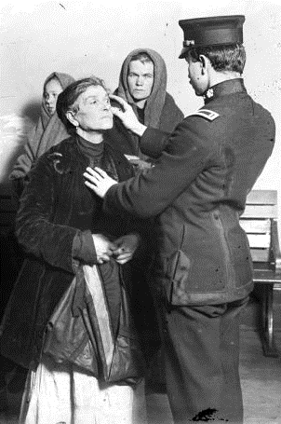
UNIT 3: Immigration
After reading this section in the Student Text, create a sensory figure by completing at least four sensory statements around the photograph below. Base your statements on information from the reading.
With my eyes, I see….
With my nose, I smell...
With my mouth, I say (or taste)..
With my ears, I hear...
With my Hands or Feet, I touch...

Slide 9
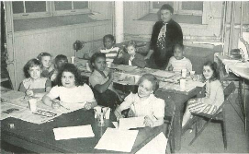
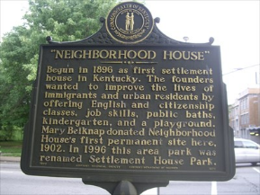
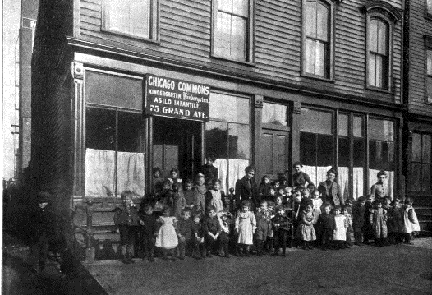
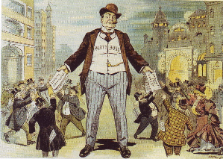
UNIT 3: Immigration
Responses to New European Immigrants
Immigrants typically came to the United States with little money and few possessions. Because of their general poverty and lack of education, most were not welcomed into American society. Without much support, they had to work hard to get ahead. In time, some saved enough to move out of the slums and perhaps even buy a home. A few opened small businesses, such as a grocery store or a tailor's shop. But many remained stuck in dangerous, low-wage factory jobs that barely paid their bills. An accident on the job or an economic downturn might leave them without work and possibly homeless and hungry.
Immigrants Receive Aid from Several Sources In the late 1800s, the government did not provide aid or assistance to unemployed workers. They were expected to fend for themselves. But needy immigrants did have several places to turn for help. The first sources of aid were usually relatives or friends, who might provide housing and food.
If necessary, the needy might seek assistance from an immigrant aid society. These ethnic organizations started as neighborhood social groups. They met mainly in churches and synagogues, groceries, and saloons—the centers of immigrant community life. They might pass the hat to collect money for a family in need. In time, local immigrant aid societies joined together to form regional and national organizations, such as the Polish National Alliance and the Sons of Italy in America.
During the 1890s, a type of aid organization called a settlement house arose in the ethnic neighborhoods of many large cities. A settlement house was a community center that provided a variety of services to the poor, especially to immigrants. It might offer daytime care for children, as well as classes, health clinics, and recreational opportunities for the entire community.
Immigrants might also turn to political bosses for help. These bosses were powerful leaders who ran local politics in many cities. They were in a position to provide jobs and social services to immigrants in exchange for the political support of immigrants who could vote. These supporters often voted for the boss and his slate of candidates in local elections.

Slide 10
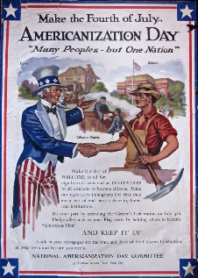
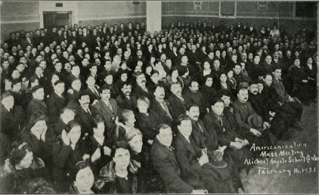
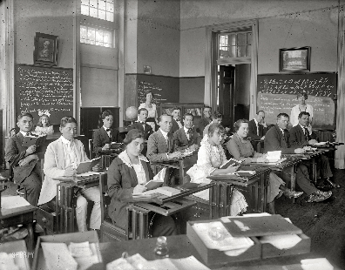
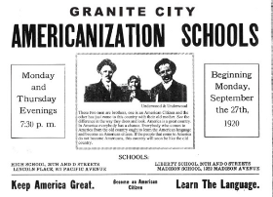
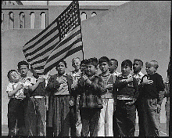
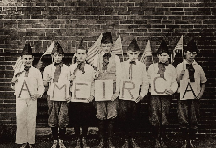
UNIT 3: Immigration
The Assimilation of Immigrants Many immigrants held on to their old customs and language as they gradually adapted to American life. This was especially true for older immigrants living in ethnic neighborhoods. The children of immigrants, however, typically found assimilation into American society much easier than their parents did.
Education was the main tool of assimilation. Immigrant children in public schools studied American history and civics, and they learned to speak English. Yearning to fit in, they more eagerly adopted American customs.
Some patriotic organizations pushed for the Americanization of immigrants, fearing that increased immigration posed a threat to American values and traditions. Through efforts such as the publishing of guides for new citizens, they promoted loyalty to American values.

Slide 11
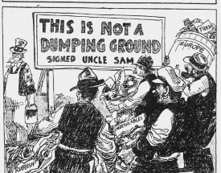
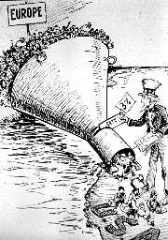
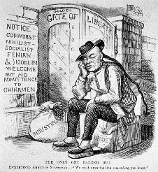


UNIT 3: Immigration
Some Americans Reject Immigrants Many Americans disliked the recent immigrants, in part because of religious and cultural differences. Most of the earlier immigrants were Protestants from northern Europe. Later waves of immigrants came from southern and eastern Europe and were often Catholics or Jews. Their customs seemed strange to Americans of northern European ancestry, who often doubted that these more recent immigrants could be Americanized. Many people also blamed them for the labor unrest that had spread across the country in the late 1800s. They especially feared that foreign anarchists and socialists might undermine American democracy.
Dislike and fear provoked demands to limit immigration and its impact on American life. This policy of favoring the interests of native-born Americans over those of immigrants is called nativism. Nativism had a long history in the United States. Before the Civil War, nativists had opposed the immigration of Irish Catholics. In the 1850s, they formed a secret political party known as the Know-Nothings, because when asked a question about the group, members were told to answer, "I don't know."
As the main source of immigration shifted to southern and eastern Europe in the late 1800s, nativism flared up again. Nativists were not only bothered by religious and cultural differences, but also saw immigrants as an economic threat. Native workers worried that immigrants were taking their jobs and lowering wages. Immigrants often worked for less money and sometimes served as scabs, replacement workers during labor disputes.
In 1894, a group of nativists founded the Immigration Restriction League. This organization wanted to limit immigration by requiring that all new arrivals take a literacy test to prove they could read and write. In 1897, Congress passed such a bill, but the president vetoed it. Twenty years later, however, another literacy bill became law. Meanwhile, efforts to slow immigration continued. During the 1920s, Congress began passing quota laws to restrict the flow of European immigrants into the United States

Slide 12
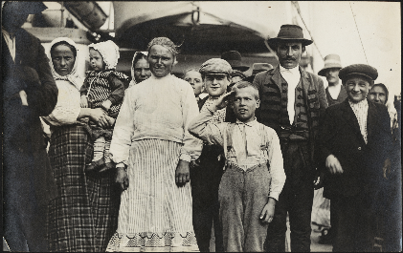
UNIT 3: Immigration
After reading this section in the Student Text, create a sensory figure by completing at least four sensory statements around the photograph below. Base your statements on information from the reading.
With my eyes, I see….
With my nose, I smell...
With my mouth, I say (or taste)..
With my ears, I hear...
With my Hands or Feet, I touch...

Slide 13
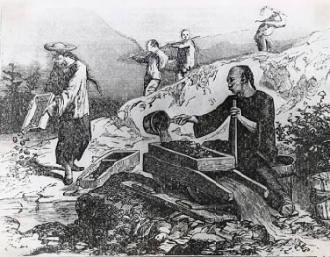
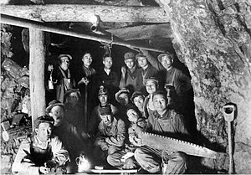
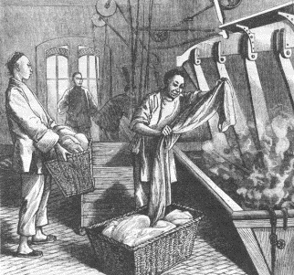
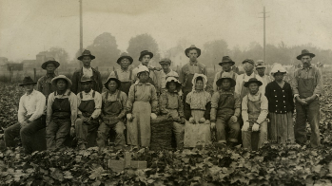
UNIT 3: Immigration
Immigration from Asia
Although immigration after the Civil War was mainly from Europe, many immigrants also arrived each year from Asia. They made important contributions to the country. They also provoked strong reactions from nativists.
Chinese Immigrants Seek Gold Mountain You have read about the thousands of Chinese railroad workers who laid track through the Sierra Nevada for the Central Pacific Railroad. Thousands more joined the swarms of prospectors who scoured the West for gold. In fact, the Chinese referred to California, the site of the first gold rush, as Gold Mountain.
The vast majority of Chinese immigrants were men. They streamed into California, mainly through the port of San Francisco. Most expected to work hard and return home rich. However, they usually ended up staying in the United States.
Besides finding employment in mining and railroad construction, Chinese immigrants worked in agriculture. Some had first come to Hawaii as contract laborers to work on sugar plantations. There they earned a reputation as reliable, steady workers. Farm owners on the mainland saw the value of their labor and began bringing the Chinese to California. The Chinese were willing to do the "stoop labor" in the fields that many white laborers refused to do. By the early 1880s, most harvest workers in the state were Chinese.
Many businesses hired the Chinese because they were willing to work for less money. This allowed owners to reduce production costs even further by paying white workers less. As a result, friction developed between working-class whites and Chinese immigrants.

Slide 14
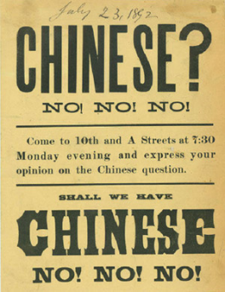
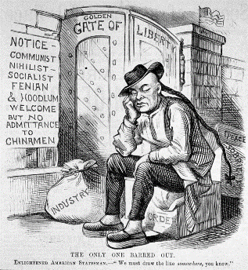
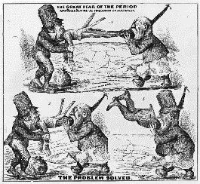
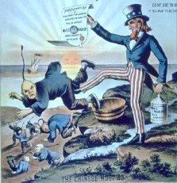
UNIT 3: Immigration
The Exclusion Act: Shutting the Doors on the Chinese During the 1870s, a depression and drought knocked the wind out of California's economy. Seeking a scapegoat, many Californians blamed Chinese workers for their economic woes. The Chinese made an easy target. They looked different from white Americans, and their language, religion, and other cultural traits were also very different. As a result, innocent Chinese became victims of mob violence, during which many were driven out of their homes and even murdered.
Anti-Chinese nativism had a strong racial component. The Chinese were seen as an inferior people who could never be Americanized. Economist Henry George reflected this racist point of view in characterizing the Chinese as "utter heathens, treacherous, sensual, cowardly, cruel."
Nativists demanded that Chinese immigration be curtailed, or reduced. Their outcries led to the passage of the Chinese Exclusion Act in 1882. This law prohibited the immigration of Chinese laborers, skilled or unskilled, for a period of 10 years. It also prevented Chinese already in the country from becoming citizens. For the first time, the United States had restricted immigration based solely on nationality or race.
The Chinese Exclusion Act still allowed a few Chinese to enter the country, including merchants, diplomats, teachers, students, and relatives of existing citizens. But the act did what it was supposed to do. Immigration from China fell from a high of nearly 40,000 people in 1882 to just 279 two years later.

Slide 15
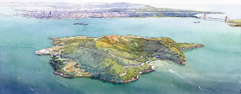
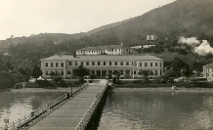
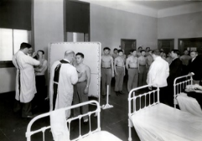
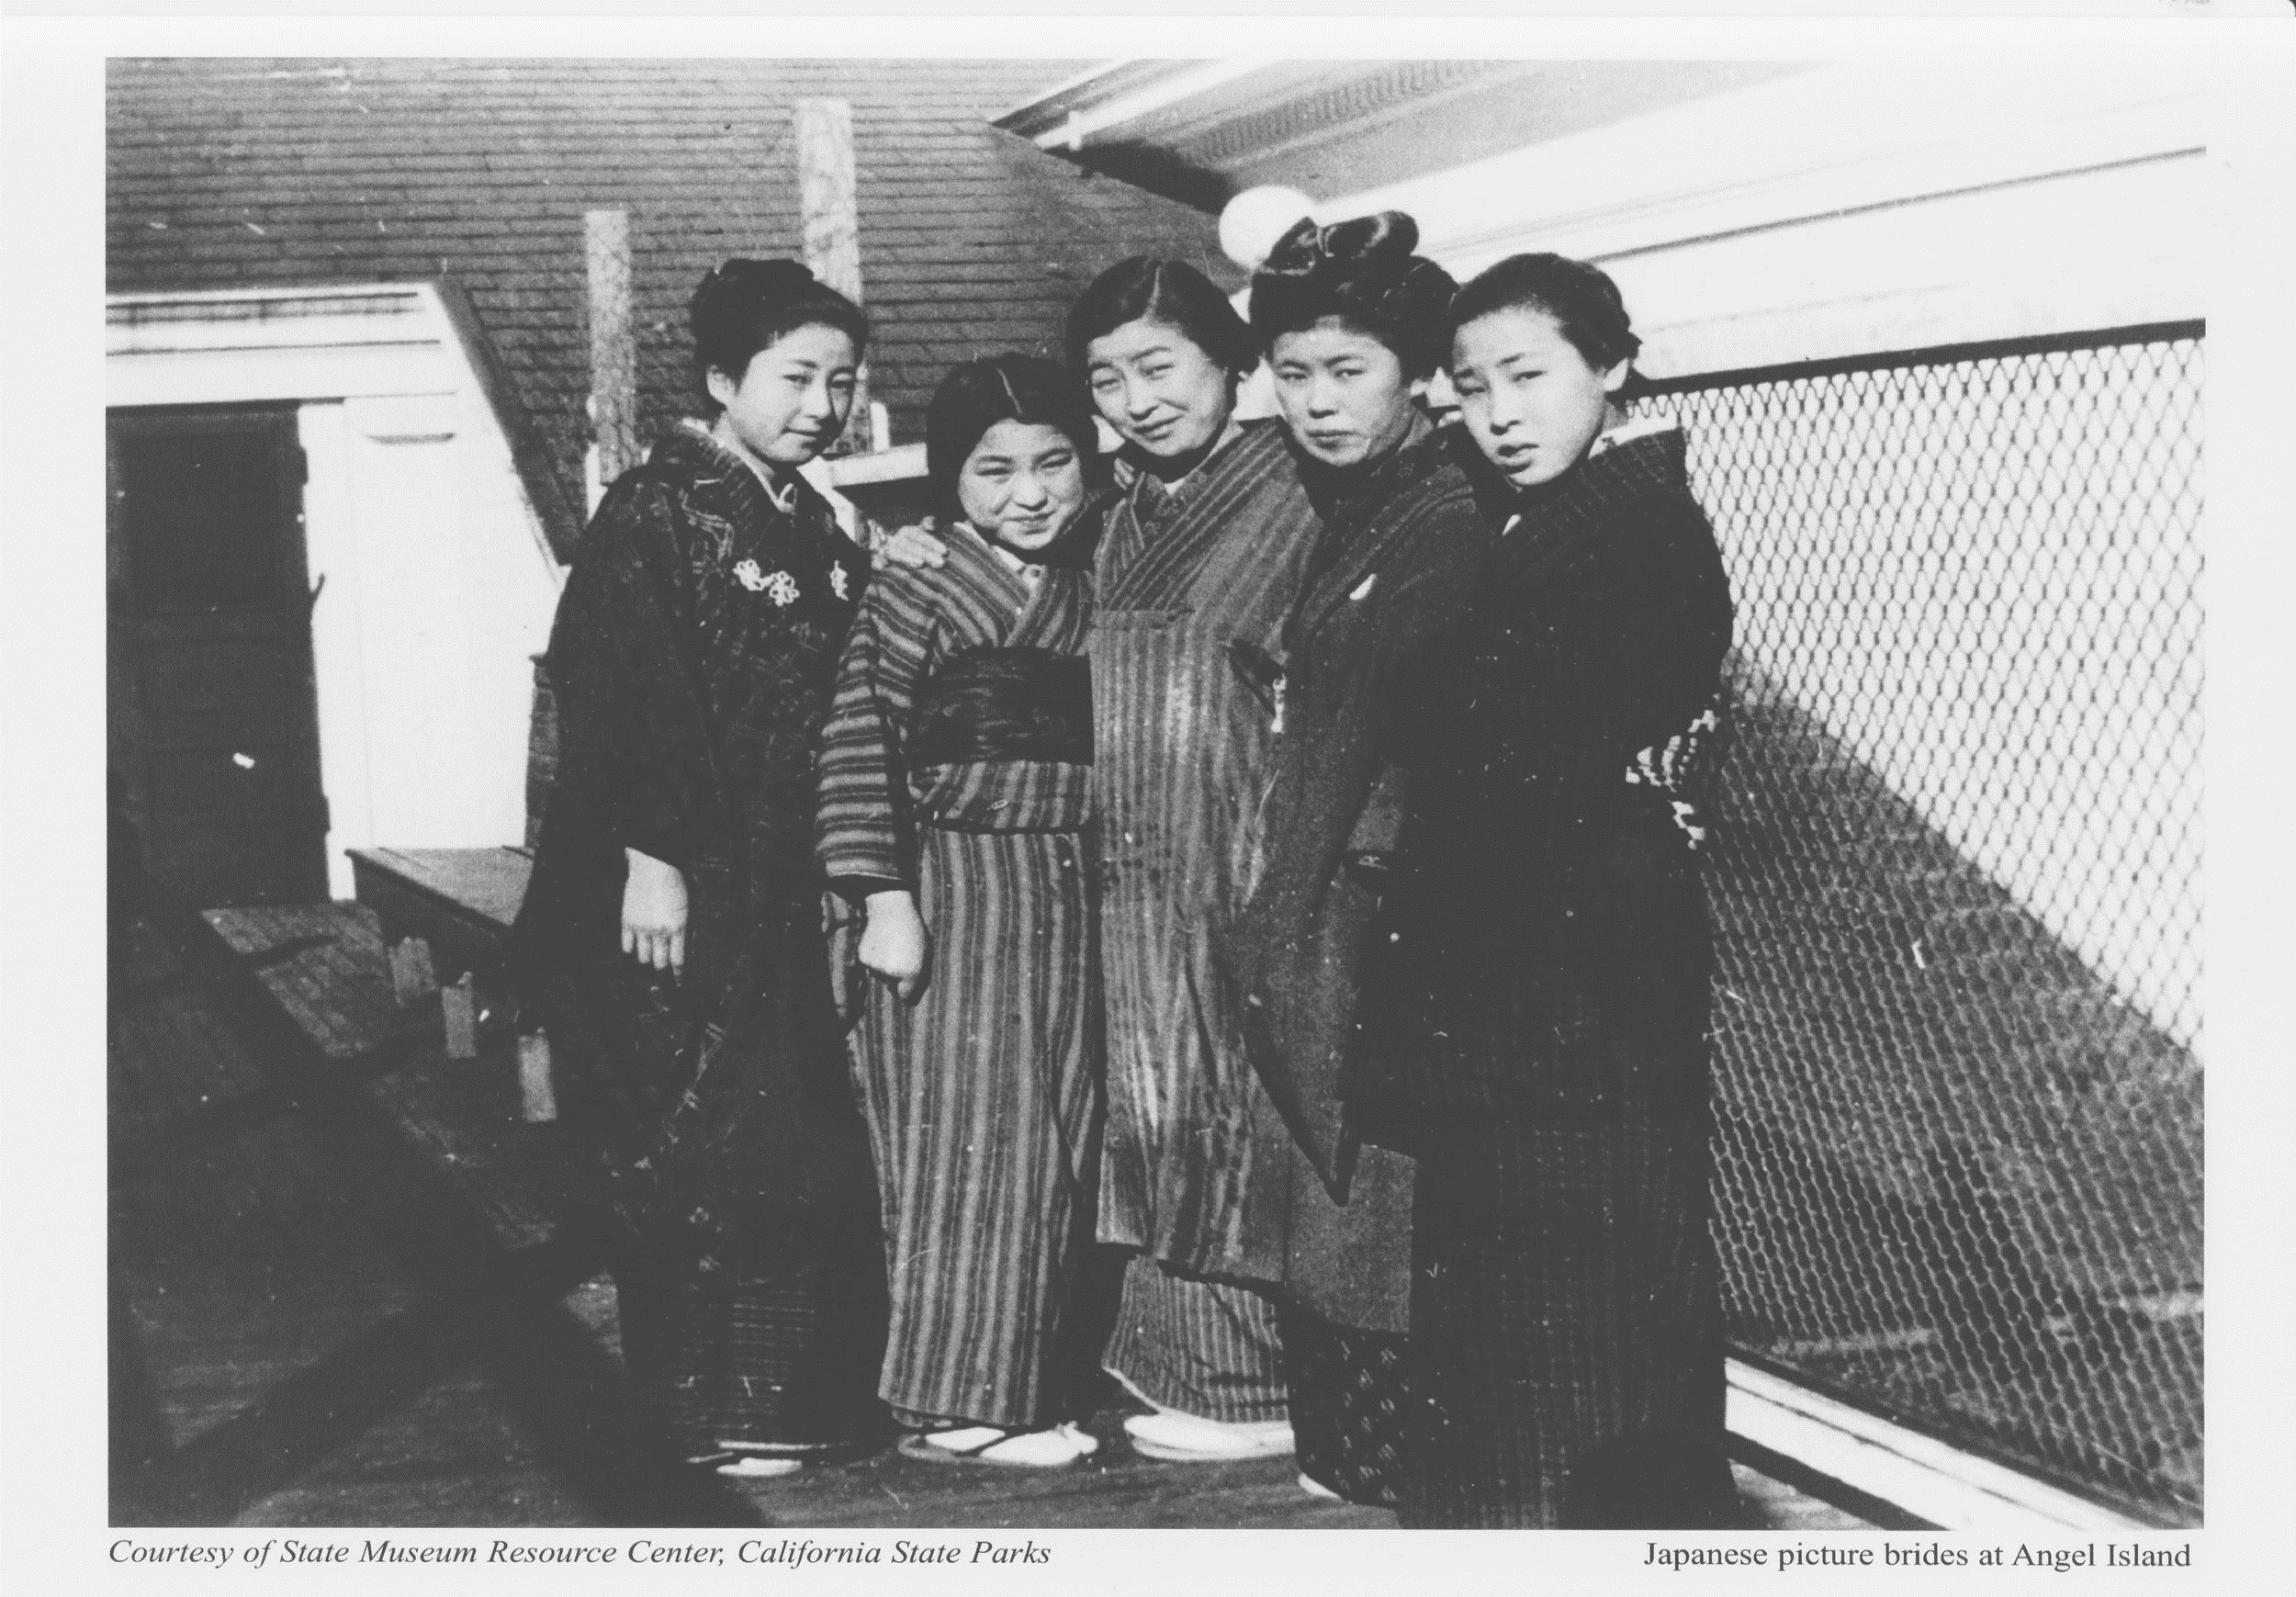
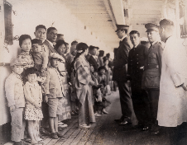
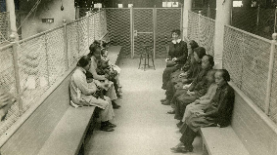
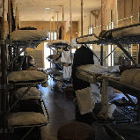
UNIT 3: Immigration
Angel Island: The Ellis Island of the West Although the Chinese Exclusion Act was highly effective, some Chinese managed to evade the law by using forged documents and false names. In response, federal officials developed tougher procedures for processing Asian immigrants. They also decided to replace the old immigrant-processing center in San Francisco with a new, more secure facility located on Angel Island in San Francisco Bay.
Completed in 1910, the Angel Island Immigration Station became known as the "Ellis Island of the West." It was designed to enforce the exclusion act by keeping new Chinese arrivals isolated from friends and relatives on the mainland and preventing them from escaping. At Angel Island, immigrants underwent a thorough physical exam. Then they faced an intense legal interview, more involved and detailed than the Ellis Island version. Officials hoped to exclude Chinese who falsely claimed to be related to American citizens.
Interviewers asked applicants specific questions about their home village, their family, and the house they lived in. They also questioned witnesses. The process could take days. Those who failed the interviews could enter an appeal, but additional evidence took time to gather. Applicants were often detained for weeks, months, or even years.
Chinese detained at Angel Island stayed locked in wooden barracks. These living quarters were crowded and unsanitary. Detainees felt miserable and frustrated to be stopped so close to their goal. From their barracks, they could see across the water to the mainland. Some carved poems onto the walls to express their feelings. One Chinese detainee wrote,
Imprisoned in the wooden building day after day,
My freedom withheld; how can I bear to talk about it?
—from Ronald Takaki, Strangers from a Different Shore, 1989
Many Chinese never made it to the mainland. About 10 percent were put on ships and sent back to China after failing the medical exam or legal interview.

Slide 16
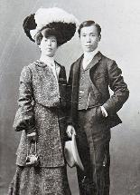




UNIT 3: Immigration
Other Asian Groups Immigrate to the United States The Chinese Exclusion Act created a shortage of farm laborers. Large-scale farmers looked to Japan and later to Korea and the Philippines for workers. These other Asian immigrants had experiences similar to those of the Chinese. Many first emigrated to work on Hawaiian sugar plantations. They came to the United States through Angel Island to work in orchards, in vineyards, and on farms in California, Oregon, and Washington. Some worked for railroads and other industries.
A number of Japanese immigrants leased farmland and had great success growing fruits and vegetables. They formed ethnic neighborhoods that provided for their economic and social needs. Koreans had less success. Only a small number moved from Hawaii to the mainland in the early 1900s, and they led more isolated lives. Immigrants from the Philippines migrated up and down the West Coast, taking part in fruit and vegetable harvests. In the winter, many of these Filipinos worked in hotels and restaurants.
Despite their contributions, all Asian immigrants faced prejudice, hostility, and discrimination. In 1906, anti-Asian feelings in San Francisco caused the city to segregate Asian children in separate schools from whites. When Japan's government protested, President Theodore Roosevelt got involved. Hoping to avoid offending East Asia's most powerful nation, the president persuaded San Francisco's school board to repeal the segregation order. In return, he got a pledge from Japan to discuss issues related to immigration.
In 1907 and 1908, the American and Japanese governments carried out secret negotiations through a series of notes. These notes became known as the Gentlemen's Agreement. In the end, Japanese officials agreed not to allow laborers to emigrate to the United States. They did, however, insist that wives, children, and parents of Japanese in the United States be allowed to immigrate.

Slide 17

UNIT 3: Immigration
After reading this section in the Student Text, create a sensory figure by completing at least four sensory statements around the photograph below. Base your statements on information from the reading.
With my eyes, I see….
With my nose, I smell...
With my mouth, I say (or taste)..
With my ears, I hear...
With my Hands or Feet, I touch...

Slide 18







UNIT 3: Immigration
Immigration from North and South
The East and West coasts were the main gateways for immigrants to the United States in the late 1800s and early 1900s. But immigrants also crossed the country's northern and southern borders. Before 1900, people passed back and forth across these land borders largely unchecked. Even later, the length and isolation of the country's borders made enforcement of immigration laws almost impossible. Europeans and Asians sometimes crossed by land to avoid immigration restrictions. However, most who came this way were either French Canadians from the north or Mexicans from the south.
Crossing the Southern Border: Immigrants from Mexico In the late 1800s and early 1900s, legal restrictions on Chinese and Japanese immigration mounted. As they did, the population of Asian farmworkers in the United States shrank. Commercial farmers in the West began to rely on a different source of labor: Mexico. By the late 1920s, Mexicans constituted a large portion of California's agricultural workers. Many Mexicans also became migrant farmworkers and construction workers in Texas.
Mexicans had lived in the area of Texas, New Mexico, Arizona, and California since the earliest Spanish settlements. In the late 1800s, more Mexicans moved to this area, in part to escape poverty and civil unrest in Mexico. By 1890, many Mexicans were migrating into the Southwest. Around this time, railroads began extending their lines across the border, which made travel faster and easier.
Higher wages in the United States attracted many Mexicans. Some came to work on the railroads. Others labored in the copper mines of Arizona. Still others worked on the farms and in the citrus groves that blossomed throughout the region with the expansion of irrigation. The Mexican Revolution, which began in 1910, pushed even more Mexicans across the border.
Like other immigrant groups, the Mexicans often suffered at the hands of native-born Americans. They might be welcomed as cheap labor, but they were commonly scorned as inferior to white Americans. Racist attitudes toward Mexicans, especially those with dark skin, led to discrimination. They were kept in low-level jobs and commonly denied access to public facilities, including restaurants. Many Mexican children were only allowed to attend segregated schools.

Slide 19




UNIT 3: Immigration
Crossing the Northern Border: The French Canadians Many Canadians also came to the United States after the Civil War. Between 1865 and 1900, more than 900,000 immigrants arrived from Canada. Some of these were English-speaking Protestants, but a larger number were French-speaking Catholics. They arrived mainly from the province of Quebec.
Like other immigrants, the French Canadians were seeking greater opportunities than they had at home. Typically, they traveled by train across the border to the United States. But most did not go too far south. The majority settled in New England and around the Great Lakes. There they worked chiefly in textile mills and lumber camps.
With their language, religion, and customs, the French Canadians differed from the English-speaking society around them. At first, they resisted Americanization, preferring to maintain their cultural and historical ties to Quebec. In part because of their apparent unwillingness to assimilate, French Canadians came under attack by nativists. In 1881, a Massachusetts official declared,
The Canadian French are the Chinese of the Eastern States. They care nothing for our institutions . . . Their purpose is merely to sojourn [stay temporarily] a few years as aliens . . . They are a horde of industrial invaders, not a stream of stable settlers.
—Massachusetts Bureau of Statistics of Labor, Twelfth Annual Report, 1881
European, Asian, Mexican, and French Canadian immigrants all faced accusations that they were unwilling to become members of American society. In time, all would prove the nativists wrong. They would establish vibrant ethnic communities, and their cultures would become vital pieces of the American mosaic.

Slide 20

UNIT 3: Immigration
After reading this section in the Student Text, create a sensory figure by completing at least four sensory statements around the photograph below. Base your statements on information from the reading.
With my eyes, I see….
With my nose, I smell...
With my mouth, I say (or taste)..
With my ears, I hear...
With my Hands or Feet, I touch...

Slide 21




Chinese Exclusion Act 1882
a) Chinese Immigrants the first to be banned from entering the U.S.
b) California citizens BELIEVED they were a threat to their jobs
c) BUT, Chinese immigrants w/ certain skills were still allowed in
- e.g. Doctors
Why do you think Chinese Immigrants had a far more difficult
time with ADAPTATION, ASSIMILATION, and ACCULTURATION
compared to European Immigrants in the United States?

