Slide 1
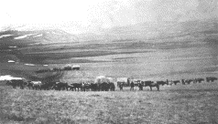
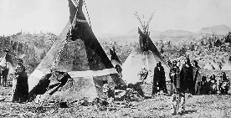
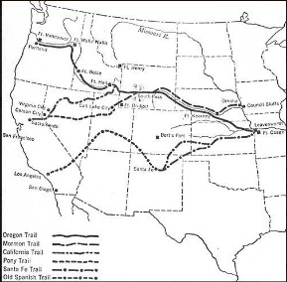
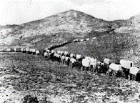
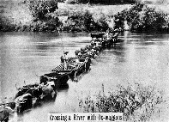
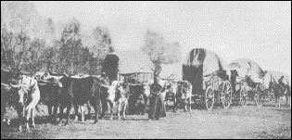
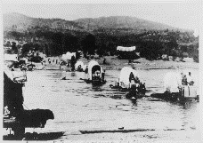
UNIT 3: Migration
Introduction
By the mid-1800s, many Americans felt the need for a change, for a fresh start. Like the early settlers who crossed the Appalachians, they migrated westward in search of opportunity.
Entire families packed their belongings into covered wagons and hit the westward trail. Sooner or later, they crossed the Mississippi River. From their perspective, this mighty river was the frontier, or boundary, marking the beginning of wilderness. "I do remember my emotions after we were all landed on the [other] side of the river," one traveler recalled. "I felt as if we had left all civilization behind us."
In many ways, they had. Overland travelers would spend weeks or months on what amounted to a long and challenging expedition. They would have to adapt themselves to the demands of living on the trail, such as repairing wagons and handling oxen and other livestock. They also had to learn to cook and clean under tough circumstances.
The travelers had to survive with limited resources. Water and wood were scarce on the plains, and food was also difficult to find. They brought very little to eat besides flour, bacon, beans, salt, and coffee. One woman wrote in her journal, "About the only change we have from bread and bacon is bacon and bread."
Many of the new migrants were farmers, but other people also sought opportunity in the West. Miners searched for gold, silver, and other minerals in the hills and mountains. On the grassy plains, ranchers hired cowboys to herd their cattle. Immigrant workers found jobs laying rail lines, and railroad owners made profits shipping western goods to market. However, this rising tide of migration brought further conflict with American Indians. The tribes of the Great Plains, in particular, would fight long and hard against the massive invasion of their lands and destruction of their way of life.
-

Slide 2
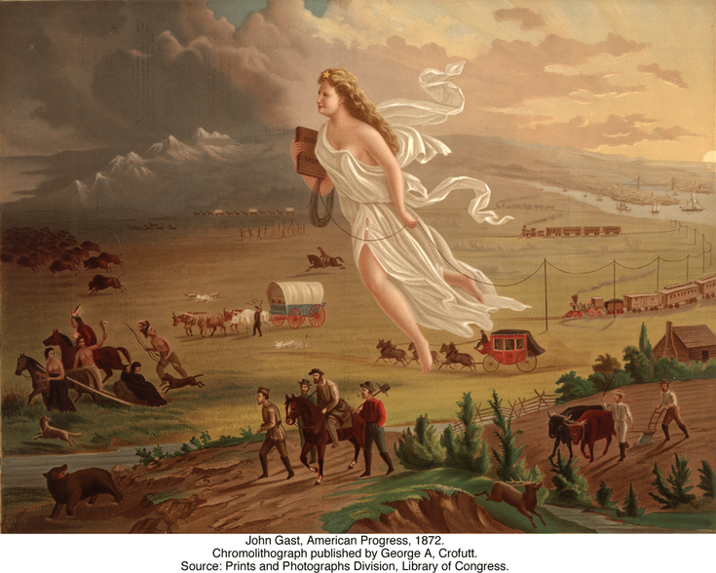
Manifest Destiny
Directions: Artist John Gast’s 1872 painting “American Progress” has come to symbolize Manifest Destiny and the groups affected most by it. Research more about the painting, then complete the graphic organizers by explaining more about the American Frontier, who is pictured and how Manifest Destiny impacted them.
Her
Buffalo
Railroads
Cowboys
Native Americans
49ers
Farmers
.

Slide 4
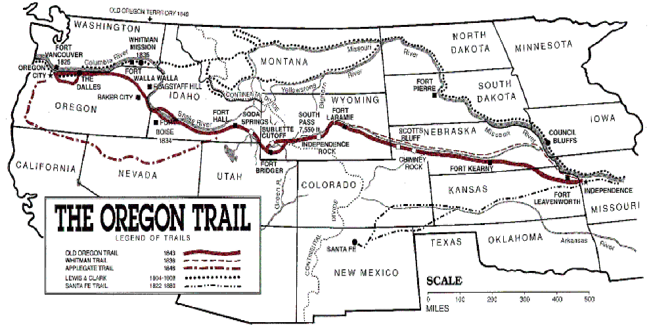
The Oregon Trail
Directions: One of the most popular routes to the west in the mid-1800’s was the 2,000 mile Oregon Trail. Research about the trail here http://ow.ly/DhIG30fG8J8 here http://ow.ly/tPxV30fG8LW and here http://ow.ly/zrJx30fG95Y to complete the prompts below..
When did the travel on the Oregon Trail begin?
Where did the trail begin and end?
How long was the journey from the Missouri "jumping off" place to California or Oregon?
What is meant by the “jumping off” place?
How long did the trip take on the average?
What if they ran out of food or other materials along the way?
Why did people go west?
How many travelers followed the trails to California and Utah?
How many people died on the Oregon Trail?
What kinds of illnesses did people get while traveling?
What were some other causes of death on the trail?
How many travelers were killed by Indians and vice versa?

Slide 5
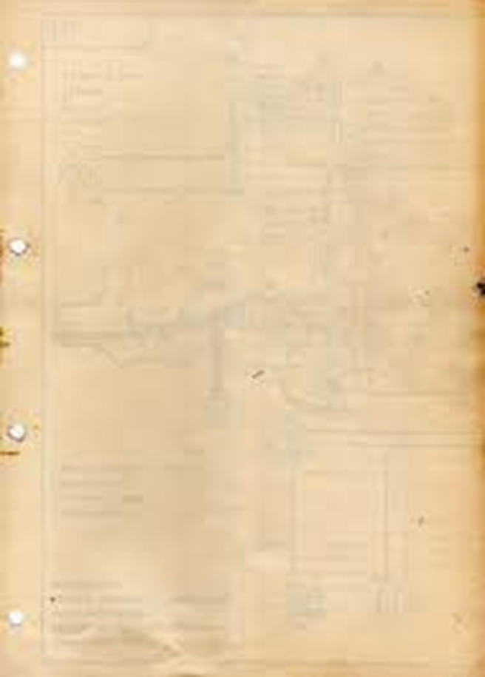
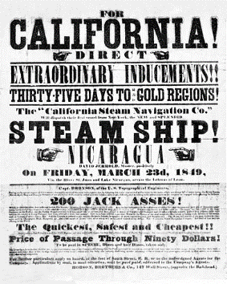
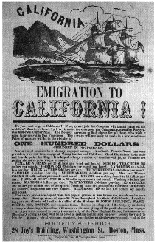
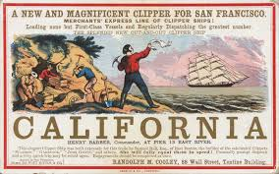
The California Gold Rush
Directions: The discovery of gold in Northern California in 1848 radically changed America as the subsequent Gold Rush brought thousands to the West Coast. Read here http://ow.ly/U5Fr30fG7Z7 here http://ow.ly/tz8530fG82O to answer the prompts below.
Who were the 49rs?
Why were they going to California?
What were some of the troubles they faced heading West?
How did this change
the nation?
What did this mean for
Native Americans?

Slide 6
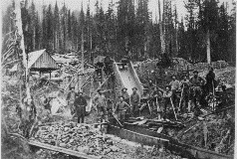
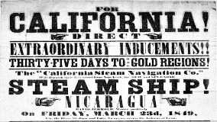
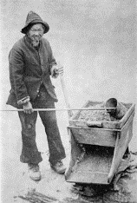
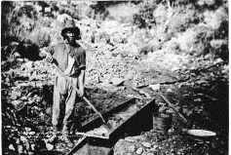
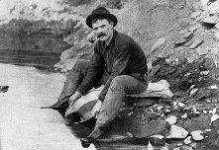


UNIT 3: Migration
Mining and Ranching Opportunities in the West
The first settlers heading west from the Mississippi Valley had a distant objective. They wanted to reach the rich farmlands of the Far West. They moved as fast as they could across the Great Plains. Then they struggled to get over the Rocky Mountains. Most of them stopped for good only when they reached the fertile fields and valleys of Oregon and California. By 1848, 14,000 people had made this journey. This trickle of migration changed quickly in the mid-1800s, however, after settlers found gold in California.
Miners: In Search of the Big Strike In 1848, a landowner named John Sutter was building a sawmill on the American River, in California's Central Valley. This river flowed down from the Sierra Nevada range to the east. In January of that year, Sutter's workers found gold near the mill. Sutter tried to keep the gold a secret, but eventually word got out. Up and down the Pacific Coast, men deserted their work to head for Sutter's Mill. By the year's end, gold fever gripped the whole nation and even spread abroad. The California gold rush was on.
In the spring of 1849, some 40,000 migrants from the East headed overland to California. That same year, about 40,000 more people boarded steamships bound for San Francisco. Soon California swarmed with "forty-niners," as these miners were called. About nine out of ten were men, most of them young. Many came from Mexico, and thousands more arrived from as far away as Europe and China. All of them were motivated by one great hope—to strike it rich.
Few of these prospectors and treasure hunters knew anything about mining. Luckily, much of California's gold was not locked up in solid rock. Over time, water erosion had dislodged much of the gold and washed it down into streambeds. Miners called this placer gold, which they could mine using simple tools, such as pans and shovels. Other prospectors looked for veins of gold and silver in solid rock. Often working in groups, they used hand tools and weak explosives to extract the metal. Miners called a thick vein a lode. Every prospector's dream was to find the "mother lode" that would produce untold riches.
Between 1850 and 1860, California's population jumped from about 93,000 to over 380,000. Prospectors set up tent camps near their claims. Merchants of all kinds followed close on their heels. As stores, banks, saloons, and restaurants opened up, some camps swelled into towns. When a site no longer produced much metal, most prospectors moved on.
For three decades after the California gold rush, hordes of miners chased their dream of riches from Mexico to Alaska and east as far as the Black Hills of Dakota. They endured backbreaking work and conditions that were dismal and sometimes dangerous. However, very few prospectors ever struck it rich. After years of searching, most would have agreed with the familiar saying, "Gold is where I ain't!"
By the early 1850s, most of the ore that could be easily mined in California had been found. Individual prospectors eventually gave way to large mining companies that used hydraulic machines to wash away whole hillsides in search of gold. In the process, they damaged the environment, destroying habitat, polluting rivers, and leaving behind large piles of debris on which nothing could grow.

Slide 7
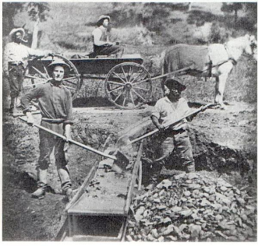
UNIT 3: Migration
Suppose you are a miner. In the space below, list the negative impact and positive impact of westward expansion.
NEGATIVE IMPACTS
(Challenges and Hardships)
POSITIVE IMPACTS
(Opportunities)

Slide 8

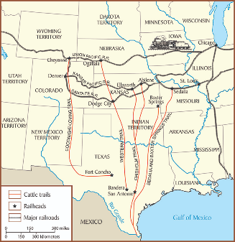
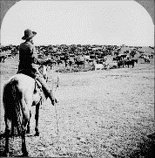
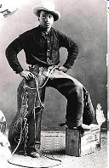
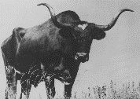
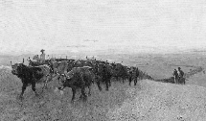
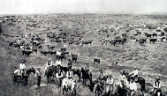

UNIT 3: Migration
Ranchers and Cowboys Find a Home on the Range While miners uncovered the West's valuable stores of gold, silver, and other minerals, cattle ranchers found opportunity in a different kind of natural resource: grass. Their beef cattle thrived on the abundant grasses and open range of the Great Plains.
Plains cattle ranching had started in Texas before the Civil War. The region had a long tradition of ranching going back to the first Spanish settlers. Mexican vaqueros started many cowboy customs. They rode horses and wore boots with pointed toes and wide-brimmed hats. They rounded up cattle and branded them.
Many Texas ranchers went off to fight in the Civil War and never returned. Untended, their cattle multiplied. By the mid-1860s, several million tough longhorn cattle roamed wild on the open plains. Many lacked the brands that showed ownership. Some Texans began to round up unbranded cattle with an eye toward driving, or herding, them north to market.
Their timing was good. The growing populations of eastern cities had raised the demand for beef. In the East, ranchers could get $40 a head for cattle that sold for $5 or less back in Texas. Also, railroad companies had begun extending rail lines west from Missouri into Kansas. Cowhands could drive their herds to "cow towns" that sprang up along the rail lines. The potential for large profits made a long cattle drive to one of these cow towns seem well worth the effort.
The era of the long drive began in 1867, when cowboys following the Chisholm Trail drove longhorns north from San Antonio, Texas, to Abilene, Kansas. From Abilene and other cow towns, live cattle were shipped in rail cars to meatpacking centers like Chicago. Working as a team, a dozen cowboys could drive more than a thousand cattle at a time along the trail. African Americans and Mexican Americans made up at least a quarter of all cowboys on the long drives.
Cowboys led rough lives, working outdoors and sleeping on the ground in all types of weather. They had to be prepared to defend the herd against people who wanted to steal the cattle, as well as against Indian attacks. There was also the constant threat of a stampede.
The long drives ended once rail lines reached into cattle country during the 1880s. The new lines not only transported cattle to market but also brought farmers to the plains. The newcomers sparked conflict with the cattle ranchers by fencing off their farms with barbed wire, effectively closing the open range. Nature dealt cattle ranching an even harsher blow when the blizzards of 1886 and 1887 killed thousands of cattle, forcing many ranchers into bankruptcy. Those who survived decided to fence in their ranches and raise only as many cattle as their land could support.
-

Slide 9
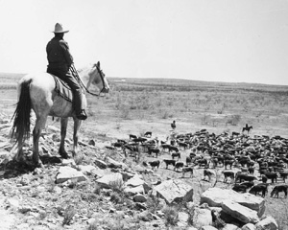
UNIT 3: Migration
Suppose you are a Rancher or a Cowboy. In the space below, list the negative impact and positive impact of westward expansion.
NEGATIVE IMPACTS
(Challenges and Hardships)
POSITIVE IMPACTS
(Opportunities)

Slide 10
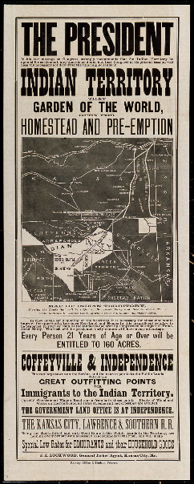
The Homestead Act
Directions: In 1862, President Lincoln officially signed the Homestead Act into law. After researching more about the Act, here http://ow.ly/7luD30fGbf8 explain the reasons for its passage, what the Act did, what the opposition to it was, and the effect that it had on the U.S.
Signed into law in May 1862, the Homestead Act opened up settlement in the western United States, allowing any American, including freed slaves, to put in a claim for up to 160 free acres of federal land. By the end of the Civil War, 15,000 homestead claims had been established, and more followed in the postwar years. Eventually, 1.6 million individual claims would be approved; nearly ten percent of all government held property for a total of 420,000 square miles of territory.
The Homestead Act (May 20, 1862) set in motion a program of public land grants to small farmers. Before the Civil War, the southern states had regularly voted against homestead legislation
because they correctly foresaw that the law would hasten the settlement of western territory, ultimately adding to the number and political influence of the free states. This opposition to the homestead bill, as well as to other internal improvements that could hasten western settlement, exacerbated sectional conflicts. Indeed, the vision of independent yeomen establishing homesteads on the prairies was offered in the political rhetoric of the 1850s as a vivid contrast to the degradation of slave labor on southern plantations.
A homestead bill passed the House in 1858 but was defeated by one vote in the Senate; the next year, a similar bill passed both houses but was vetoed by President James Buchanan. In 1860, the Republican platform included a plank advocating homestead legislation.
The Homestead Act remained in effect for more than 100 years. The final claim, for 80 acres in southeastern Alaska, was approved in 1988.
After the southern states had seceded, homestead legislation was high on the Republican agenda. The Homestead Act of 1862 provided that any adult citizen (or person intending to become a citizen) who headed a family could qualify for a grant of 160 acres of public land by paying a small registration fee and living on the land continuously for five years. If the settler was willing to pay $1.25 an acre, he could obtain the land after only six months’ residence.
But the law did not provide the new beginning for urban slum dwellers that some had hoped; few such families had the resources to start farming, even on free land. The grants did give new opportunities to many impoverished farmers from the East and Midwest, but much of the land granted under the Homestead Act fell quickly into the hands of speculators. Also, over time, the growing mechanization of American agriculture led to the replacement of individual homesteads with a smaller number of much larger farms.
Reasons for the Act
What the Act did
Opposition to the Act
Effect of the Act on the US

Slide 11
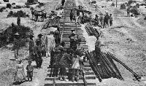
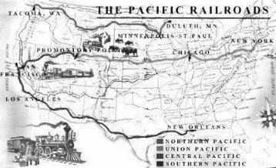
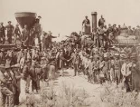

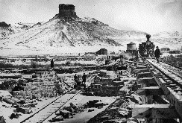
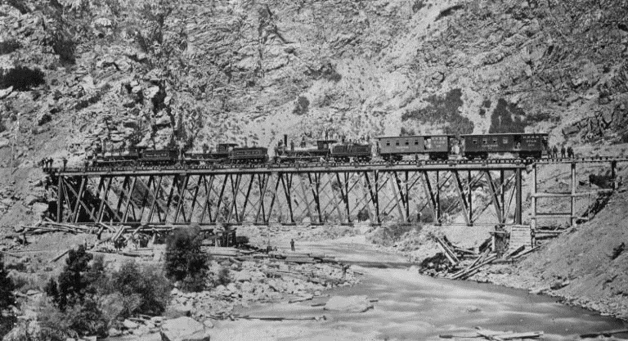

UNIT 3: Migration
Railroads Open the West to Rapid Settlement
An easterner bound for the California goldfields in 1849 could not have made it halfway to the Mississippi River by train alone. Before the 1850s, most railroads were short lines, connecting cities and towns in just one region. A flurry of rail building in the 1850s changed that. By 1860, rail lines extended from the Atlantic Coast across the Mississippi. This expansion set the stage for opening up western lands to settlement and for linking the East and West coasts by rail.
The gold rush had produced a population explosion in the Far West. Yet this growing region remained in isolation, essentially separated from the rest of the nation. During the 1850s, many people pointed out the need for better transportation and communication between East and West. In particular, merchants demanded a faster way to transport goods across the Great Plains and the Rockies. They wanted a transcontinental railroad, one that spanned the continent. This need presented a great opportunity to railroad builders.
The First Transcontinental Railroad Creates Huge Challenges In 1861, four wealthy merchants in Sacramento, California, founded the Central Pacific Railroad Company. Known as the "Big Four," they sought government support for a transcontinental railroad. One of them, C. P. Huntington, went to Washington to act as a lobbyist to push for a railroad bill. Lobbyists try to persuade legislators to pass laws favorable to groups they represent.
Plans for a transcontinental railroad had been stalled by debate in Congress over whether to follow a northern or southern route. However, the South's secession and the onset of the Civil War led Congress to approve a northern route that would unite California and Oregon with the rest of the Union. The Pacific Railway Act, passed in 1862, directed the Central Pacific and the newly created Union Pacific Railroad Company to construct railway and telegraph lines from the Missouri River to the Pacific Ocean. The Union Pacific would start in Omaha, Nebraska, and work its way west. The Central Pacific would start in Sacramento and head east.
Building the first transcontinental railroad posed tremendous challenges. One problem was raising enough funds. Under the Pacific Railway Act, the government pledged to help each company by granting it 6,400 acres of land and up to $48,000 in loans for each mile of track laid. Once the laying of rails began, the owners could sell the land to settlers to help pay for construction costs. But they needed startup money. The Union Pacific had trouble raising funds and did not lay its first rails until 1865.
The Union Pacific also faced conflicts with some of the tribes that lived on the Great Plains. Its route followed the Platte River through territory controlled by the Cheyenne, Arapaho, and Lakota Sioux. All three tribes had been battling the U.S. Army for years, and their attacks on railroad workers sometimes stopped construction.
For the Central Pacific, rough terrain was a major challenge. Crossing the Sierra Nevada was an epic engineering feat. The rail line had to pass over, and sometimes through, high mountain passes. It also had to bridge deep canyons. On some days, progress was measured in inches. Beyond the Sierra Nevada lay the Great Basin, a vast, dry region where summers are blistering hot.

Slide 12
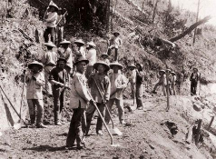
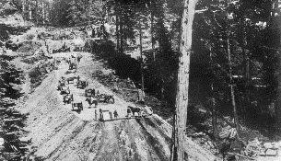
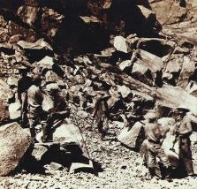
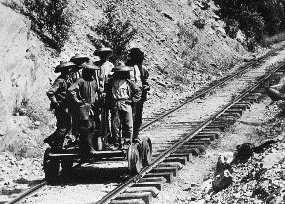
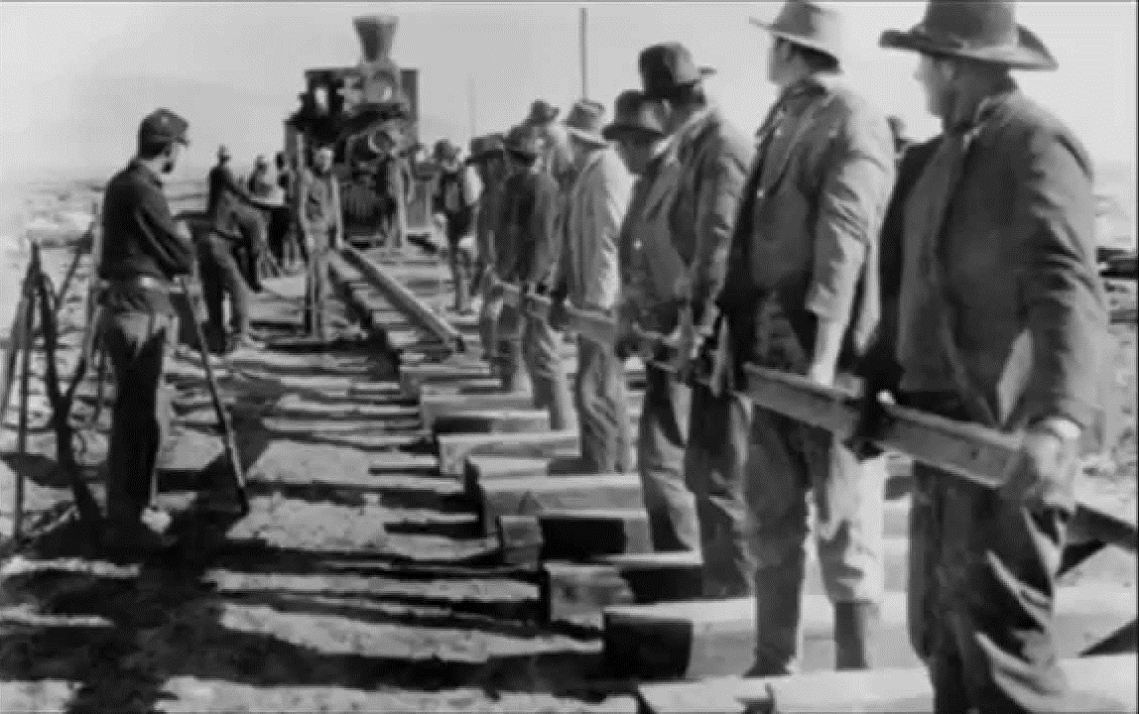
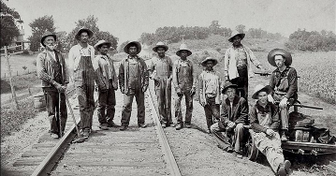
UNIT 3: Migration
Working on the Railroad: Jobs and Hardships for Immigrants
In meeting these construction challenges, the two railroad companies owed much of their success to immigrant labor. At first, both companies faced a severe labor shortage. They needed thousands of workers, but the Civil War and the gold rush had siphoned off a large part of the labor pool.
The end of the Civil War in 1865 solved part of the Union Pacific's labor problem. Ex-soldiers and former slaves eagerly joined company crews. So did immigrants from Europe. In fact, the bulk of its 12,000-man workforce was made up of Irish immigrants. Large numbers of Irish began immigrating to the United States after a potato disease brought famine to Ireland in 1845. Many first settled in eastern cities, where they were looked down on for being Catholic and poor. In the face of such discrimination, railroad jobs seemed like an attractive opportunity.
When the Central Pacific began construction in 1865, it also faced a shortage of workers. In desperation, it decided to hire workers from China, despite widespread prejudice against the Chinese. The company advertised in China, promising impoverished workers good pay. By 1868, the Central Pacific was employing about 10,000 Chinese workers, who made up four fifths of its labor force. Chinese workers were paid lower wages than white workers and were targets of racism.
Working on the railroad was both strenuous and dangerous. Some workers were killed in Indian attacks. The use of dynamite to blast tunnels through the Sierra Nevada also resulted in injuries and deaths. Extreme cold in winter left many workers with frostbite, and snow avalanches killed others. Yet the workers who survived had money in their pockets.

Slide 13
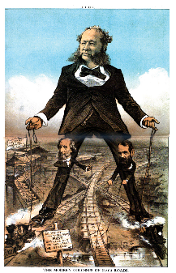
UNIT 3: Migration
Suppose you are a Railroad Owner. In the space below, list the negative impact and positive impact of westward expansion.
NEGATIVE IMPACTS
(Challenges and Hardships)
POSITIVE IMPACTS
(Opportunities)

Slide 14
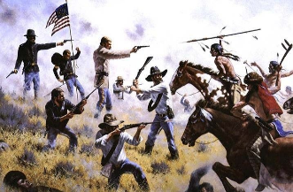
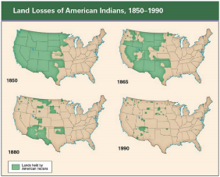
UNIT 3: Migration
Indian Wars Shatter Tribal Cultures
To many people, the railroad represented progress. But for the Indians on the Great Plains, it was a threat to their very existence. The railroad cut through their hunting grounds, disturbing the buffalo, their main source of food, clothing, and shelter. It also brought ranchers, farmers, and soldiers to the hunting grounds. In response, many tribes fought the railroad, waging war to stop the rush of settlement that jeopardized their ways of life. Their battle for survival represented the latest round of what are known as the Indian Wars.
Cultures Clash on the Great Plains From the perspective of a nation bent on expanding westward, the many Indian tribes in the West presented a problem. They refused to change their customs to conform to the settlers' culture. For example, they believed that tribes or villages had rights to areas of land. However, they did not believe that land could be owned, bought, or sold.
Differences between Indians and settlers over land had led to conflict early in the nation's history. Conflicts continued as settlers crossed the Appalachians and laid claim to tribal lands in the Ohio and Mississippi river valleys. To end such conflicts, the Indian Removal Act of 1830 had forced the largest tribes living east of the Mississippi to move west to Oklahoma Territory on the Great Plains. When settlers began to populate the West after the Civil War, they again clashed with native peoples. The Indians were once more viewed as "an obstacle to the progress of settlement and industry," as one government official put it.
A complex clash of cultures occurred on the Great Plains. Nomadic tribes had roamed the plains freely for centuries in pursuit of buffalo. They had little in common with eastern tribes, who had been conquered and "removed" to the plains in the 1830s. These differences led to conflict between nomadic tribes that wanted more open land and settled tribes that wanted to protect their farmland.
Larger conflicts arose with the advance of white civilization. As settlers moved westward, they slaughtered millions of buffalo, endangering a vital element of tribal cultures. Many tribes refused to give up their homelands and ways of life without a fight. Their warriors began attacking settlers.
The U.S. Army responded with attacks on the plains tribes. In 1864, troops raided a party of Cheyennes and Arapahos who had camped at Sand Creek, Colorado, with permission from the commander of a nearby fort. More than 150 people, many of them women and children, were killed. The Sand Creek Massacre sparked a general uprising among the plains tribes.
In an effort to end conflict and open up land for settlers, the federal government tried to confine most western tribes to reservations. A reservation is an area of federal land reserved for an Indian tribe. Federal officials promised to protect these tribes. However, instead of protecting Indians, the government far too often helped prospectors and settlers who invaded a reservation. For example, a gold strike in the Black Hills of the Dakota Territory brought hordes of miners onto the Sioux reservation in the 1870s. The government ignored the invasion, even though the Treaty of Fort Laramie, signed in 1868, guaranteed the Sioux exclusive rights to the land.
Many tribes, from the Apaches and Comanches in the south to the Sioux, Cheyennes, and Arapahos in the north, refused to stay on reservations. Bands of raiders moved out onto the plains, where they fought to stop the expansion of settlements. In 1876, Sioux and Cheyennes who were camped near the Little Bighorn River in Montana came under attack by U.S. Cavalry troops under George Armstrong Custer. The much larger Indian force, led by Sioux chiefs Sitting Bull and Crazy Horse, wiped out Custer's troops.
After the Battle of the Little Bighorn, also known as "Custer's Last Stand," federal forces hunted down and captured about 3,000 Sioux warriors. Over the next few years, the army subdued the other major tribes of the Great Plains.

Slide 15
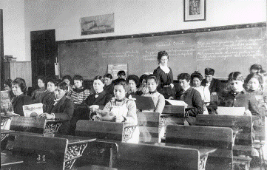
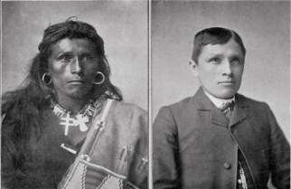
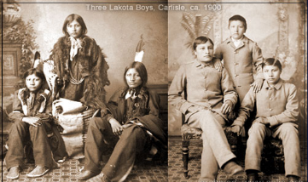
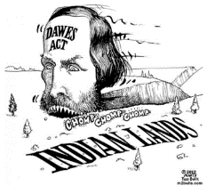
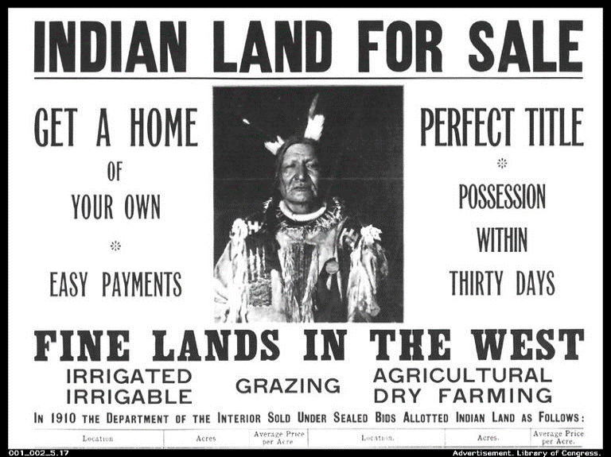
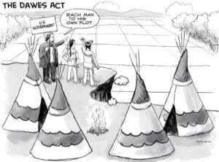
UNIT 3: Migration
Adaptation and Efforts to Assimilate American Indians The settlement of the West was disastrous for large numbers of American Indians. Many died as a result of violence, disease, and poverty. Others clung to a miserable existence on reservations.
The survivors struggled to adapt to their changed circumstances. Some Indians tried agriculture. The eastern tribes that had been removed to Oklahoma became successful farmers. Many tribes established their own government and schools.
At the same time, the U.S. government adopted policies aimed at speeding the assimilation, or absorption, of Indians into the dominant culture. Federal officials set up about two dozen boarding schools to educate American Indians in "white men's ways." Congress furthered the assimilation push by enacting the Dawes Act of 1887. Under this law, a tribe could no longer own reservation lands as a group. Instead, the government began distributing land to individuals within a tribe. Each family was granted its own plot of land, which it could hold or sell. This change eroded a cornerstone of American Indian cultures—the belief that land could not be bought or sold. Land sales, both free and forced, greatly decreased the amount of Indian-owned land.
-

Slide 16
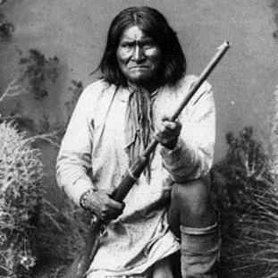
UNIT 3: Migration
Suppose you are an American Indian. In the space below, list the negative impact and positive impact of westward expansion.
NEGATIVE IMPACTS
(Challenges and Hardships)
POSITIVE IMPACTS
(Opportunities)

Slide 17
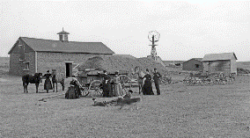
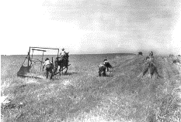



UNIT 3: Migration
Settling the Great Plains
Despite resistance from tribes of the Great Plains, settlers continued to migrate there during the second half of the 19th century. They ventured on foot, on horseback, and in ox-drawn wagons. Later they came by rail. Most had one goal: the opportunity to turn a plot of grassland into a farm.
Opportunities and Challenges on the Great Plains Several factors transformed the Great Plains from a place to pass through on route to the West Coast into a land of opportunity. Perhaps the most important was the steady expansion of the railroads. The railroads carried settlers onto the plains, and the railroad companies sold settlers land that the companies had been granted by the government. Another factor was that families felt much safer migrating to the West because the army had reduced the threat of attack by plains tribes. A third factor was the passage in 1862 of two federal laws that encouraged settlement.
The two new laws were the Homestead Act and the Morrill Land-Grant Act. The Homestead Act was designed to provide tracts of land called homesteads to settlers in the West. The act offered 160 acres of public land for a small fee to anyone who agreed to work the land and live on it for five years. This law attracted about 600,000 farmers who claimed more than 80 million acres of land by the end of the 19th century. The Morrill Land-Grant Act gave each state large tracts of public land to help finance the establishment of agricultural colleges. To raise funds to build colleges, states sold homesteads to settlers.
The plains offered settlers a fresh start. The settlers knew by the look and smell of the rich soil that crops would thrive in this land. To be successful, however, they had to overcome some difficult challenges. The first was building houses on the largely treeless plains. Lacking lumber, some homesteaders simply dug a hole in the side of a hill as a shelter. Other settlers fashioned houses out of the tough plains turf, or sod. They called these houses "soddies." Sod blocks, cut out of the ground with a shovel or an ax, formed the walls. Most roofs were made of sod as well. Once farmers could afford lumber delivered by train, they replaced their dugouts and soddies with wood-frame houses.
Another challenge was the environment. The Great Plains region typically has an arid climate. The settlers who flocked there in the 1870s and 1880s arrived during an abnormally wet period. The unusual amounts of rain helped crops flourish. Still, farmers had to deal with winter's deep cold, piercing winds, and blizzard snows. By the early 1890s, drought conditions had returned, especially in Kansas, Nebraska, Colorado, and the Dakotas. As the soil dried up, wheat, corn, and other crops failed. Farmers also had to contend with grasshoppers. Great clouds of these pests, thick enough to darken the sky, descended on fields with little warning. They chewed for days on everything edible, destroying entire crops.
In the face of these hardships, many farmers left the plains. The sides of their covered wagons bore the words "In God We Trusted, In Kansas We Busted." Others worked to overcome the harsh conditions by using dry-farming techniques. To conserve soil moisture, they plowed and planted a field one year and left it uncultivated the next. Also, tools had made farm life easier. The steel plow, invented in 1837, had made it easier to cut through the thick prairie sod and prepare it for planting. The mechanical reaper neatly cut and bound sheaves of grain at harvest time. Windmills pumped water from deep wells for household use and irrigation.

Slide 18

UNIT 3: Migration
Suppose you are a Settler. In the space below, list the negative impact and positive impact of westward expansion.
NEGATIVE IMPACTS
(Challenges and Hardships)
POSITIVE IMPACTS
(Opportunities)

Slide 19

See Ms. Greif for your migration assessment before you move on

