Slide 1
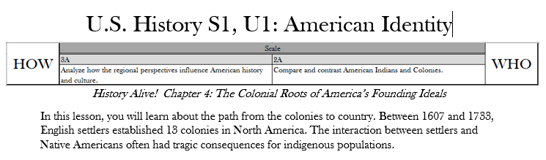
Comparing British & French Colonization
Directions: While both England and France explored and had settlements in North America, their settlements became very different. After reading about French and English colonies, https://www.mpm.edu/wirp/ICW-144.html and http://ow.ly/nest30ftK7n
https://www.youtube.com/watch?v=UqUSY59Kilk and https://tinyurl.com/m9judne
match the characteristics from the bank below to the corresponding colonies.
British Colonies
French Colonies
Leaders are elected by colonists
Leaders are selected by King
Slow population growth
Colonies were mostly trading posts
Colonies had royal charters
Friendly with Native Americans
Exports of tobacco, rice, and cotton
Many fur traders
Included slaves and indentured servants
Rapid population growth
Often hostile relations with Native Americans

Slide 2
Colonists Interact with Natives
DIRECTIONS: Long before Europeans began arriving on the shores of what would become North and South America, thousands of Natives occupied these lands. Research the relationship between the early European colonists and the Powhatan Indians of the Chesapeake Bay region, and answer the questions below
In what ways did the relationship between English Colonists
and the Natives change over time?
What role did disease play in English colonization?
What role did treaties play in English colonization?

Slide 4
The French & Indian War
Directions: : While France and England were part of a worldwide conflict known as the Seven Years’ War, in America it became known as the French and Indian War. After reading about the conflict, look at the comic strips below and answer the questions.
Look at a comic strip illustrating how the French and Indian War began. http://ow.ly/rEvD30f707L
How did the French and Indian War begin?
Look at a comic strip illustrating how George Washington learned about warfare. http://ow.ly/ghEd30f70ji
How did Washington learn warfare?
Look at a comic strip illustrating when the French and Indians split http://ow.ly/5MIe30f70w5
When did the French and Indians split?
Click here to look at a comic strip illustrating how Britain won the war. http://ow.ly/yXNR30f70CQ
How did Britain win the war?
Click here to look at a comic strip who paid for the French and Indian War. http://ow.ly/4cYd30f70GL
Who paid for the French and Indian War?
Why were the colonists upset with the King of England after the French and Indian war?

Slide 6
Historical Patterns between Natives & Europeans
Directions: Historical patterns are considered the motivations (what was the underlying cause for doing something) and outcome of that motivation. In the boxes below – match each motivation to their description, and each outcome to their description.
Motivation
God
Gold
Glory
Description of motivation
The competition between monarchies. Some kings sought to establish their claims to newly contacted territories so as to strengthen their position in European politics and increase their power at the expense of the landowning nobility.
The militant crusading and missionary traditions of Christianity, characterized in part by rivalry with Islam and hatred of non-Christians.
The search for material gain through acquiring and selling Asian spices, African slaves, American metals, and other resources. As merchants gained influence in the late-medieval Western Europe, they convinced their governments to establish a direct connection to the lucrative Asian trade, leading to the first European voyages in the 1400’s.
Outcome
Food exchange
Weapons
Destruction of Native villages
Spiritual life
Disappearance of Native languages
Description of outcome
Natives prayed for rain, sun, healthy children, all good things in their lives. Puritans hoped to enlighten the Natives in Massachusetts. Spanish settlers hoped to convert Natives in the Southwest. Europeans increasingly forceful attempts were met with hostile Native resistance.
This was an immediate exchange, sometimes friendly, other times not. Either way, over time, the diets of both Natives & Europeans widened.
The nature of hunting and warfare changed and Natives traded for whatever the Europeans were carrying, whenever they could.
There were as many as 300+ spoken tongues at the time of encounter. Then came Spanish, French, Dutch, Portuguese, and English. Over time, Native tongues disappeared and the common use of European, especially English, became widely used.
Over time, the landscape changed as the number of European communities increased and resembled the cities of Europe while Native settlements were destroyed or pushed West.

Slide 7
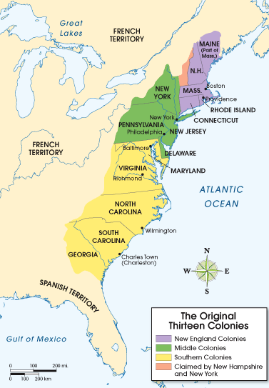
Comparing Colonial Regions
Directions: As the American Colonies grew and more colonists arrived,
each region developed different characteristics. Read the pages included and
use the information you have learned about each region.
based on growing cash crops such as rice, indigo and tobacco.
families settled in small towns centered on strict religious practices
greatest ethnic diversity
based on farming, lumbering, fishing, shipbuilding and trade.
based on livestock and trade in port cities, like Philadelphia
relied heavily on indentured servants, and eventually, on slaves
New England
Middle
Southern

Slide 9
Stamp Act | Townshend Act | Sugar Act | Intolerable Act
Boston Tea Party | Boston Massacre | Lexington/Concord | Bunker Hill

Slide 10
Taxes Lead to Revolution
Directions: The Sugar Act, Stamp Act, Townshend Acts, & Intolerable Acts were all passed by Parliament and met with resistance in the American Colonies.
For the Acts below, give the year they were passed, explain what they did, then why the colonists were opposed to them. History Alive! Ch. 5, p40-42
The Sugar Act
.
The Stamp Act
The Townshend Acts
The Intolerable Acts

Slide 11
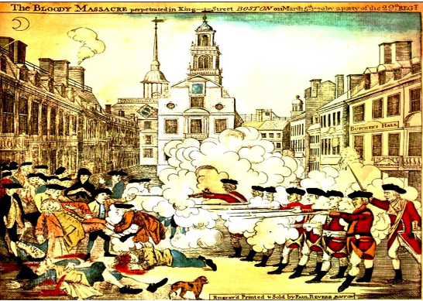
The Boston Massacre
Directions: : On March 5, 1770, British soldiers killed five civilians and injured six others in Boston. The incident became known as the The Boston Massacre. After reading about and analyzing the event, look at the engraving by Paul Revere below. Then, analyze the image by completing the text boxes.
What were the Patriots protesting?
Why?
What were the British soldiers ordered to do?
How did the colonists respond?
What happened?
In the trial…
Who was the defense?
What was the verdict?
What was the sentence?
Who were the Sons of Liberty?
What was their opposition?
What did they do in response to the “massacre”?
Why is the Boston Massacre significant?
Paul Revere was a Patriot. He is responsible for the above artwork.
What else is he known for in regards to the revolution?

Slide 13
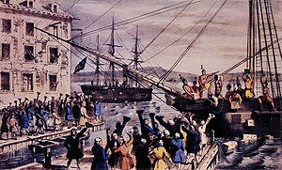

The Boston Tea Party
On December 16th, 1773, just three years after the Boston Massacre, reacted again in protest, this time involving tea. Research this event and answer the questions below.
What happened on the night of
December 16th, 1773?
Who did it?
How did they do it?
What were the Coercive Acts?
What was the Tea Act?
What is Parliament?
Who is the East India Company?
Why do either of those
organizations matter?
Why was the
Boston Tea Party
significant?
Why did it happen?
What was the outcome?

Slide 15
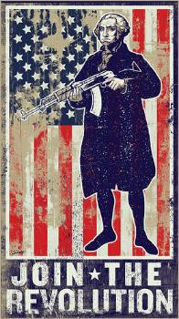
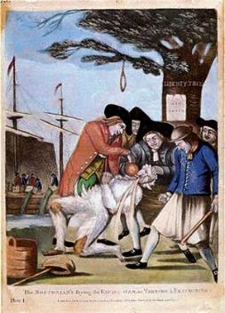
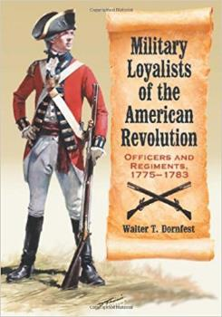
Patriots, Neutrals, and Loyalists
Directions: As calls for independence grew across the 13 Colonies, people began to take sides. After reading about these 3 groups, describe the reasons each group had for their stance, then explain what your stance would be and why if you were alive at the time.
Patriots Neutral Loyalists
Patriots supported Independence. Why?
From whom?
Some were neutral. They were called “fence-sitters”. Why?
Loyalists supported Great Britain. Why?
My stance would be ...

Slide 17
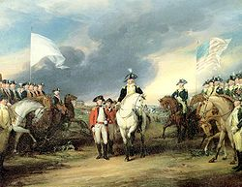
Battles and Key Events of the Revolution
Lexington & Concord
What started the conflict at Lexington?
Why was this called “the shot heard ‘round the world?
1775
Battle of Bunker Hill
Who won the battle?
What was significant about it?
1776
Washington Crosses the Delaware
What was so significant about this move?
.
Saratoga
Why was Saratoga considered a turning point in the war?
1777
Valley Forge
What hardships were Washington & his men facing?
How did the winter at Valley Forge help the Continental Army?
1778
1779
Yorktown
Who led the forces at Yorktown?
Why did Lord Cornwallis surrender?
1780
Directions:
visit this site www.history.com or research in chapter 5 of textbook History Alive! to learn about the key battles of the Revolution and respond to the prompts in the boxes on this organizer.
1781

Slide 18
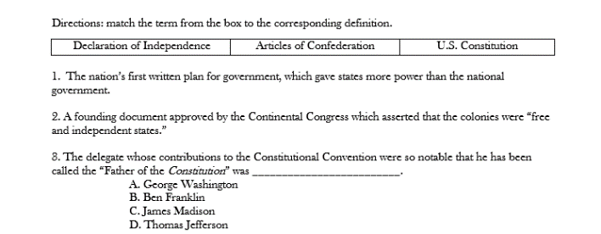
America’s Republican Values
Republicanism is the guiding political philosophy of the United States. It has been a major part of American civic thought since its founding. It stresses liberty and unalienable individual rights as central values, making people sovereign as a whole, rejects monarchy, aristocracy and inherited political power, expects citizens to be independent in their performance of civic duties, and vilifies corruption. American republicanism was founded and first practiced by the Founding Fathers in the 18th century. For them, according to one team of historians, "republicanism represented more than a particular form of government. It was a way of life, a core ideology, an uncompromising commitment to liberty, and a total rejection of aristocracy."
Directions: After completing the activities on the following pages, in the boxes below, explain the ways in which American founding documents reflected republican values.
The Declaration of Independence
The Articles of Confederation
The United States Constitution

Slide 19
The Declaration of Independence
Directions: The most famous date in American history - July 4, 1776 - marks the date when the Declaration of Independence was formally adopted by the Continental Congress. After analyzing the Declaration, briefly explain each section in your own words.
Preamble
Statement of Beliefs
List of Grievances
Attempts at Negotiation
Declaration

Slide 23
The Articles of Confederation
Directions: After declaring independence from Great Britain, America’s first government was established by the Articles of Confederation – which reflected Americans’ fear of a powerful national government which was justified as they had just broke free from King and Crown. However, some weaknesses were evident and over time clearly needed to be addressed. Research the next page, chose 3 major weaknesses, why they were a problem to the new government of the new country of the United States of America, and what needed to be done about it.
Weakness
#1
Weakness
#2
Weakness
#3
What problems did these weaknesses pose to the new government?
What did Americans decide to do in order to solve these problems?

Slide 26
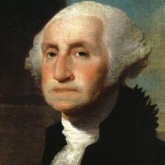
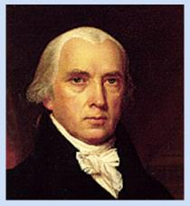
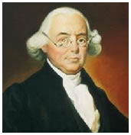
The United States Constitution
Directions: The Constitutional Convention of 1787 took place in Philadelphia and originally was held to revise the Articles of Confederation. It was quickly decided, however, that a totally new government was needed. Despite the fact that most delegates to the Constitutional Convention believed the government designed by the Articles of Confederation had to be replaced, many still feared a strong central government. The Constitution has remained flexible enough to guide the United States through changing times now for several reasons. Most importantly, it describes some very basic principles that constitute the guiding philosophy of the republic. Read about the “Philadelphia Convention”
on the following pages in order to complete the graphic organizer below.
__________?_________
President of the Convention
His contributions included….
__________?_________
Father of the
Constitution
His contributions included….
__________?_________
Three-Fifths
Compromiser
His contributions included….
Virginia Plan
Explain this plan here….
New Jersey Plan
Explain this plan here….
Difficulties
Why did some have trouble getting to the convention?
Frustration
Who did not attend? Why?
Failure
What was the significant failure of the United States Constitution?
What did this failure possibly lead to…?

