Slide 1
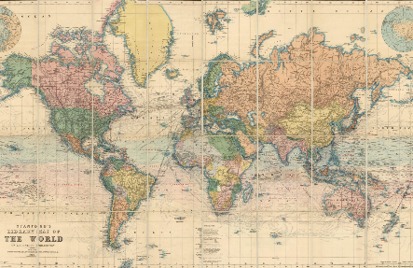
The Spanish-American War
Directions: The Spanish -American War was called a “splendid little war” by
Secretary of State John Hay. After reading about the war, http://ow.ly/l4fC30f3cMd
sort the events on the timeline. Then explain what happened to each territory after the war.
US Marines Capture Guantanamo Bay
The US & Spanish sign the Treaty of Paris
The US Declares War on Spain
Commodore Dewey destroys Spanish fleet in the Philippines
Roosevelt’s Rough Riders Capture Kettle Hill
The USS Maine Battleship Explodes
Guam
Cuba
Puerto Rico
The Philippines

Slide 2
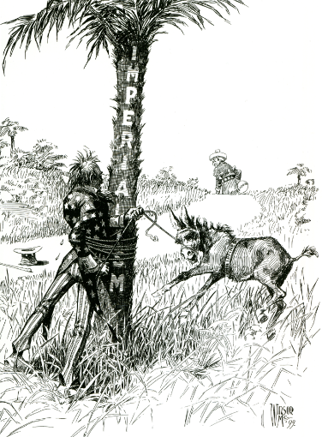
The Philippine-American War
Directions: Almost immediately after fighting with Filipino rebels against the Spanish, the US was fighting them against them in a longer, more brutal conflict. Complete the boxes on the war then analyze the cartoon below.
Reasons for the War
Stages of the War
Results of the War
What does this cartoon have to say about the Philippines’ role in American imperialism?
Do you feel the US was right to try and retain the Philippines? Explain.
In this 1899 political cartoon, Uncle Sam is entangled around a tree labeled "Imperialism" trying to subdue a bucking mule labeled "Philippines" while a figure representing Spain walks off in the horizon.

Slide 5
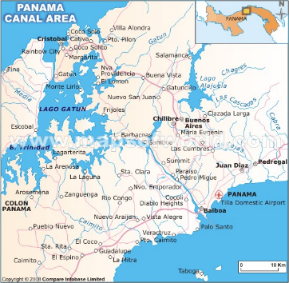
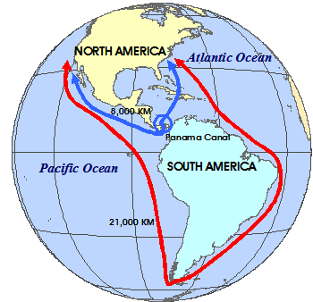
The Panama Canal
Directions: The construction of the Panama Canal is one of the great building projects in history. Research the history of Panama before, during, and after the canal along with how iit was built in order to complete the organizer below.
Who first attempted to build a canal?
How did their attempt go?
What difficulties were faced in building the canal?
Why was a canal in Central America so important for the United States?
What are concerns facing the Panama Canal today?
The Panama Canal has live webcams that show various spots along the canal!
These can be viewed here.
https://www.pancanal.com/eng/photo/camera-java.html

Slide 8
Imperialism & Teddy Roosevelt
Directions: President Roosevelt is one of the few presidents known as much for his accomplishments with foreign affairs as he is with domestic ones. Research President Roosevelt’s foreign policies and his “Big Stick Ideology” and History Alive! Chapter 21 to complete the graphic organizer below.
The Big Stick Policy
Explain the policy in your own words here…..
Example #1
Example #2
Example #3
While President McKinley ushered in the era of the American empire through military strength and economic coercion, his successor, Theodore Roosevelt, established a new foreign policy approach, allegedly based on a favorite African proverb, “speak softly, and carry a big stick, and you will go far.”
At the crux of his foreign policy was a thinly veiled threat. Roosevelt believed that in light of the country’s recent military successes, it was unnecessary to use force to achieve foreign policy goals, so long as the military could threaten force. This rationale also rested on the young president’s philosophy, which he termed the “strenuous life,” and that prized challenges overseas as opportunities to instill American men with the resolve and vigor they allegedly had once acquired in the Trans-Mississippi West.
Roosevelt believed that while the coercive power wielded by the United States could be harmful in the wrong hands, the Western Hemisphere’s best interests were also the best interests of the United States. He felt, in short, that the United States had the right and the obligation to be the policeman of the hemisphere. This belief, and his strategy of “speaking softly and carrying a big stick,” shaped much of Roosevelt’s foreign policy.
Roosevelt formalized this policy in a major address to Congress.
He reminded his audience of what doctrine?
And what was that doctrine designed to do?
This statement became known as the Roosevelt
A is a proposition that is a logical extension of a principle.
Who was the president to follow Roosevelt?
What was his foreign policy?
Who was the president after that who championed democracy around the globe?
What was his policy?

Slide 9
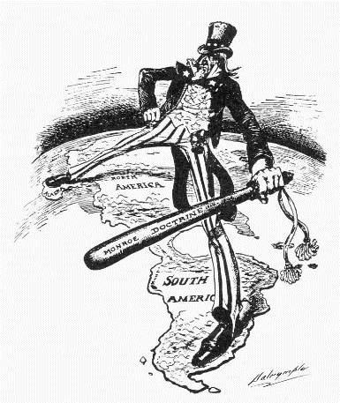
The Monroe Doctrine
Directions: The Monroe Doctrine was issued in 1823 and was an American foreign policy regarding Europe and Latin American countries. After learning about the Doctrine, respond to the prompts below in order to complete this graphic organizer.
What is the significance
of the Monroe Doctrine?
What is the main idea of this political cartoon?
What is the extension
of the Monroe Doctrine?
What was the last time the U.S. has invoked the Monroe Doctrine?
Do you see any irony to the Monroe Doctrine? If so, what?

Slide 12
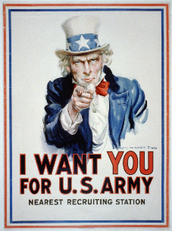
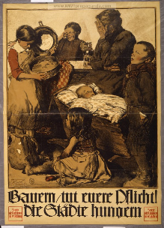
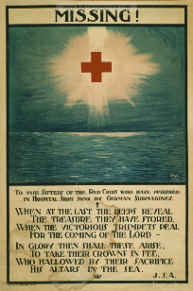
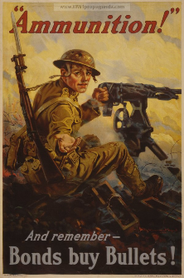

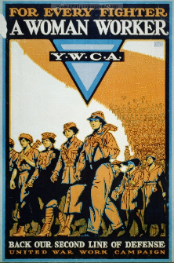
Propaganda
While Wilson tried hard to keep the nation out of war, both the Allies and the Central
Powers launched propaganda campaigns designed to whip up support for their side.
Directions: define propaganda, who used it, and why, and if it was successful.
Next, research here http://www.ww1propaganda.com/ the propaganda below and interpret.

Slide 13
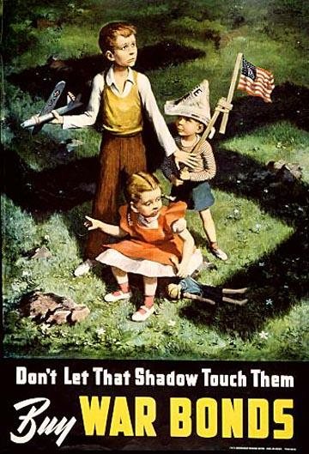

Slide 14
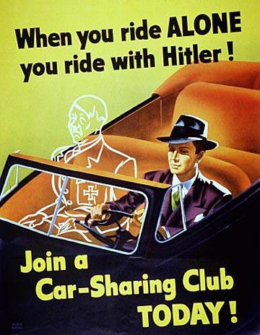

Slide 15
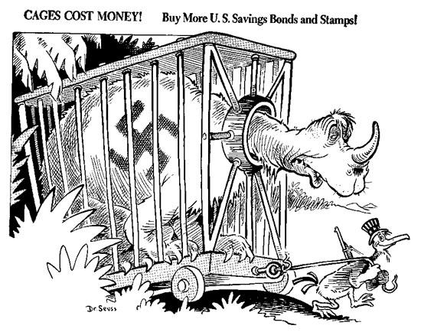

Slide 16
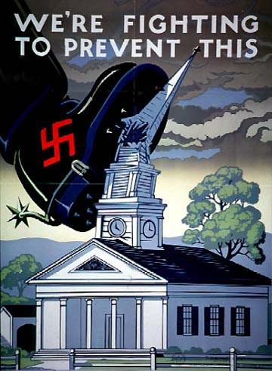

Slide 17
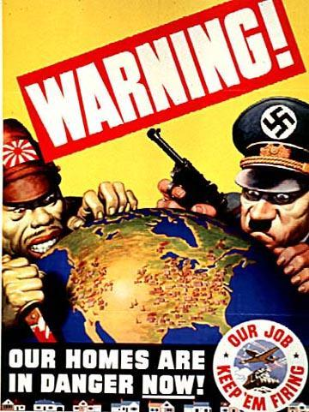

Slide 18
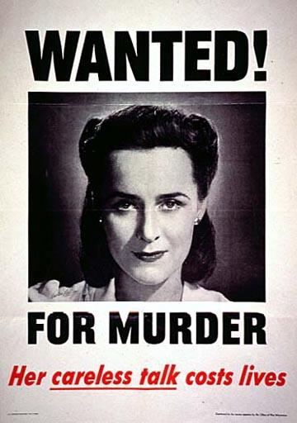

Slide 19
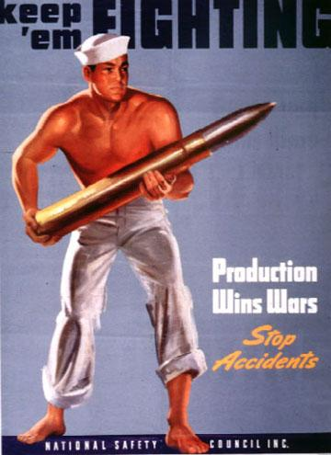

Slide 20
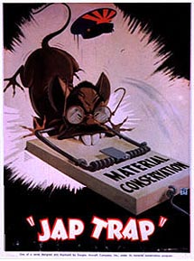

Slide 21
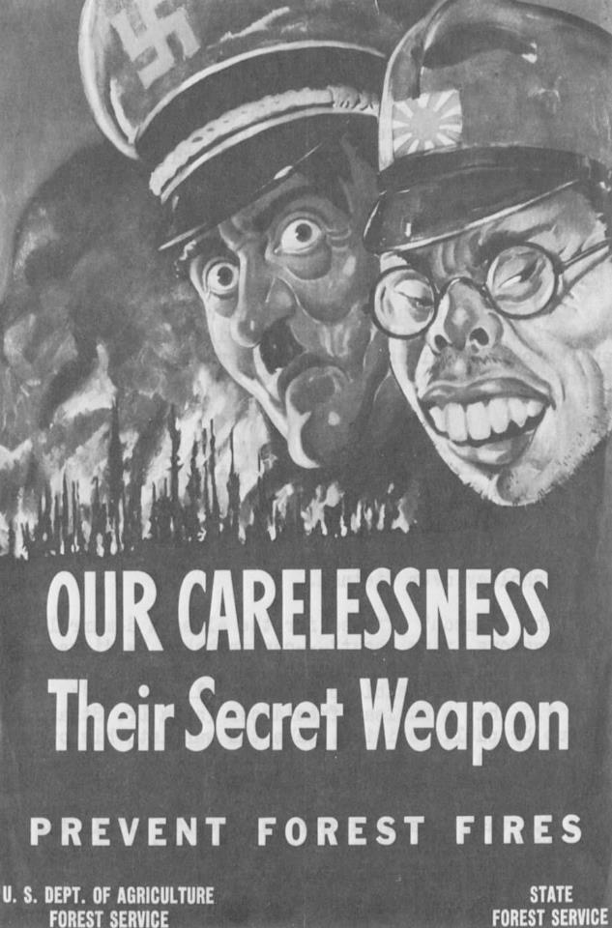

Slide 22
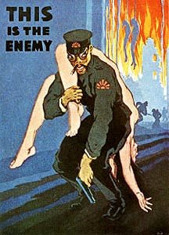

Slide 23
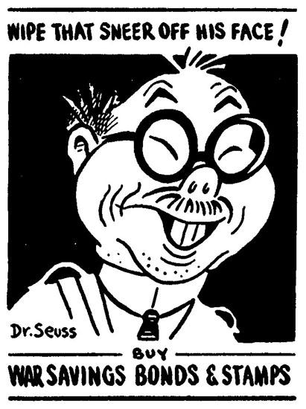

Slide 24
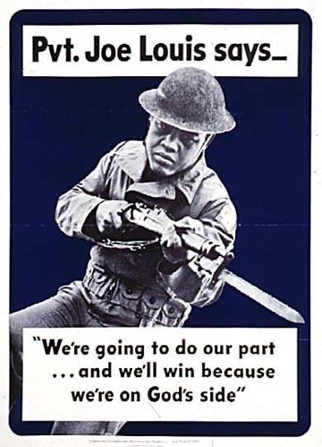

Slide 25
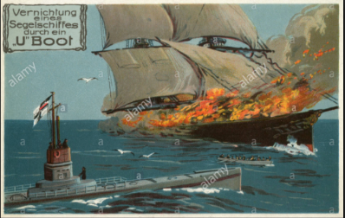
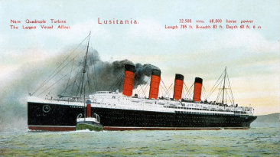
Lusitania
As the land war dragged on, both sides sought to break the stalemate. Unable to defeat
their enemy on land, both Britain and Germany looked for ways to starve their
enemies into submission. To do this they needed to win control of the seas.
Directions: continue research in chapter 22 of History Alive!
in order to respond to the prompts below.
What was a U-boat?
Who used them?
Why?
Were they successful?
Why or why not?
What was unrestricted submarine warfare?
Who used it?
Why?
Was it successful?
Why or why not?
What was the Lusitania?
Why was it significant?

Slide 26
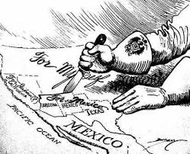
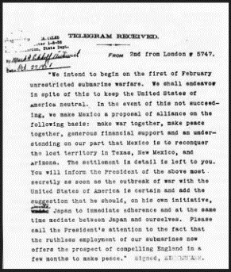
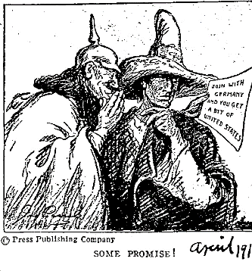
Zimmerman Note
Written in code, the Zimmermann note was deciphered by British cryptographers. The British waited to release the telegram to
American newspapers until relations between the United States and
Germany were at an all-time low. History Alive! Chapter 22
What was
written in
Zimmermann Note?
Why was it important?
What happened
in response to
the Zimmermann Note?

Slide 27
Marching Toward War
Directions: Read about the background and years leading up to WWI.
http://www.worldwar1.com/tlwarorg.htm
Then, determine the order of the following events.
Year
Austria declares war on Serbia.
The Triple Alliance is formed between Germany, Italy, & Austria-Hungary.
Gavrilo Princip shoots Archduke Franz Ferdinand in Sarajevo, Bosnia.
Germany takes Alsace-Lorraine region from France in the Franco-Prussian War.
The Triple Entente is formed between France, Britain, & Russia.
Great Britain declares war on Germany.
Germany declares war on Russia & France.
Austria takes over Bosnia & Herzegovina.
The militaristic Kaiser Wilhelm forces Otto von Bismarck to resign in Germany.

Slide 28
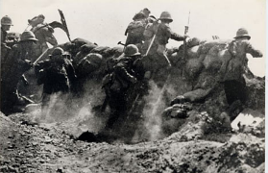
Battles of the Great War
Directions: Use this interactive timeline of World War 1 http://ow.ly/Evt130fCDqB
and this map and info http://www.greatwar.co.uk/battles/ to complete the timeline below.
How and why did the Battle of the Marne affect the Schlieffen Plan?
1914
1915
1916
1917
1918
1919
What was the Schlieffen Plan?
What was significant about the Second Battle of Ypres?
What was significant for the French at Verdun?
Was the Allied offensive at the Somme effective? Explain.
What effect did American
soldiers have on the war?
Why did Russia leave the war?

Slide 29


Fourteen Points
Directions: As World War I was coming to an end, President Woodrow Wilson drew up his plan for a lasting peace which he termed his 14 Points. He brought this plan with him to the Paris Peace Conference. However, the Treaty of Versailles that came from the conference was not exactly how Wilson expected it to be. Complete the Venn Diagram with characteristics that apply to only Wilson’s 14 Points or the Treaty of Versailles and then some that apply to both. There are readings on the included binder pages, the book, and http://ow.ly/oVbO30fCFMV
Wilson’s
14 Points
Both
The Treaty
of Versailles
League of Nations
What was it?
Was it successful?
Why or why not?

Slide 31
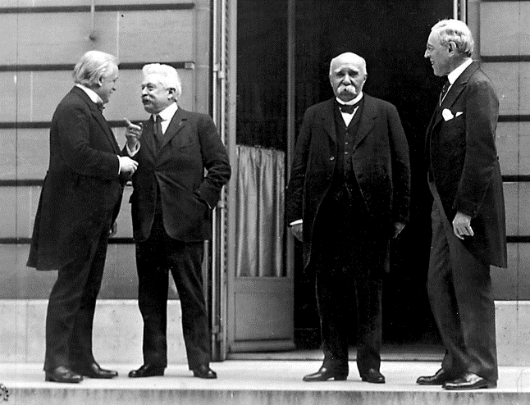




Treaty of Versailles
Directions: : The Big Four were the Allied leaders who met at the Paris Peace Conference in January 1919 following the end of World War I. They were Woodrow Wilson of the United States, David Lloyd George of Britain, Vittorio Orlando of Italy, and Georges Clemenceau of France. Each had their own goals . Use the reading and Modern World History Chapter 13
as resources to identify the opinions of each leader, then follow the prompts below.
David Lloyd George
Georges Clemenceau
Vittorio Orlando
Woodrow Wilson
Where did the treaty “talks” take place?
What countries were not present? What countries were absent? Why?
Was there a precedent for this type of conference? How many times did they meet?
What was Wilson’s fear?
What was the Supreme Council? How often did they meet?
When was the treaty signed? How long after assassination?
What were some of the provisions of the treaty? Were there problems?

Slide 33
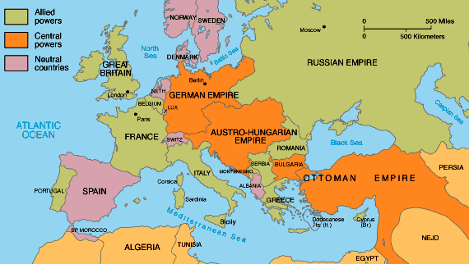
Neutrality Acts
For most Americans, the war was a distant conflict that did not concern them. Few felt alarmed by its outbreak. In September 1914, Theodore Roosevelt smugly observed that the US was lucky to be almost “alone among the great civilized powers being unshaken by the present worldwide war.” Research more in Chapter 34 of History Alive! in order too respond to the prompts below.
1) The Neutrality Acts (1935 to 1937) were intended to keep the United States from
  being drawn into a European war
  provoking a war with Japan
  a war to protect the Panama Canal
  aiding the Axis Powers
2) Define each
Isolationism | Fascism | Totalitarianism
Nazism | Nationalism | Militarism
3) According to the map, which European countries were neutral?

Slide 34
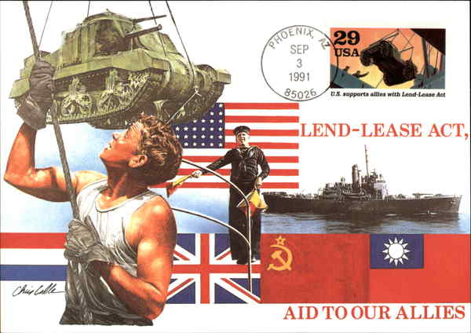
Lend Lease Act
After war broke out in Europe, isolationism lost some of its appeal for Americans. Most now openly supported the Allies. Hoping to keep the United States out of the war, Hitler sought to expand his alliance. In September 1940, Germany, Italy, and Japan signed the Tripartite Pact, making Japan a member of the Axis powers. The three nations agreed to provide mutual support in the event of an attack by a country not yet in the war. The attacker they had in mind was the United States. Continue reading History Alive! Chapter 34 in order to respond to the prompts below.
If the United States
entered the war, who would they have to fight?
What did the
Neutrality Acts ban?
Define the
Lend Lease Act.
What is meant by
“fight on two fronts”?
What was
“cash and carry”?
What was the outcome
of the Lend Lease Act?

Slide 35
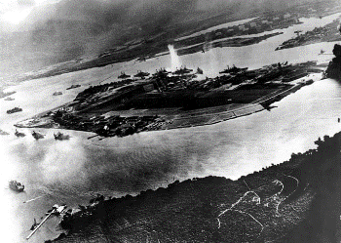
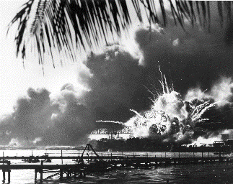
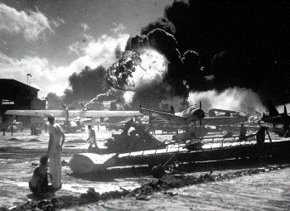
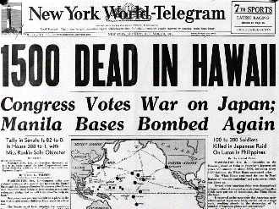
Pearl Harbor
From 1940 to 1941, Japan continued seeking raw materials through conquest. It occupied French Indochina, in Southeast Asia, and set its sights on the Dutch East Indies. Its goal was to push Western powers out and establish a “new order in East Asia,” with Japan at the center. The United States tried to undercut Japan’s aggression in several ways. It sent loans and other aid to Japan’s enemy, China, and froze Japanese assets in American banks. It also blocked the export of vital resources, including oil, to Japan. Relations between the two nations steadily worsened.
By 1941, American intelligence officers had managed to intercept and decode secret messages from Japan to its foreign offices. Late in the year, officers learned of a coming attack on American territory in the Pacific Ocean. They thought the attack might target an American base in the Philippines. Instead it was aimed at Pearl Harbor, Hawaii – the home of the U.S. Pacific Fleet.
When was Pearl Harbor attacked? How long did the attack last?
How many Japanese bombers and fighter planes attacked Pearl Harbor?
How many U.S. ships were damaged or sunk? How many U.S.military aircraft were damaged or destroyed?
How many Americans were killed and how many were wounded? How many Japanese planes were lost?
What did U.S. President Roosevelt do in response? What did Germany and Italy do in response?

Slide 36
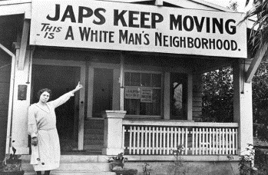
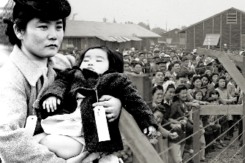
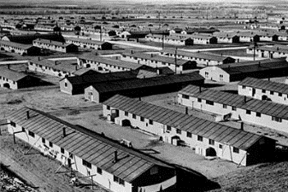
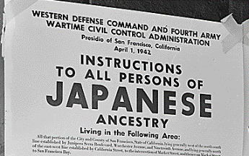
Japanese-American Internment
Directions: Starting in 1942, the US government forced about 110,000 Japanese-Americans who lived along the west coast into camps called “War Relocation Camps”. Most of the people held were there until the war ended in 1945. Follow this link https://www.archives.gov/research/alic/reference/military/japanese-internment.html
then answer the questions and provide pictures for the spaces below.
What was Executive Order 9066?
Why was it enacted?
How do you think it felt to grow up in the conditions you see below?
How do you think Japanese-Americans reacted to attitudes like the one above?
Do you feel the US was justified in “relocating” Japanese-Americans? Explain.
Japanese Americans were placed in internment camps during World War II
        due to numerous acts of espionage and sabotage
        in retaliation for the placement of Americans in concentration camps by the Japanese
        because they were seen as a threat to national security
        because many were loyal to Japan

Slide 37
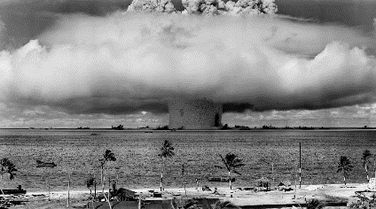
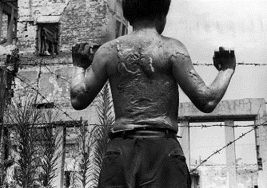
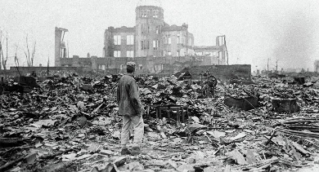
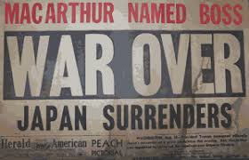
Hiroshima & Nagasaki
Directions:.The atomic bombs dropped on Japan had a devastating effect. The searing
heat from the blasts turned thousands of people into ash. Birds caught fire in midflight.
Clothing, trees, and wooden building exploded into flames. Survivors suffered from
sever burns, radiation sickness, and later, cancer. History Alive Chapter 36
The atomic bomb attacks on Hiroshima and Nagasaki prompted Japan to surrender
to the Allies on August 14, 1945. Continue reading in the textbook and follow these links
https://tinyurl.com/ya5bd6uw and https://tinyurl.com/ybs7qtx6
https://www.youtube.com/watch?v=b293Ok7FLV4
In order to respond to the prompts below.
What was the Manhattan Project?
What was “Fat Man” and “Little Boy”?
What effects (immediate and lasting) did the bombs have on the people in its path?
Was the United States justified in dropping the atomic bombs? Why or why not?

Slide 38
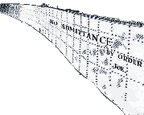
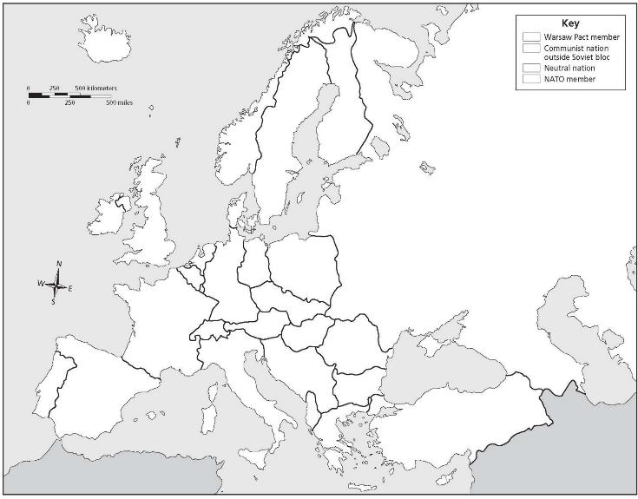
Cold War Alliances of Europe
Directions: The Iron Curtain was the symbolic division of Europe between communist countries under the Soviet Union’s influence in the east and more open countries in the west. Label each country by dragging and dropping, then use the paint bucket tool fill the text boxes to identify which alliance they belonged to. Then drag & drop the “iron curtain” to divide them.
Poland
E. Germany
Spain
Great Britain
USSR
Norway
France
Finland
Hungary
Ireland
Greece
Turkey
Bulgaria
Romania
Sweden
W. Germany
Italy
Key
Warsaw Pact
NATO
Neutral

Slide 40




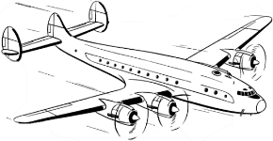
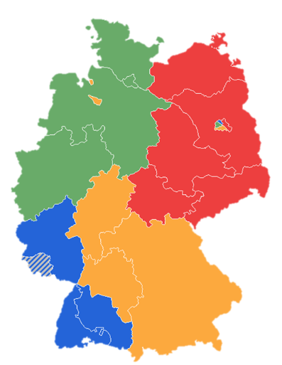


German Occupation & the Berlin Airlift
Directions: After Germany’s surrender in World War II, the country, and its capital Berlin, were divided into 4 occupation zones by the Allied countries. While France, England, and the US desired to rebuild their territories to be strong democratic allies, the Soviet Union wished to keep its former enemy weak and divided. As a result, they cut off the east and trapped those in West Berlin. Drag & drop the flags below to match the occupation zones, then read about the Berlin Airlift here and complete the boxes on the Berlin Airlift.
What was it?
Why was it necessary?
What was the result?

Slide 42
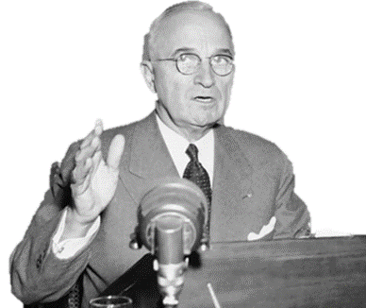

Containment & the Truman Policy
Directions: President Harry Truman began a new policy toward communism known as Containment. Learn about this policy and how it involved various strategies to prevent the spread of communism around the world. Then, for each document, describe how the US tried to contain communism in that region.
Stopping Communism in Western Europe
Stopping Communism in Asia
Stopping Communism in Latin America

Slide 45
The Marshall Plan
Directions: The Marshall Plan was America’s initiative to help Europe rebuild after World War II. The US gave $17 billion in economic support to the democratic countries of Western Europe. A popular poster supporting it used a windmill to demonstrate how all democracies should work together. You can learn more about the plan here, then describe each aspect of the Marshall Plan on the graphic organizer.
Type your response here
Type your response here
What did it do?
Who did it help?
The Marshall Plan
The Marshall Plan
Type your response here
Type your response here
Why did the US
do this?
How did it work?
c
What impact did the Marshall Plan have on Europe and the world?

Slide 47
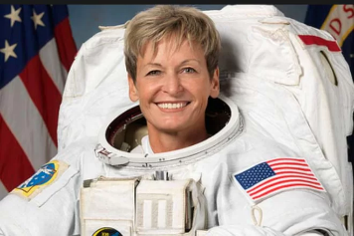
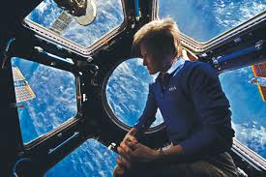

Iowan Influence
Directions: Evaluate Iowans or groups of Iowans who have influenced United States history. Follow the links in order to respond to the prompts in the box below.
https://www.jsc.nasa.gov/Bios/htmlbios/whitson.pdf
https://www.glamour.com/story/women-of-the-year-2017-peggy-whitson
https://www.nasa.gov/astronauts/biographies/peggy-a-whitson
https://tinyurl.com/y8czc9ow
Who is Peggy Whitson? Why is she significant?
What other Iowan or Iowans have influenced U.S. history?
There is a common misconception that one person cannot make a change. Much of history argues that many times significant change began with just one person.
Can you think of such a person in history?
What was the change?
Did they make the world better? Or worse?
Butterfly Effect – the scientific theory
that a single occurrence, no matter
how small, can change the course
of the universe forever.
How do you want to affect change?

Slide 48


Proxy Wars
Directions: America fought 2 wars (or Proxy Wars to be specific) during the Cold War. One in Korea and one in Vietnam. Both were intended to stop the spread of communism but had different results. Complete the Venn diagram with characteristics that apply and then some that apply to both. Think about reasons for the war, when it was fought, how, people involved, effects, perspectives on them, and their results.
Both
Korean War
Vietnam War
Explain the effects of the Vietnam conflict at home and abroad.
Define and describe each:
Hawks & Doves My Lai Massacre
Viet Cong Kent State Shootings
Vietnamization Veterans: POW/MIA

Slide 56


History Repeats Itself
Directions: Look at the cartoons below. Who is in them? What is happening? Why do you think that? How do you think this relates to this unit of study involving the Cold War?

