Slide 1
France | Austria-Hungary | United States | Russia
Germany | Italy | Ottoman Empire | Great Britain
Triple Alliance (Central Powers) | Triple Entente (Allied Powers)

Slide 2
Marching Toward War
Directions: Read about the background and years leading up to WWI.
http://www.worldwar1.com/tlwarorg.htm
Then, determine the order of the following events.
Year
Austria declares war on Serbia.
The Triple Alliance is formed between Germany, Italy, & Austria-Hungary.
Gavrilo Princip shoots Archduke Franz Ferdinand in Sarajevo, Bosnia.
Germany takes Alsace-Lorraine region from France in the Franco-Prussian War.
The Triple Entente is formed between France, Britain, & Russia.
Great Britain declares war on Germany.
Germany declares war on Russia & France.
Austria takes over Bosnia & Herzegovina.
The militaristic Kaiser Wilhelm forces Otto von Bismarck to resign in Germany.

Slide 3
Causes of WWI
Directions: While one single event sparked World War I, many long term causes had been building for years. Next to each title, explain how that cause led to a world war.
Modern World History: Chapter 13 – The Great War
M
How did militarism cause World War I?
Militarism
A
How did alliances cause World War I?
Alliances
N
How did nationalism cause World War I?
Nationalism
I
How did imperialism cause World War I?
Imperialism
A
How did an assassination cause World War I?
Assassination

Slide 4
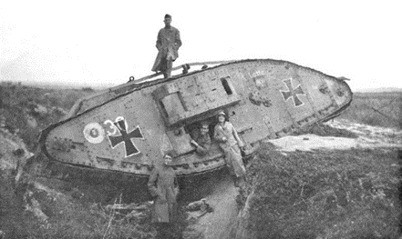
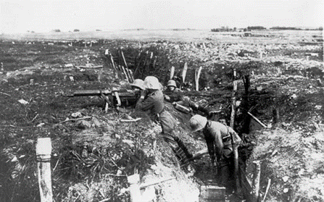
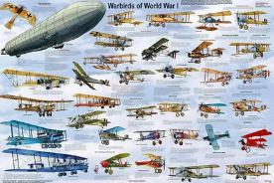
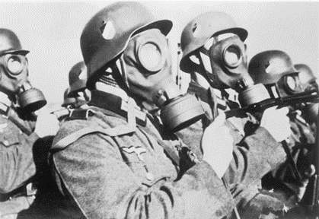
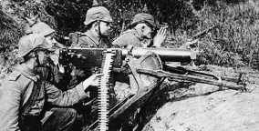
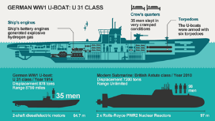

Slide 5
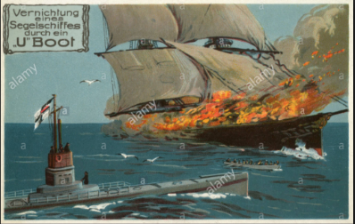
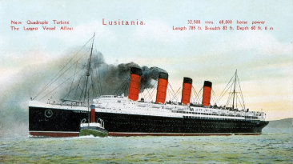
Lusitania
As the land war dragged on, both sides sought to break the stalemate. Unable to defeat
their enemy on land, both Britain and Germany looked for ways to starve their
enemies into submission. To do this they needed to win control of the seas.
Directions: continue research in chapter 22 of History Alive!
in order to respond to the prompts below.
What was a U-boat?
Who used them?
Why?
Were they successful?
Why or why not?
What was unrestricted submarine warfare?
Who used it?
Why?
Was it successful?
Why or why not?
What was the Lusitania?
Why was it significant?

Slide 6
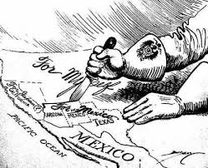
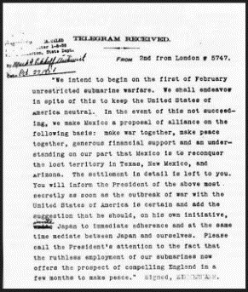
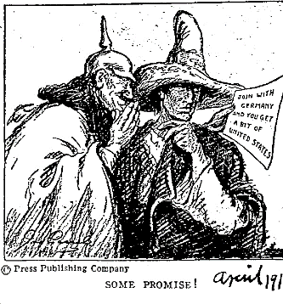
Zimmerman Note
Written in code, the Zimmermann note was deciphered by British cryptographers. The British waited to release the telegram to
American newspapers until relations between the United States and
Germany were at an all-time low. History Alive! Chapter 22
What was
written in
Zimmermann Note?
Why was it important?
What happened
in response to
the Zimmermann Note?

Slide 7
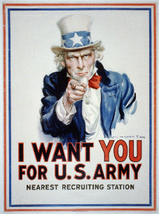
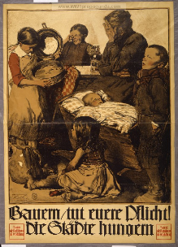
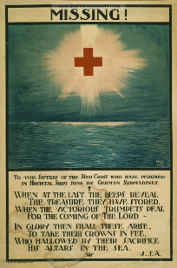
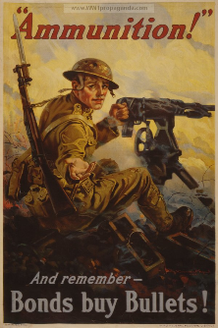

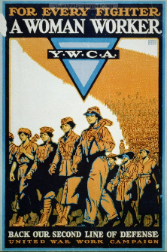
Propaganda
While Wilson tried hard to keep the nation out of war, both the Allies and the Central
Powers launched propaganda campaigns designed to whip up support for their side.
Directions: define propaganda, who used it, and why, and if it was successful.
Next, research here http://www.ww1propaganda.com/ the propaganda below and interpret.

Slide 8
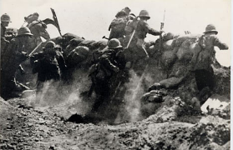
Battles of the Great War
Directions: Use this interactive timeline of World War 1 http://ow.ly/Evt130fCDqB
and this map and info http://www.greatwar.co.uk/battles/ to complete the timeline below.
How and why did the Battle of the Marne affect the Schlieffen Plan?
1914
1915
1916
1917
1918
1919
What was the Schlieffen Plan?
What was significant about the Second Battle of Ypres?
What was significant for the French at Verdun?
Was the Allied offensive at the Somme effective? Explain.
What effect did American
soldiers have on the war?
Why did Russia leave the war?

Slide 9
Much of Northern France was destroyed. | Germany kept the land it had taken. | Austria-Hungary was split.
United States controlled Germany. | Many new factories were built. | Most countries lost billions of dollar fighting the war.

Slide 10
TOTAL WAR
Countries involved in World War I often devoted all of their resources to the war effort. The lasting impacts of World War I were felt at home as well as abroad. Countries the world over made the efforts necessary to end war, pursue peace, and repair the damage.
IMPACTS OF WAR
SOCIAL
Total war meant that governments turned to help from women as never before. Thousands of women replaced men in factories, offices, and shops. Women built tanks and munitions, plowed fields, paved streets, and ran hospitals. They also kept troops supplied with food, clothing, and weapons. Many factories were built as a result of all the extra supplies needed for war. And although most women left the work force when the war ended, they changed many people’s views of what women were capable of doing. Women saw the horrors of war firsthand, just as much as men, working on or near the front lines as nurses. The enormous suffering that resulted from the Great War left a deep mark on society. A sense of disillusionment settled over the survivors. The insecurity and despair that many people experienced are reflected in the art and literature of the time. Find an example here http://ow.ly/j1L530fnfdc and describe.
ECONOMIC
As discussed in the social section of impacts of war, many factories were built. This meant more jobs and more money which is definitely a positive economic impact of war. However, when the war came to a close, many nations felt the negative economic effects. Most countries lost billions of dollars fighting the war, especially countries in Europe where the fighting took place. The great conflict drained the treasuries of European countries. One account put the total cost of the war at $338 billion, a staggering amount for that time. The war also destroyed acres of farmland, as well as homes, villages, and towns. Which country lost the most $$? soldiers? civilians? http://ow.ly/1Plk30fnfJ2
POLITICAL
World War I was over. The killing had stopped. The terms of peace, however, still had to be worked out. On January 18, 1919, a conference to establish those terms began at the Palace of Versailles, outside Paris. Attending the talks, known as the Paris Peace Conference, were delegates representing 32 countries. For one year, this conference would be the scene of vigorous, often bitter debate.
Continue reading on pages 424-427 and complete the following activity pages over:
The Treaty of Versailles, Fourteen Points, and The League of Nations

Slide 11
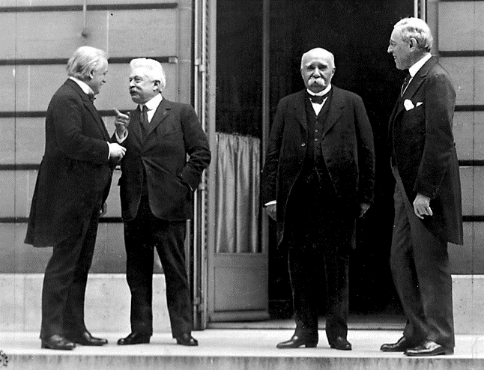




Treaty of Versailles
Directions: : The Big Four were the Allied leaders who met at the Paris Peace Conference in January 1919 following the end of World War I. They were Woodrow Wilson of the United States, David Lloyd George of Britain, Vittorio Orlando of Italy, and Georges Clemenceau of France. Each had their own goals . Use the reading and Modern World History Chapter 13
as resources to identify the opinions of each leader, then follow the prompts below.
David Lloyd George
Georges Clemenceau
Vittorio Orlando
Woodrow Wilson
Where did the treaty “talks” take place?
What countries were not present? What countries were absent? Why?
Was there a precedent for this type of conference? How many times did they meet?
What was Wilson’s fear?
What was the Supreme Council? How often did they meet?
When was the treaty signed? How long after assassination?
What were some of the provisions of the treaty? Were there problems?

Slide 13


Fourteen Points
Directions: As World War I was coming to an end, President Woodrow Wilson drew up his plan for a lasting peace which he termed his 14 Points. He brought this plan with him to the Paris Peace Conference. However, the Treaty of Versailles that came from the conference was not exactly how Wilson expected it to be. Complete the Venn Diagram with characteristics that apply to only Wilson’s 14 Points or the Treaty of Versailles and then some that apply to both. There are readings on the included binder pages, the book, and http://ow.ly/oVbO30fCFMV
Wilson’s 14 Points
Both
The Treaty of Versailles
What was it?
Was it successful? Why or why not?
League of Nations

Slide 15
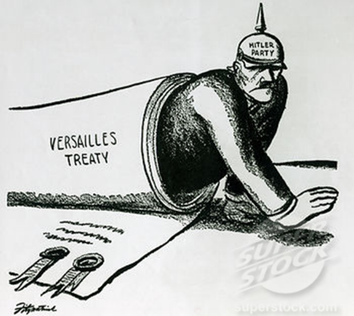
Writing Informative Text
WRITING INFORMATIVE TEXT 20th Century World History Semester 1
4 | 3 | 2
Writes informative text that demonstrates a depth of knowledge by going above and beyond the grade level expectation. The student digs deeper into the content by connecting the writing to previous learning or to contemporary issues. | Writes informative text. Introduce a topic (sentence or a full paragraph); Organize ideas and concepts (chronologically or thematically); Develop the topic with relevant facts, evidence and accurate examples that are appropriate to the topic; uses extended definitions; Provide a concluding statement that supports the information or explanation presented. | Writes informative text. A level 2 writing sample fails to meet the level 3 standard in one or more areas: Introduction Organization Use of evidence Conclusion *A level 1.5 writing sample fails to meet the level 3 standard in two areas. *A level 1 writing sample fails to meet the level 3 standard in all areas, but a valid attempt was made by the student.
Did the
Treaty of Versailles
lead to the
rise of Hitler
and eventually
World War 2?
If so, how?
Directions: The Treaty of Versailles was the official end to World War 1. However, many Historians believe the Treaty was the beginning of the rise of Hitler and eventually World War 2. Research the Treaty of Versailles. Write a mini essay answering the question. Use the scale to guide your work.

