Slide 1
democracy | totalitarianism | communism | fascism | imperialism
Italy | Great Britain | US | France | Germany | USSR | Japan
Axis Powers | Allied Powers
Militarism | Appeasement | Rationing | Neutrality | Propaganda

Slide 2
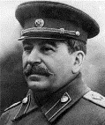

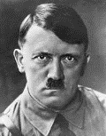

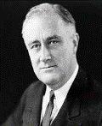

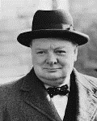

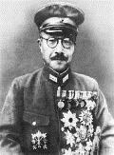

World War 2 Leaders
Directions: Match the leader during the war to the country, pic, and flag.
USA
Great Britain
Japan
Soviet Union
Germany
Joseph Stalin
Winston Churchill
Franklin Roosevelt
Adolf Hitler
Hideki Tojo

Slide 5
The Failure of the League of Nations
Weak
.It had no army.
America
the strongest nation in the world never joined;
Britain and France were not strong enough to impose pace on their own
Structure
the League's organization was muddled, so it took ages to do anything;
members couldn’t agree, and decisions had to be unanimous - this paralyzed the League
Depression
the world-wide Depression made countries try to get more land and power;
they were worried about themselves, not about world peace
Unsuccessful
the more the League failed, the less people trusted it; in the end, everybody just ignored it
Members
Germany wasn’t allowed to join, Russia also didn’t join,
Italy and Japan defied and left the League, France and Britain betrayed it
Bullies
in the 1920s, the League had been successful with small, weak countries
in the 1930s, powerful countries like Germany, Italy and Japan defied the League
    they were too strong for the League to stop them
The Rise of Militarism & Dictators
Directions: The failure of the League of Nations and the worldwide economic depression of the 1930’s created turbulent times. Some countries experienced revolutions and others turned to dictators. Germany, Italy, Japan, and the Soviet Union are 4 countries who saw militaristic leaders rise to power. Complete the chart below with info about what happened in each country in the decades between World War I and World War II. Include military actions, political changes, and alliances created/joined.
Germany | Italy | USSR | Japan
 |  |  |  | 1920s to 1940s

Slide 6
Failure of the Treaty of Versailles
The Treaty of Versailles, made in 1919 at the end of the First World War, was intended to make a lasting peace. Many people felt that the Treaty had caused terrible resentment in Germany. When the Germans heard about the Treaty of Versailles, they felt ‘pain and anger’. They felt it was unfair. They had not been allowed to take part in the talks – they had just been told to sign.
On 7 May, the victors presented their Treaty to the small German delegation. Count Brockdorff-Rantzau angered the Big Three by giving a long speech criticising the Treaty; then the delegation left and set about countering it. A little later, they sent their counter-proposal based on the Fourteen Points) to the Big Three -- their reply was so good that one of the British delegation said it was much better than the Allies' suggestions, and even Lloyd George wondered for a time if they ought to rethink the treaty . Then the delegation went home. Many Germans wanted to refuse to sign the treaty; some even suggested that they start the war again. So it was with great difficulty that the President got the Reichstag to agree to sign the treaty, and the imperious way the two German representatives were treated when they were forced to sign made things worse.
The Germans hated Clause 231; they said they were not to blame for the war. The soldier sent to sign the Treaty refused to sign it – ‘To say such a thing would be a lie,’ he said. Clause 231 did not physically harm Germany, but it hurt Germany's pride - and it was this, as much as anything else, that made them want to overturn the treaty.
The Germans hated reparations; they said France and Britain were trying to starve their children to death. At first they refused to pay, and only started paying after France and Britain invaded Germany (January 1921).
The Germans hated their tiny army. They said they were helpless against other countries. At first they refused to reduce the army, and the sailors sank the fleet, rather than hand it over.
The Germans also hated the loss of territory. Germany lost a tenth of its land - they claimed that the treaty was simply an attempt to destroy their economy. Other nations were given self-determination – but the Treaty forced Germans to live in other countries. Germans were also angry that they could not unite with the Austrian Germans.

Slide 7
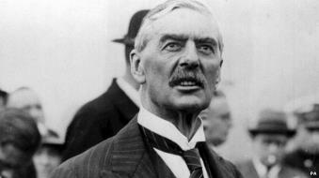
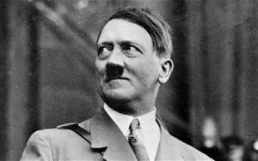
Appeasement
Hitler had been able to play on these resentments in order to achieve power. Other governments believed that Hitler and Germany had genuine grievances, so if these could be met (‘appeased’) Hitler would be satisfied and become less demanding.
After the First World War, the map of Europe was re-drawn and several new countries were formed. As a result of this, three million Germans found themselves now living in part of Czechoslovakia. When Adolf Hitler came to power, he wanted to unite all Germans into one nation.
In September 1938 he turned his attention to the three million Germans living in part of Czechoslovakia called the Sudetenland. Sudeten Germans began protests and provoked violence from the Czech police. Hitler claimed that 300 Sudeten Germans had been killed. This was not actually the case, but Hitler used it as an excuse to place German troops along the Czech border.
During this situation, the British Prime Minister, Neville Chamberlain, flew to meet Hitler at his private mountain retreat in Berchtesgaden in an attempt to resolve the crisis.
Directions: During Germany’s rise to power in the 1930’s, both England and France practiced appeasement rather than challenging Adolf Hitler’s actions. Read the text to learn about appeasement then follow the prompts below.
Chamberlain thinks…
Hitler thinks…
Neville Chamberlain
Adolf Hitler
others think…
the outcome.

Slide 8
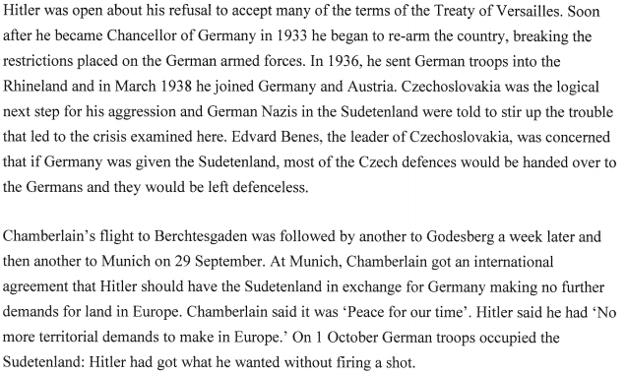
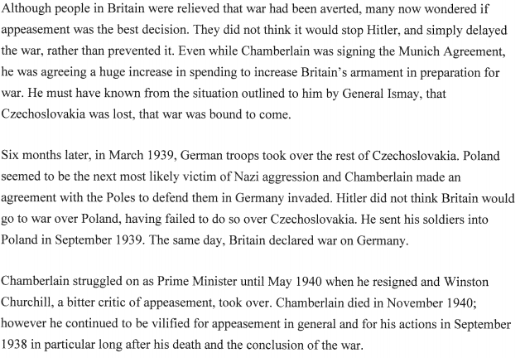

Slide 10
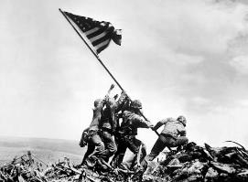
Battles of World War 2: 1939-1945
Nonaggression Pact
What 2 countries signed a pact in 1939?
Why did they make the agreement?
1939
Directions: Complete the boxes for the timeline by responding to the prompts.
Invasion of Poland
Why did the Nazi invasion of Poland start WWII?
Battle of Britain
Who defended Britain against the Nazi Luftwaffe?
What technologic advantage did they have?
1940
The Fall of France
Why did France fall so easily to the Nazis?
1941
Pearl Harbor 41
Who attacked Pearl Harbor & why?
What was the result?
1942
Stalingrad 43
What was significant about this battle?
1943
D-Day 44
Why was Normandy Beach selected for D-Day?
Soldiers from which countries participated in the landings?
1944
Iwo Jima 45
Below is the famous photo of marines raising the flag on Iwo Jima. Why do you think this picture became so famous?
1945
Hiroshima and Nagasaki 45
Why did the US drop an atomic bomb on Hiroshima?
Do you thing the US was justified in nuclear warfare against a belligerent?

Slide 11
Island Hopping in the Pacific
Directions: After entering World War II, America developed a plan for defeating Japan known as “Island Hopping” to gain military bases and secure the many small islands in the Pacific. Rearrange the colored boxes by dragging and dropping so that they match the battles and events they are describing.
Fought in February, 1945 this bloody battle resulted in victorious American marines raising the flag on Mt. Suribachi.
Battle of Midway
Fought in Spring, 1945 this long, very bloody battle featured Japanese civilians and kamikaze fighting to defend an island only 340 miles from Japan.
Battle of Guadalcanal
Battle of
Iwo Jima
June, 1942 battle in which the US won a crucial naval victory that proved to be a turning point in the war.
Battle of Okinawa
This 6-month long battle from 1942 - 1943 was the first major offensive by Allied forces against Japan.

Slide 13
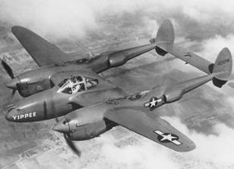
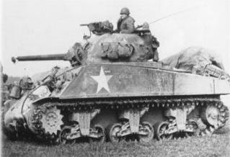
World War II Technology
Directions: History Alive! Chapter 16, beginning on page 520 is the different technologies (weapons) of war. Go back through the chapter or research reliable sources involving
World War II technology online. Who used what and why? Describe in specific detail.
Military planes
Poison Gas
Machine Guns
Tanks
Directions: After the Manhattan Project successfully created and tested an
atomic bomb, President Truman authorized its use on 2 Japanese cities. Analyze the
article, pictures, and videos about the bombing here
http://www.history.com/topics/world-war-ii/bombing-of-hiroshima-and-nagasaki
and the reading on the following page then complete the boxes by following the prompts.
Why was the decision made to use the atomic bomb on Japan?
Why was Hiroshima chosen as the bombing site?
Describe what happened to the city after the bomb hit
Describe some of the long-term effects the atomic bombs had
on the people, cities, and government of Japan.
Do you think it was necessary to drop the atomic bomb? Both bombs? Why or why not?

Slide 14
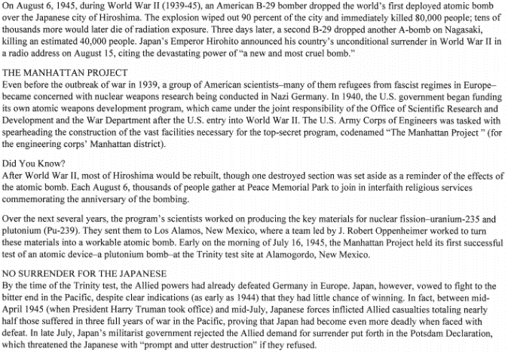
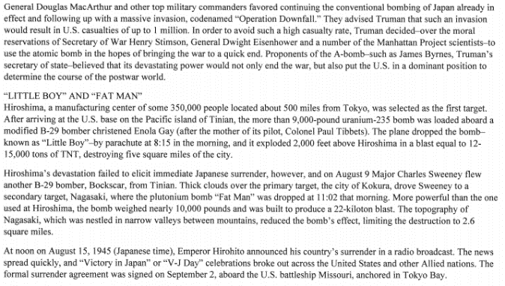

Slide 15
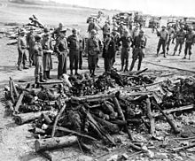
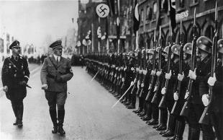
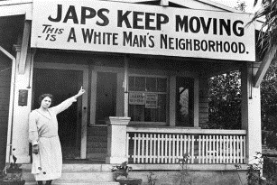
The Holocaust
Directions: Research the text History Alive! Chapter 16 beginning on page 502 and watch this video https://www.youtube.com/watch?v=k0aZH_6LhKQ In order to answer the questions.
Define and describe the Holocaust.
Define and describe Kristallnacht.
How many people died in the Holocaust?
What was the Final Solution?
Define genocide.
Research “Holocaust medical experiments”
online and describe.
What was Auschwitz?
What is cyanide?
Japanese-American Internment
Directions: Starting in 1942, the US government forced about 110,000 Japanese-Americans who lived along the west coast into camps called “War Relocation Camps”. Most of the people held were there until the war ended in 1945. Research Japanese relocation & internment then answer the questions.
https://www.archives.gov/research/alic/reference/military/japanese-internment.html
How do you think Japanese-Americans reacted to attitudes like the one above?
What was Executive Order 9066?
Why was it enacted?
How do you think it felt to grow up in the camp?
Do you feel the US was justified in “relocating” Japanese-Americans? Explain.

Slide 16
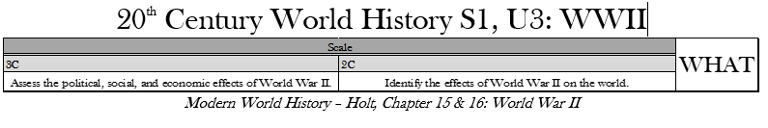
Impacts of World War 2
Directions: The impact of World War 2 was felt around the world. Discuss at least one impact of the war in each of the following categories using specific examples from History Alive! 514-517 or https://civitaspolitics.org/2010/01/06/the-end-game-the-consequences-of-world-war-ii/
.
ECONOMIC
Possible topics include:
property damage
Europe in ruins due to bombing and shelling
farmland ravaged
transportation systems destroyed
Possible topics include:
more death and destruction than any other conflict in history (60 million dead);
homelessness and displacement as a result of the war; no water, electricity, malnutrition, starvation;
survivors of concentration camps, prisoners of war, refugees in lands where borders had changed; famine and disease spread;
atomic bomb and its destruction
Women went to work in large numbers
SOCIAL
Possible topics include:
atomic bomb
Nuremberg Trials
demilitarization
democratization
The United Nations
POLITICAL
What international peacekeeping organization, that still exists today, was created as a result of World War II?

Slide 17
What Do You Think?
Directions: Use the scale below, in addtion to your research, to write a 1 page essay answering the Essential Question. You will be graded on this assignment, so be sure to follow the scale, use specific examples, and cite your sources.
WRITING INFORMATIVE TEXT 20th Century World History Semester 1
4 | 3 | 2
Writes informative text that demonstrates a depth of knowledge by going above and beyond the grade level expectation. The student digs deeper into the content by connecting the writing to previous learning or to contemporary issues. | Writes informative text. Introduce a topic (sentence or a full paragraph); Organize ideas and concepts (chronologically or thematically); Develop the topic with relevant facts, evidence and accurate examples that are appropriate to the topic; uses extended definitions; Provide a concluding statement that supports the information or explanation presented. | Writes informative text. A level 2 writing sample fails to meet the level 3 standard in one or more areas: Introduction Organization Use of evidence Conclusion *A level 1.5 writing sample fails to meet the level 3 standard in two areas. *A level 1 writing sample fails to meet the level 3 standard in all areas, but a valid attempt was made by the student.
Was World War 2 preventable?

