Slide 1

communism | democracy

Slide 2
controlled elections
Cold War: Communism VS Democracy
Directions: Research the differences and similarities between Communism and Democracy. Use the terms from the word bank in the bottom box to complete the Venn diagram below.
lacking in individual rights
free elections
Strong leaders
COMMUNISM
BOTH
DEMOCRACY
Individual citizens can own factories, mines, and farms
people vote for leaders
Government owns factories, mines, and farms
controlled elections
lacking in individual rights
free elections
strong leaders
individual citizens can own businesses such as factories, mines, farms
people vote for leaders
government owns all the businesses such as factories, mines, farms
jobs and housing decided by government
freedom of press (speech, media)
government controlled media
individual rights and freedoms
provides public education (schools)
Soviet Union
United States
Jobs and housing decided by government
Freedom of press (media)
Government controlled media
individual rights and freedoms
Provides public education (schools
Soviet Union
United States

Slide 4
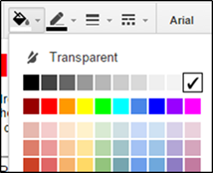
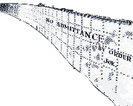
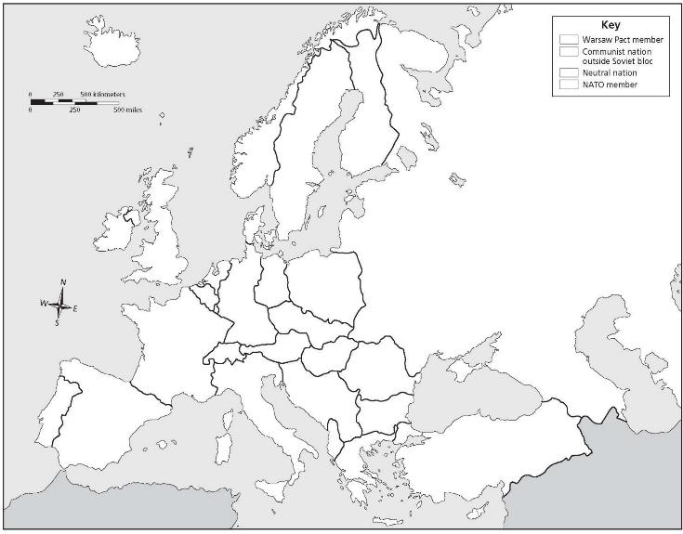
Cold War Alliances of Europe
The Iron Curtain was the symbolic division of Europe between communist countries under the Soviet Union’s influence in the east and more open countries in the west. Label each country then identify which alliance they belonged to. Then draw the “iron curtain” to divide them.
Poland
E. Germany
Spain
Great Britain
USSR
Norway
France
Finland
Hungary
Ireland
Greece
Turkey
Bulgaria
Romania
Sweden
W. Germany
Italy
The paint bucket tool selector can be seen above - be sure you have selected a box before choosing the color. Students can also choose different colors for the alliances if they choose.
Key
Warsaw Pact
NATO
Neutral

Slide 6
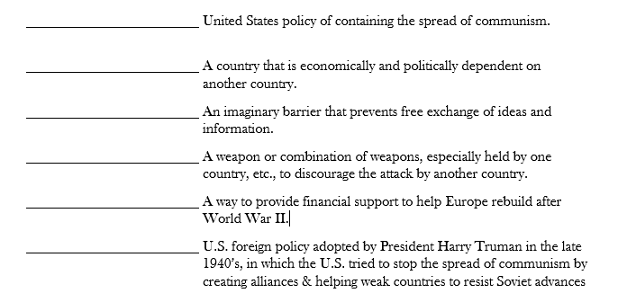
Marshall Plan | containment | iron curtain
deterrents | satellite state | Truman Doctrine

Slide 7




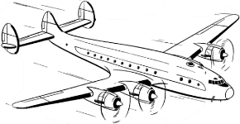
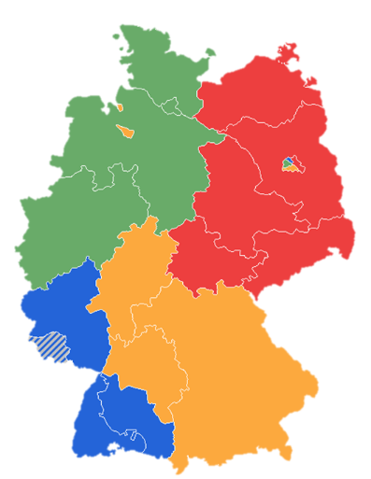


German Occupation & the Berlin Airlift
Directions: After Germany’s surrender in World War II, the country, and its capital Berlin, were divided into 4 occupation zones by the Allied countries. While France, England, and the US desired to rebuild their territories to be strong democratic allies, the Soviet Union wished to keep its former enemy weak and divided. As a result, they cut off the east and trapped those in West Berlin. Drag & drop the flags below to match the occupation zones, then read about the Berlin Airlift here and complete the boxes on the Berlin Airlift.
What was it?
Why was it necessary?
What was the result?

Slide 9
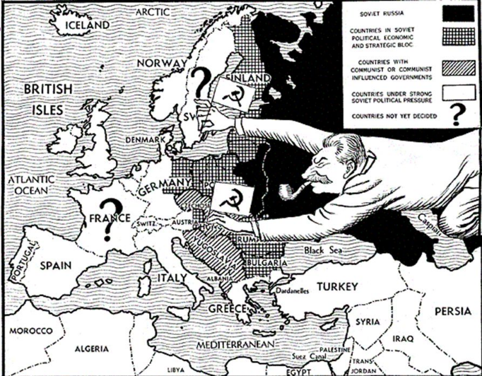
Stalin’s Goals for Eastern Europe
Directions: After World War 2, Stalin felt that he deserved a reward for helping defeat Hitler and the Nazis. Research Stalin’s goals after World War 2, and describe them below.
What were Stalin’s goals for Eastern Europe after World War 2?

Slide 12
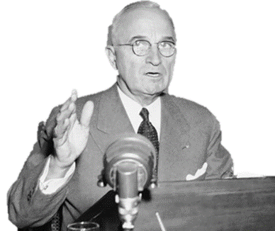

Containment & the Truman Policy
Directions: President Harry Truman began a new policy toward communism known as Containment. Learn about this policy and how it involved various strategies to prevent the spread of communism around the world. Then, for each square, describe how the US tried to contain communism in that region.
Stopping Communism in Western Europe
Stopping Communism in Asia
Stopping Communism in Latin America

Slide 15
The Marshall Plan
Directions: The Marshall Plan was America’s initiative to help Europe rebuild after World War II. The US gave $17 billion in economic support to the democratic countries of Western Europe. A popular poster supporting it used a windmill to demonstrate how all democracies should work together. You can learn more about the plan here, http://ow.ly/3pxw30f2OZd then describe each aspect of the Marshall Plan on the graphic organizer.
What did it do?
Who did it help?
The Marshall Plan
The Marshall Plan
Why did the US
do this?
How did it work?
c
What impact did the Marshall Plan have on Europe and the world?

Slide 17
Summarize the Goals of USSR & US
Directions: Match the terms from the word bank below to the corresponding country.
USSR
US
Spread of communism across the globe
Containment of communism
Rebuild Germany into a democratic country
Rebuild Europe with the Marshall Plan (equipment, housing, industry)
Keep Germany weak
Enlarge the sphere of influence
Satellite states – control over Eastern European countries near borders
Truman Doctrine to provide military and
economic aid for countries fighting communism

Slide 18
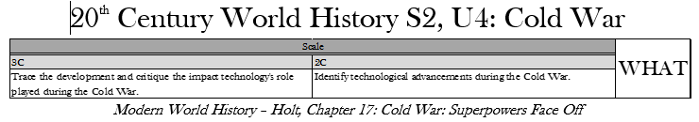
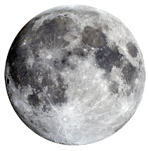
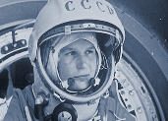
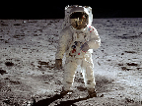
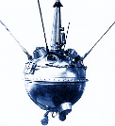
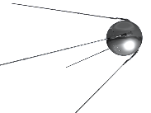
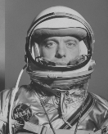


Space Race
Directions: The Space Race was a competition to see which type of government could successfully launch a space program. Research the Space Race during the Cold War in order to complete the graphic organizer.
Yuri Gagarin
Who (include country)
What accomplishment
When (date)
Luna 2
Who (include country)
What accomplishment
When (date)
Apollo 11
Who (include country)
What accomplishment
When (date)
Sputnik 1
Who (include country)
What accomplishment
When (date)
:
Explorer 1
Who (include country)
What accomplishment
When (date)
:
Alan B Shepard
Who (include country)
What accomplishment
When (date)

Slide 19


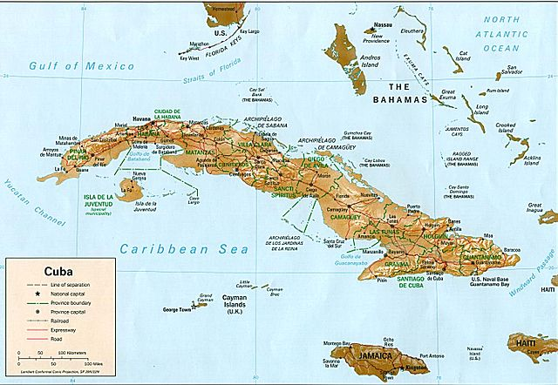
The Cuban Missile Crisis
Directions: Perhaps the tensest moment of the entire Cold War was the Cuban Missile Crisis in October 1963. This 13 day confrontation between the US and Soviet Union almost led to a nuclear war.Learn more about it here and also here. Then, complete the text boxes on this graphic organizer
Goals
USA Soviet Union
Type your response here
Type your response here
Cause of
the Crisis
Type your response here
Result
Type your response here

Slide 21


Comparing the Korean & Vietnam Wars (Proxy Wars)
Directions: America fought 2 wars (or Proxy Wars to be specific) during the Cold War. One in Korea and one in Vietnam. Both were intended to stop the spread of communism but had different results.Complete the Venn diagram with characteristics that apply and then some that apply to both. Think about reasons for the war, when it was fought, how, people involved, effects, perspectives on them, and their results. Then find and add pictures to each side that best represent it.
Korean War
Type responses here
Both
Type responses here
Type responses here
Vietnam War

Slide 29
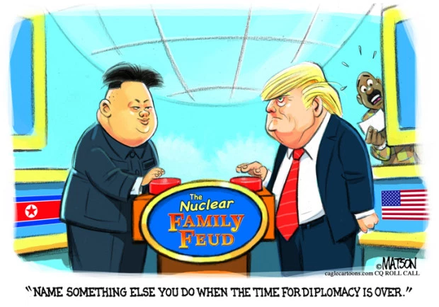
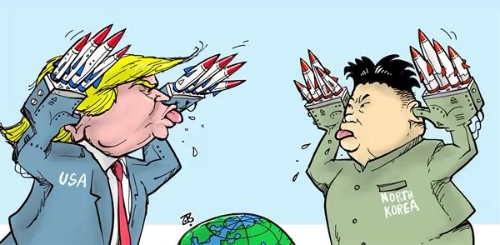
History Repeats Itself
Directions: Look at the cartoons below. Who is in them? What is happening? Why do you think that? How do you think this relates to this unit of study involving the Cold War?

