Slide 1

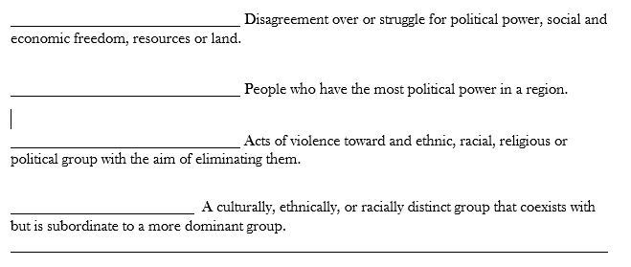
conflict | genocide | minority group | majority group

Slide 2
The 8 Stages of Genocide
Understanding the genocidal process is one of the most important steps in preventing future genocides.
The Eight Stages of Genocide were first outlined by Dr. Greg Stanton, Department of State: 1996.
The first six stages are Early Warnings:
    Classification
    Symbolization
    Dehumanization
    Organization
    Polarization
    Preparation

Slide 3
Stage 1: Classification
“Us versus them”
Distinguish by nationality, ethnicity, race, or religion.
Bipolar societies (Rwanda) most likely to have genocide because no way for classifications to fade away through inter-marriage.
Classification is a primary method of dividing society and creating a power struggle between groups.

Slide 4
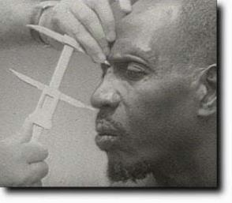
Classification (Rwanda)
Belgian colonialists believed Tutsis were a naturally superior nobility, descended from the Israelite tribe of Ham. The Rwandan royalty was Tutsi.
Belgians distinguished between Hutus and Tutsis by nose size, height & eye type. Another indicator to distinguish Hutu farmers from Tutsi pastoralists was the number of cattle owned.

Slide 5

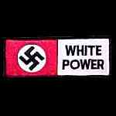
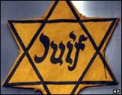
Stage 2: Symbolization
Names: “Jew”, “German”, “Hutu”, “Tutsi”.
Languages.
Types of dress.
Group uniforms: Nazi Swastika armbands
Colors and religious symbols:
    Yellow star for Jews
    Blue checked scarf Eastern Zone in Cambodia

Slide 6
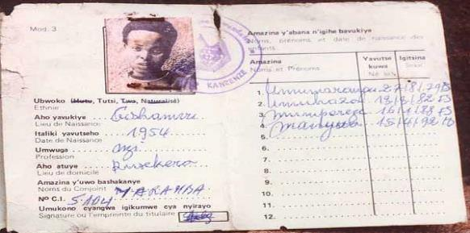
Stage 2: Symbolization (Rwanda)
“Ethnicity” was first noted on cards by Belgian Colonial Authorities in 1933.
Tutsis were given access to limited education programs and Catholic priesthood. Hutus were given less assistance by colonial auhorities.
At independence, these preferences were reversed. Hutus were favored.
These ID cards were later used to distinguish Tutsis from Hutus in the 1994 massacres of Tutsis and moderate Hutus that resulted in 800,000+ deaths.

Slide 7
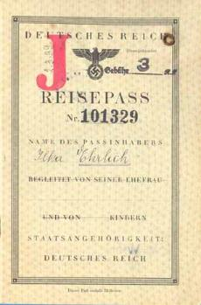
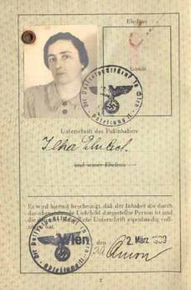
Symbolization (Nazi Germany)
Jewish Passport: “Reisepäss”
Required to be carried by all Jews by 1938. Preceded the yellow star.

Slide 8
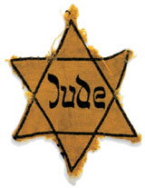
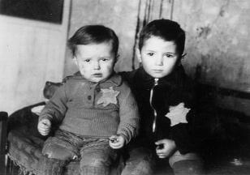
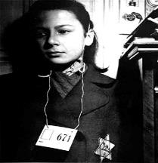
Symbolization (Nazi Germany)
Nazis required the yellow Star of David emblem to be worn by nearly all Jews in Nazi-occupied Europe by 1941.

Slide 9
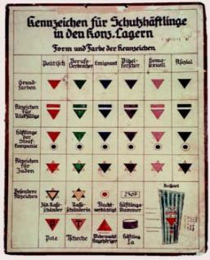
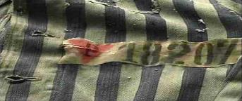
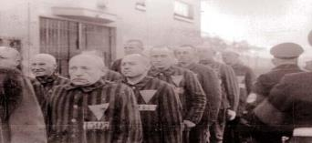
Symbolization (Nazi Germany)
Homosexuals = pink triangles
Identified homosexuals to SS guards in the camps
Caused discrimination by fellow inmates who shunned homosexuals

Slide 10
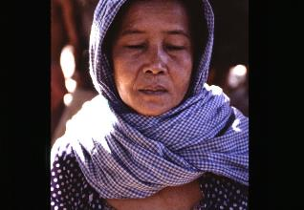
Symbolization (Cambodia)
People in the Eastern Zone, near Vietnam, were accused of having “Khmer bodies, but Vietnamese heads.”
They were deported to other areas to be worked to death.
They were marked with a blue and white checked scarf (Kroma)

Slide 11
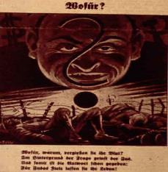
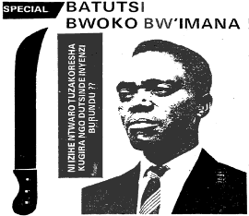
Stage 3: Dehumanization
One group denies the humanity of another group, and makes the victim group seem subhuman.
Dehumanization overcomes the normal human revulsion against murder.
Der Stürmer Nazi Newspaper:
“The Blood Flows; The Jew Grins”
Kangura Newspaper, Rwanda: “The Solution for Tutsi Cockroaches”
.

Slide 12
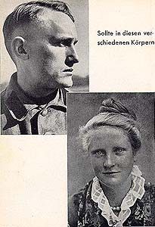
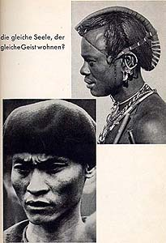
Dehumanization
From a Nazi SS Propaganda Pamphlet:
Caption: Does the same soul dwell in these bodies?

Slide 13
Dehumanization
Hate propaganda in speeches, print and on hate radios vilify the victim group.
Members of the victim group are described as animals, vermin, and diseases. Hate radio, Radio Télévision Libre des Mille Collines, during the Rwandan genocide in 1994, broadcast anti-Tutsi messages like “kill the cockroaches” and “If this disease is not treated immediately, it will destroy all the Hutu.”
Dehumanization invokes superiority of one group and inferiority of the “other.”
Dehumanization justifies murder by calling it “ethnic cleansing,” or “purification.” Such euphemisms hide the horror of mass murder.

Slide 14
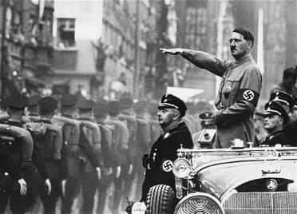
Stage 4: Organization
Genocide is a group crime, so must be organized.
The state usually organizes, arms and financially supports the groups that conduct the genocidal massacres. (State organization is not a legal requirement --Indian partition.)
Plans are made by elites for a “final solution” of genocidal killings.

Slide 15
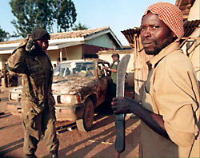
Organization (Rwanda)
“Hutu Power” elites armed youth militias called Interahamwe ("Those Who Stand Together”).
The government and Hutu Power businessmen provided the militias with over 500,000 machetes and other arms and set up camps to train them to “protect their villages” by exterminating every Tutsi.

Slide 16
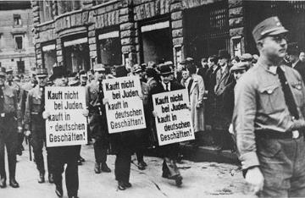
Stage 5: Polarization
Extremists drive the groups apart.
Hate groups broadcast and print polarizing propaganda.
Laws are passed that forbid intermarriage or social interaction.
Political moderates are silenced, threatened and intimidated, and killed.
Public demonstrations were organized against Jewish merchants.
Moderate German dissenters were the first to be arrested and sent to concentration camps.

Slide 17
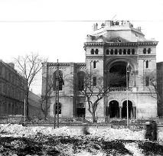
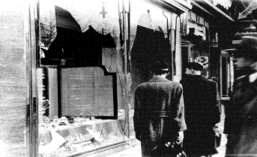
Polarization
Attacks are staged and blamed on targeted groups.
In Germany, the Reichstag fire was blamed on Jewish Communists in 1933.
Cultural centers of targeted groups are attacked.
On Kristalnacht in 1938, hundreds of synagogues were burned.

Slide 18
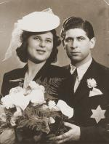
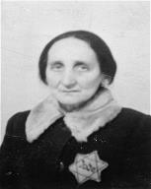
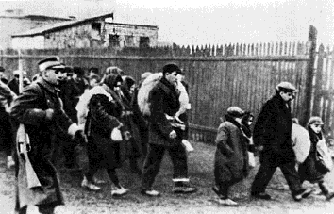
Stage 6: Preparation
Members of victim groups are forced to wear identifying symbols.
Death lists are made.
Victims are separated because of their ethnic or religious identity.

Slide 19
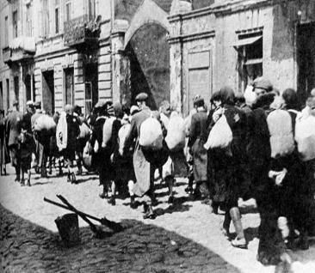
Preparation
Segregation into ghettoes is imposed, victims are forced into concentration camps.
Victims are also deported to famine-struck regions for starvation.
Forced Resettlement into Ghettos – Poland 1939 - 1942

Slide 20
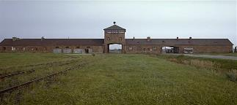
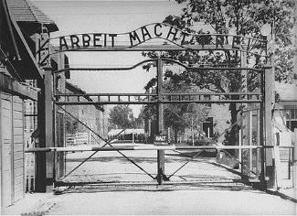
Preparation
Weapons for killing are stock-piled.
Extermination camps are even built. This build- up of killing capacity is a major step towards actual genocide.

Slide 21
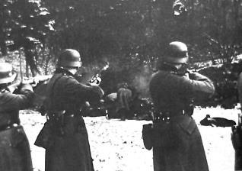
Stage 7: Extermination (Genocide)
Extermination begins, and becomes the mass killing legally called "genocide." Most genocide is committed by governments.
Einsatzgrupen: Nazi Killing Squads

Slide 22
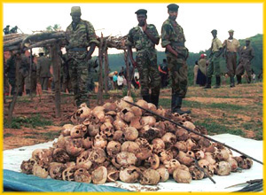
Extermination (Genocide)
Government organized extermination of Tutsis in Rwanda in 1994

Slide 23
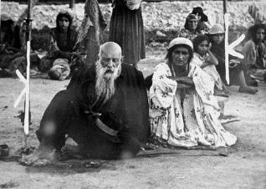
Extermination (Genocide)
The killing is “extermination” to the killers because they do not believe the victims are fully human. They are “cleansing” the society of impurities, disease, animals, vermin, “cockroaches,” or enemies.
Roma (Gypsies) in a Nazi death camp

Slide 24
Stage 8: Denial
Denial is always found in genocide, both during it and after it.
Continuing denial is among the surest indicators of further genocidal massacres.
Denial extends the crime of genocide to future generations of the victims. It is a continuation of the intent to destroy the group.
The tactics of denial are predictable.

Slide 25
Denial: Deny the Evidence.
Deny that there was any mass killing at all.
Question and minimize the statistics.
Block access to archives and witnesses.
Intimidate or kill eye-witnesses.

Slide 26
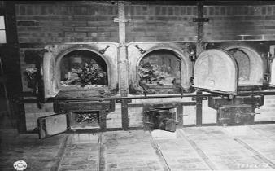
Denial: Deny the Evidence
Destroy the evidence. (Burn the bodies and the archives, dig up and burn the mass graves, throw bodies in rivers or seas.)
Holocaust Death-Camp Crematoria

Slide 27
Denial: Attack the truth-tellers.
Attack the motives of the truth-tellers. Say they are opposed to the religion, ethnicity, or nationality of the deniers.
Point out atrocities committed by people from the truth-tellers’ group. Imply they are morally disqualified to accuse the perpetrators.

Slide 28
Denial: Deny Genocidal Intent.
Claim that the deaths were inadvertent (due to famine, migration, or disease.)
Blame “out of control” forces for the killings.
Blame the deaths on ancient ethnic conflicts.

Slide 29
Denial: Blame the Victims.
Emphasize the strangeness of the victims. They are not like us. (savages, infidels)
Claim they were disloyal insurgents in a war.
Call it a “civil war,” not genocide.
Claim that the deniers’ group also suffered huge losses in the “war.” The killings were in self-defense.

Slide 30
Denial: Deny for current interests.
Avoid upsetting “the peace process.” “Look to the future, not to the past.”
Deny to assure benefits of relations with the perpetrators or their descendents. (oil, arms sales, alliances, military bases)
Don’t threaten humanitarian assistance to the victims, who are receiving good treatment. (Show the model Thereisenstadt IDP camp.)

Slide 31
Denial: Deny facts fit legal definition of genocide.
  They’re crimes against humanity, not genocide.
  They’re “ethnic cleansing”, not genocide.
  There’s not enough proof of specific intent to destroy a group, “as such.” (“Many survived!”-
  UN Commission of Inquiry on Darfur.)
  Claim the only “real” genocides are like the Holocaust: “in whole.”
  (Ignore the “in part” in the Genocide Convention.)
  Claim declaring genocide would legally obligate us to intervene. (We don’t want to intervene.)

Slide 32
Holocaust | Israeli/Arab | India/Pakistan | Armenia | Rwanda
Cambodia | Bosnia | North Korea | Israel/Palestine | Darfur
Conflict | Genocide

Slide 33
Conflict vs. Genocide
Directions: Research the similarities and differences between conflict and genocide.. http://ow.ly/kXRp30f3goG Write a brief summary explaining the goal of each,
and determine what similarities exist between the two.
Purpose/Goal of a Conflict
Purpose/Goal of a Genocide
What characteristics to Conflicts & Genocides have in common?
Analyze the causes and effects of a 20th Century genocide.
Use evidence/examples to support your answer.
Analyze the causes and effects of a 20th Century conflict.
Use evidence/examples to support your answer.

