Slide 1
racism | prejudice | discrimination | culture
ethnicity | ethnocentrism | assimilation | cultural diffusion
exploratory | political | ideological | religious | economic

Slide 2
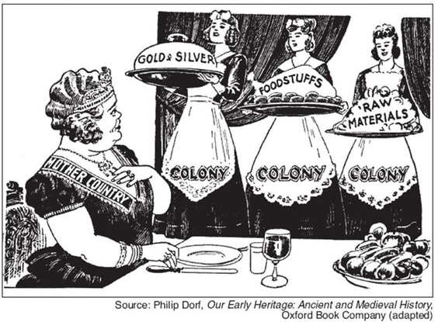
Motives for Imperialism
Directions: Wealthy, powerful countries looked to Imperialize Africa, Asia, and South America for a variety of reasons. Research the Economic, Political, and Social motives for Imperialism.
Economic
Explain how this cartoon illustrates the economic motive for imperialism.

Slide 3
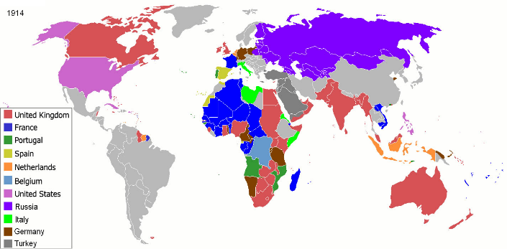
Motives for Imperialism
Directions: Wealthy, powerful countries looked to Imperialize Africa, Asia, and South America for a variety of reasons. Research the Economic, Political, and Social motives for Imperialism.
Political
Explain how this map illustrates the political motive for imperialism.

Slide 4
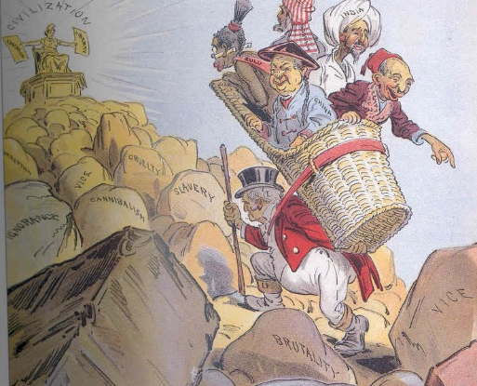
Motives for Imperialism
Directions: Wealthy, powerful countries looked to Imperialize Africa, Asia, and South America for a variety of reasons. Research the Economic, Political, and Social motives for Imperialism.
Social
Europe
Explain how this cartoon illustrates the Social motive for imperialism.

Slide 9
European Imperialism Timeline
Directions: Throughout the late 1800’s, European powers such as Britain, France, Germany, Belgium, Italy, Spain, and Russia fought several conflicts and added a huge amount of territory. Research about this ‘New Imperialism’ and then drag and drop each event to the correct place on the timeline and answer the questions.
1857
1858
1874
1884
1885
1896
Belgian Congo
Why did Belgium want the Congo?
Describe the treatment of the workers by the Belgians in charge.
The British Raj
Describe 2 good changes and 2 bad changes British rule brought to India...
Good
Bad
Sepoy Rebellion
Who were the Sepoys?
why did they Rebel?
Indian Independence
What was the Indian National Congress?
African Resistance
What happened at the Battle of Adwa?
Scramble for Africa
What was the purpose of the Berlin Conference?

Slide 10
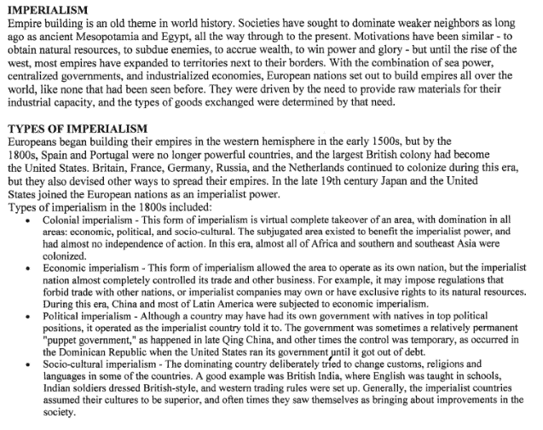
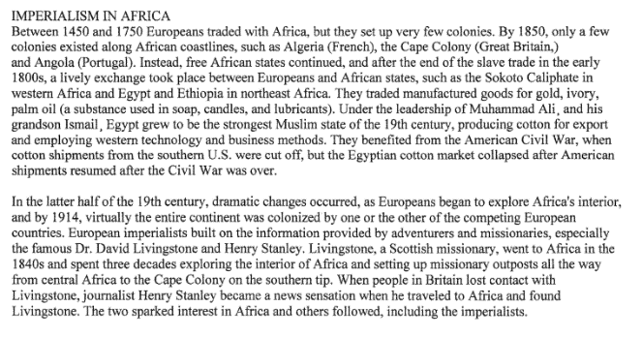

Slide 11
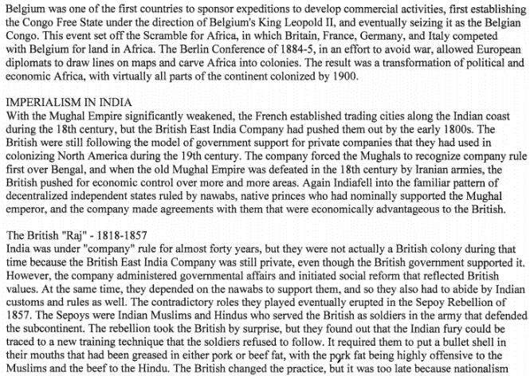
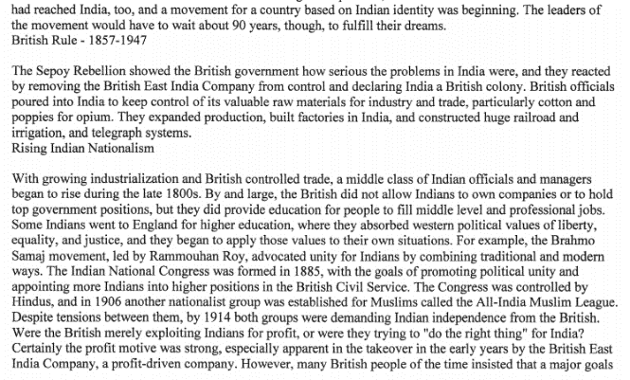

Slide 12
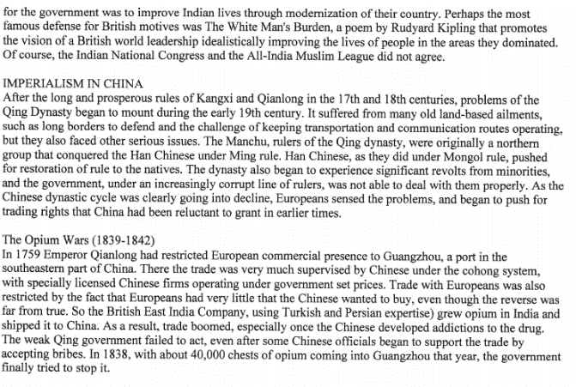
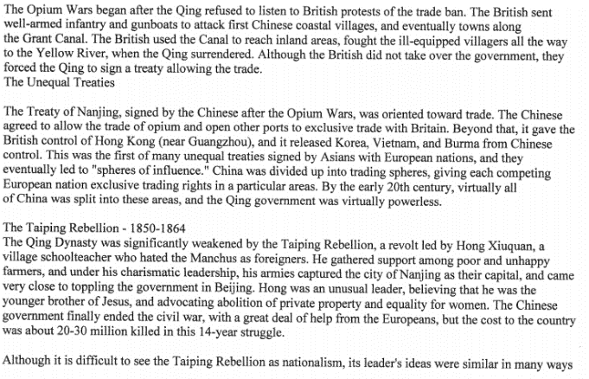

Slide 13
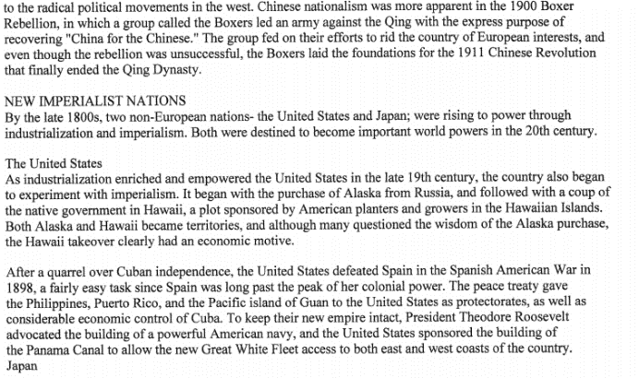
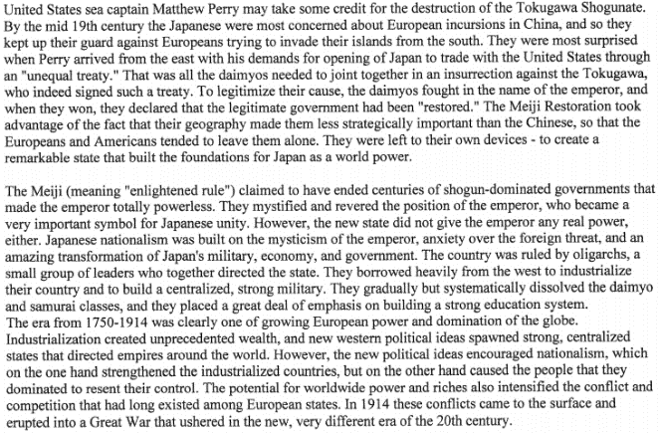

Slide 14
dependent colony | settlement colony | protectorate | sphere of influence

Slide 15
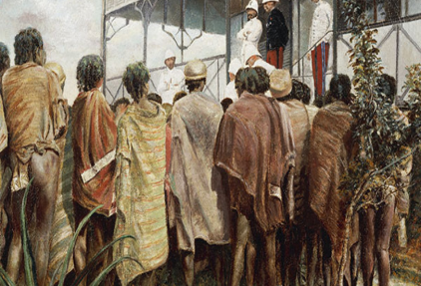
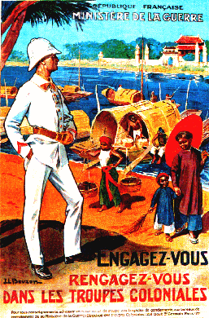
What is the difference between direct and indirect rule?
Direct Control
Directions: Once a territory had been Imperialized, the mother country needed to control the government, economy, and people in their new property.. France often used a method called DIRECT CONTROL. Research and explain this method below. Include the use of the term PATERNALISM.
Have no fear! The French are here!

Slide 16
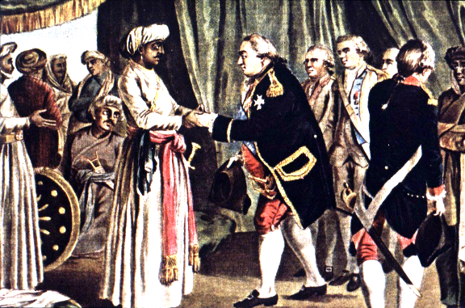
What is the difference between direct and indirect rule?
Indirect Control
Directions: Once a territory had been Imperialized, the mother country needed to control the government, economy, and people in their new property. In India, Britain used a method called INDIRECT CONTROL. Research and explain this method below.

Slide 19
Effects of Imperialism
Directions: Imperialism had lasting effects in both the mother country, and her colonies. Describe these effects, both positive and negative, using examples.
ECONOMIC (Jobs, Money, Production of Goods/Products) EXAMPLE
SOCIAL (People, Culture) EXAMPLE
POLITICAL (Government, Leadership) EXAMPLE

Slide 20
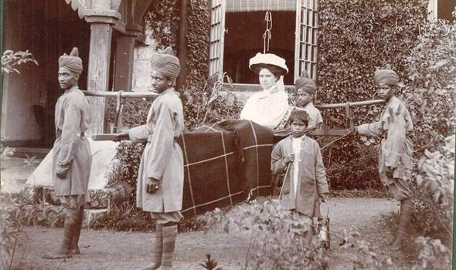
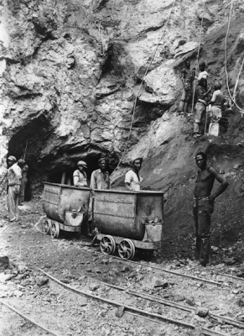
Limited Economic Opportunities
Look at the photographs taken during the height of European Imperialism in Africa and Asia. Types of jobs available to the Natives were often limited by the Imperializing country.
What types of economic opportunities existed for the natives once their country was Imperialized?

Slide 21
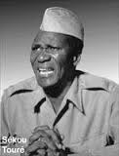
Limited Political Opportunities
When European countries imperialized Africa and Asia, they believed that their European styles of government were superior to the local and tribal leadership structures they encountered. European countries felt that the people of Africa and Asia there were not capable of running their own governments. As a result, European governments took control and removed or limited opportunities for natives to control their own governments.
More than 50 years after the European Imperialism Africa, Sekou Toure gave a speech explaining why many countries in Africa and Asia have struggled to maintain stable governments once they gained independence from the Imperialist country that had previously controlled them.
From: Sekou Toure, West African nationalist, 1962
“Colonialism’s greatest misdeed was to have tried to strip us of our responsibility in conducting our own affairs and convince us that our civilization was nothing less than savagery, thus giving us complexes which led to our being branded as irresponsible and lacking in self-confidence. . . “
Summarize Toure’s argument about why Imperialized countries have struggled to organize and maintain a stable governments once they gain independence...

Slide 22
WHAT DO YOU THINK?
Directions: Use the scale below to answer the question. Be sure to use the writing conventions in the scale and use specific details to support your opiniion. Cite your sources.
WRITING INFORMATIVE TEXT
4 | 3 | 2
Writes informative text that demonstrates a depth of knowledge by going above and beyond the grade level expectation. The student digs deeper into the content by connecting the writing to previous learning or to contemporary issues. | Writes informative text. Introduce a topic (sentence or a full paragraph); Organize ideas and concepts (chronologically or thematically); Develop the topic with relevant facts, evidence and accurate examples that are appropriate to the topic; uses extended definitions; Provide a concluding statement that supports the information or explanation presented. | Writes informative text. A level 2 writing sample fails to meet the level 3 standard in one or more areas: Introduction Organization Use of evidence Conclusion *A level 1.5 writing sample fails to meet the level 3 standard in two areas. *A level 1 writing sample fails to meet the level 3 standard in all areas, but a valid attempt was made by the student.
Do former
imperial countries
owe reparations
to former colonies?

